Slide 1
Form II Easter Holiday Homework 2020
Don’t forget to read every day to an adult or sibling!
Practice your times tables every day!
Continue to practice your spellings!
Work through your maths bond and arithmetic books at your own pace.

Slide 2
Form II Easter Holiday Homework 2020
https://www.bbc.co.uk/teach/supermovers Times tables, grammar and just for fun!
https://www.topmarks.co.uk/maths-games/7-11-years/ordering-and-sequencing-numbers Maths games
https://www.bbc.co.uk/teach/ks2-english/zbrwnrd English additional resources
https://www.bbc.co.uk/teach/ks2-maths/zm9my9q Maths additional resources
https://swiggle.org.uk/ Child safe search engine
https://www.twinkl.co.uk/go/lessons/view/arithmagic Arithmagic game. Code: TA5810

Slide 3
Handwriting
Practice your joined-up handwriting by copying these poems. You can print the slide with the handwriting lines if you like, or simply copy neatly into your lined book!
Remember where each letter begins, ends and how it joins to the next letter!
If you need help, follow this link to “handwriting repeater” and ask a grown up to show you how to form the letters!
https://www.ictgames.com/mobilePage/writingRepeater/

Slide 8
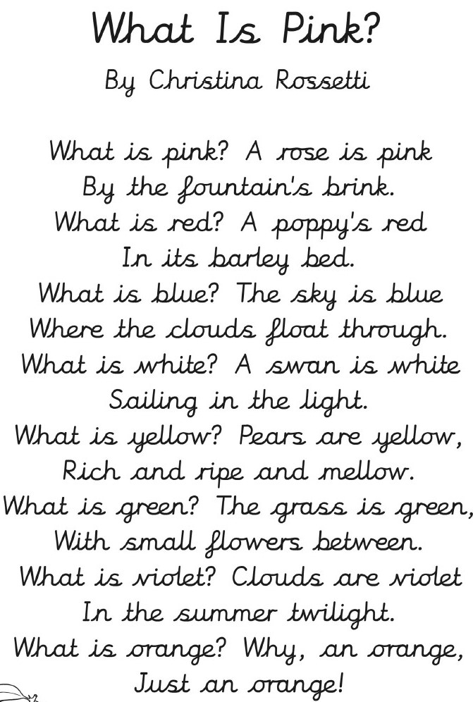

Slide 11
Complete the reading comprehensions!
Follow the links on the next slide.
Print the reading comprehension text and questions.
Read the text and answer the questions.

Slide 12
https://cdn.oxfordowl.co.uk/2019/01/02/12/51/28/371/Bond_10Minute_English_Comprehension_8_9.pdf
https://cdn.oxfordowl.co.uk/2019/07/30/08/32/31/36/Comprehension_7_years_Pugs_Questions.pdf
https://cdn.oxfordowl.co.uk/2018/03/02/14/18/38/9/PWO_Age_8_9_english.pdf

Slide 13
Times Tables
Complete the times tables activities on the following slides.
Some activities need to be printed and completed.
For other activities you need to follow the link and complete online.

Slide 14
Printable Worksheets
https://cdn.oxfordowl.co.uk/2020/03/16/08/58/51/3e2b0b73-34a1-4f7a-be3e-bd0b5c7f2310/AtHomeWith_TimesTables5-7.pdf
https://cdn.oxfordowl.co.uk/2018/03/02/14/18/18/733/PWO_Age_7_8_times_tables.pdf
https://cdn.oxfordowl.co.uk/2019/04/17/07/48/17/26/BondSATsSkills_TimesTables.pdf
https://cdn.oxfordowl.co.uk/2018/04/18/08/09/41/637/PWO_Age_8_9_times_tables.pdf
https://cdn.oxfordowl.co.uk/2018/04/18/08/14/12/224/PWO_Age_9_10_times_tables.pdf
https://cdn.oxfordowl.co.uk/2019/01/02/16/46/55/259/7TimesTableWorksheet.pdf
https://cdn.oxfordowl.co.uk/2013/08/13/10/05/00/549/Bathroom_Wall_Table.pdf

Slide 15
Online activities
https://cdn.oxfordowl.co.uk/2016/05/10/08/28/28/967/20163_content/startpage.html?activity=Multiply_by_7.html
https://www.timestables.co.uk/
http://www.maths-games.org/times-tables-games.html
https://mathsframe.co.uk/en/resources/category/7/multiplication_and_division

Slide 16
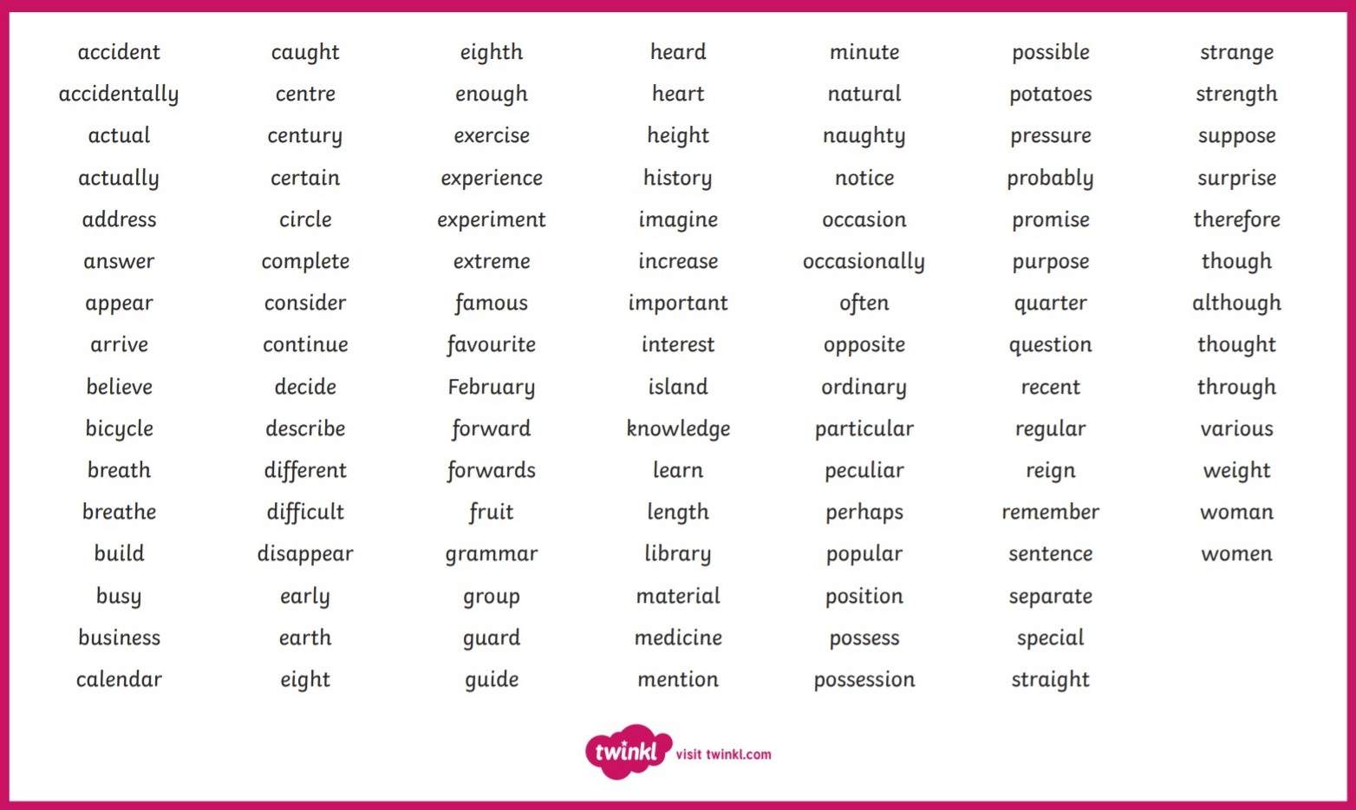
Spelling words to practice:

Slide 17
Form II Easter Holiday Homework 2020
Please complete as many of these activities as you are able, but don’t worry if you don’t manage all of them!
Don’t forget to go outside and do some exercise!

