Slide 1
Form II Home Learning 01/04/2020
Today we are learning:
English
Maths
Art
Optional extras

Slide 2
Form II Home Learning Reminders
Don’t forget to read every day to an adult or sibling!
Practice your times tables every day!
Continue to practice your spellings!
Work through your maths bond and arithmetic books at your own pace.

Slide 3
Form II Useful Resources
https://www.bbc.co.uk/teach/supermovers Times tables, grammar and just for fun!
https://www.topmarks.co.uk/maths-games/7-11-years/ordering-and-sequencing-numbers Maths games
https://www.bbc.co.uk/teach/ks2-english/zbrwnrd English additional resources
https://www.bbc.co.uk/teach/ks2-maths/zm9my9q Maths additional resources
https://swiggle.org.uk/ Child safe search engine
https://www.twinkl.co.uk/go/lessons/view/arithmagic Arithmagic game. Code: TA5810

Slide 4
English LO: To describe characters using “power of three”

Slide 5
English LO: To describe characters using “power of three” Write the date and learning objective in your lined book now!

Slide 6
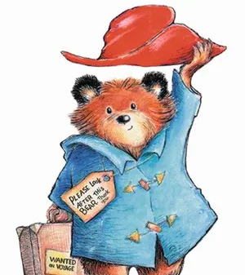
Its Paddington again!
Can you remember the exciting adjectives we used to describe him?

Slide 7
Red hat
Soft fur
Blue coat
Happy face
Friendly smile
Old suitcase
Crimson hat
Velvety fur
Sapphire coat
Cheerful face
Welcoming smile
Old-fashioned suitcase
If we describe a part of Paddington using three adjectives in a sentence, it is called “power of three”.
Paddington has soft, velvety, brown fur.

Slide 8
Red hat
Soft fur
Blue coat
Happy face
Friendly smile
Old suitcase
Crimson hat
Velvety fur
Sapphire coat
Cheerful face
Welcoming smile
Old-fashioned suitcase
What adjectives could we use to complete the following sentences?
No need to write these in your book!

Slide 9
Paddington has a ______, ______, red hat.
Paddington has a friendly, ______, _____ smile.
Paddington is holding an old, ______, _____ suitcase.
Paddington’s nose is round, _______ and ______.
Paddington is wearing a blue, ______, ______ coat.

Slide 10
Book Task:
The following picture shows one describing word for each part of the Gruffalo.
Can you add two more adjectives to make “power of three” sentences?
Example:
The Grufallo has long, sharp, purple prickles on his back.

Slide 11
The Grufallo has long, sharp, purple prickles on his back.

Slide 12
Optional extra tasks
Add to your thesaurus!
Find as many synonyms as you can for these overused words:
loud
hard
big
small

Slide 13
English LO: To describe characters using “power of three” How did you find this lesson? Colour a small traffic light at the end of your work. Red = I didn’t understand Yellow = I need a bit more practice Green = Got it!

Slide 14
Maths LO: To revise 2D shapes

Slide 15
Maths LO: To revise 2D shapes Write the date and learning objective in your squared book now!

Slide 16
Recap! Can you name these shapes?

Slide 17
Recap! Can you name these shapes?
Octagon
Hexagon
Pentagon
Square
Quadrilateral
Circle
Rectangle

Slide 18
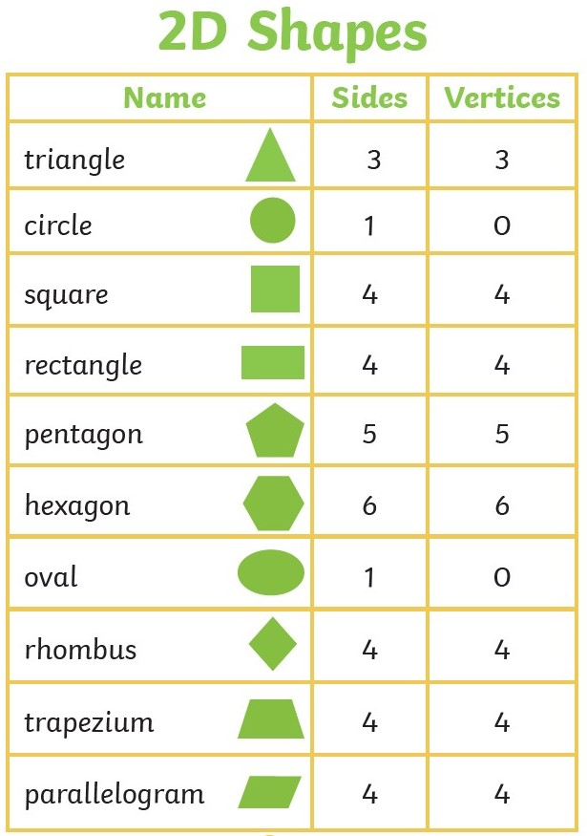
Remember:
Sides = straight or curved edges!
Vertices = Pointy bits (corners)

Slide 19
This rectangle has parallel lines.
These lines run in the same direction.
No matter how far they go, they will never cross!

Slide 20
This rectangle also has perpendicular lines.
These lines cross at a 90◦ angle.
This is also known as a right angle!

Slide 21
Online Task:
Follow this link to find more information and some video clips about 2D and 3D shapes.
https://www.bbc.co.uk/bitesize/topics/zjv39j6

Slide 22
Book Task
Print or copy the following 2D shape problems.
Stick them in your squared book and solve!
Don’t forget the date and learning objective!

Slide 23
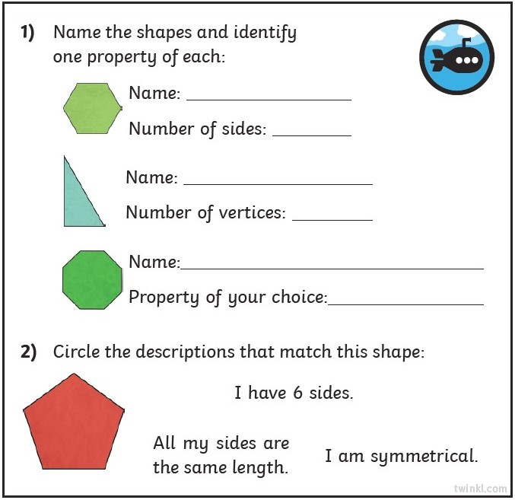

Slide 24
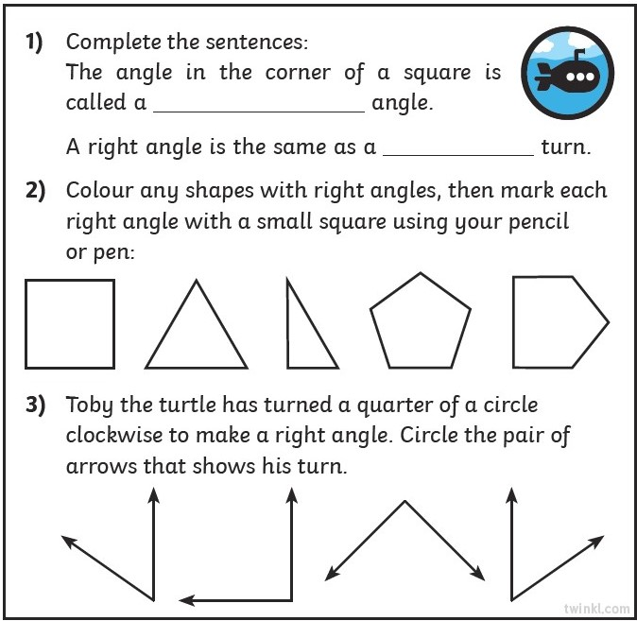
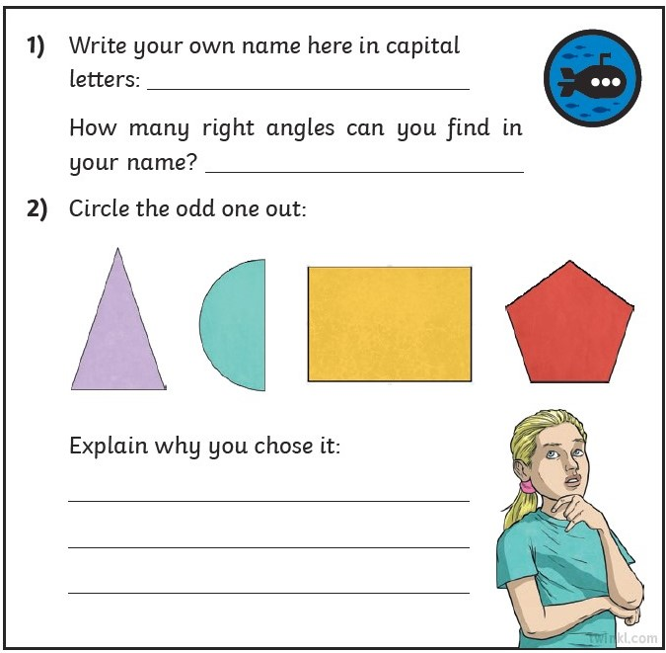

Slide 25
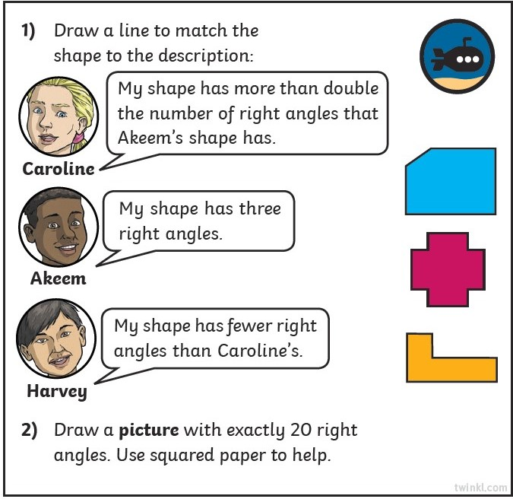

Slide 26
Optional extra task
Follow the link and enter the code to play the 2D and 3D shape activities!
https://www.twinkl.co.uk/go/lessons/view/maths
Code: TA9702

Slide 27
Maths LO: To revise 2D shapes How did you find this lesson? Colour a small traffic light at the end of your work. Red = I didn’t understand Yellow = I need a bit more practice Green = Got it!

Slide 28
Art LO: To create a picture in the style of Mondrian

Slide 29
Online Task:
Follow this link to find out about the artist Piet Mondrian!
https://www.tate.org.uk/kids/explore/who-is/who-piet-mondrian

Slide 30
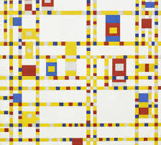
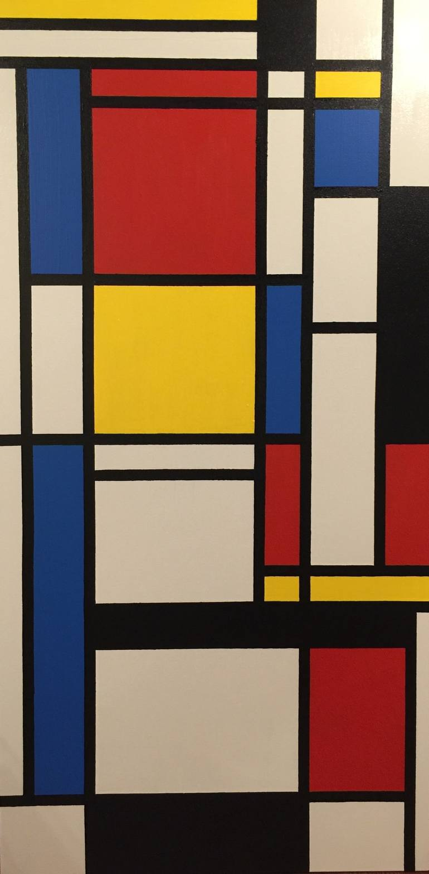
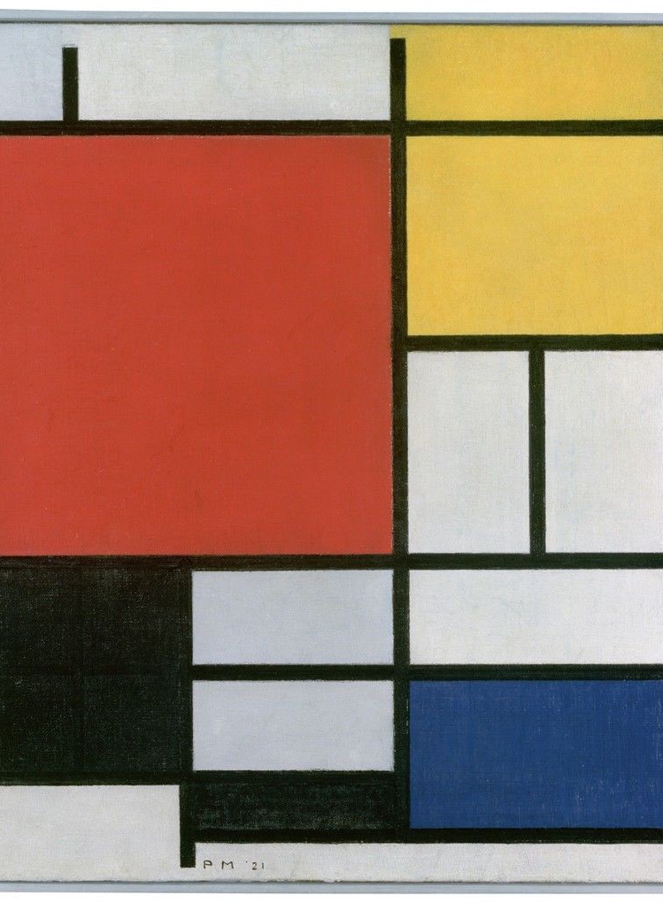
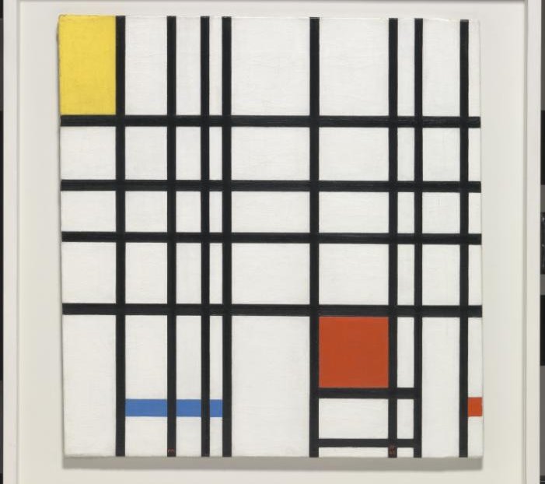

Slide 31
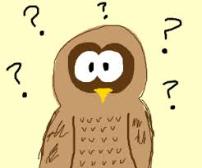
Quick Quiz!
Mondrian uses Red, Blue and Yellow in his paintings. These are called P________ colours.
Mondrian uses straight lines running in the same direction. These are called p________ lines.
Mondrian also uses perpendicular lines. This is when two lines meet at a r______ a_______.
Mondrian’s paintings are made up of four sided shapes. These are called q____________.

Slide 32
Answers!
Mondrian uses Red, Blue and Yellow in his paintings. These are called primary colours.
Mondrian uses straight lines running in the same direction. These are called parallel lines.
Mondrian also uses perpendicular lines. This is when two lines meet at a right angle.
Mondrian’s paintings are made up of four sided shapes. These are called quadrilaterals.

Slide 33
We are artists!
Can you create a picture in the style of Mondrian?
Remember to use primary colours, parallel and perpendicular lines.
You could use coloured pencil, paint or even the computer or tablet!

Slide 34
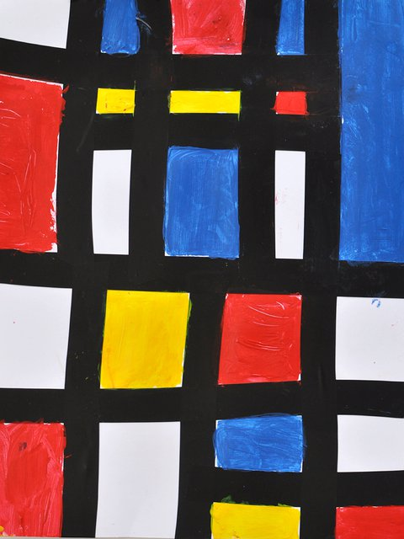
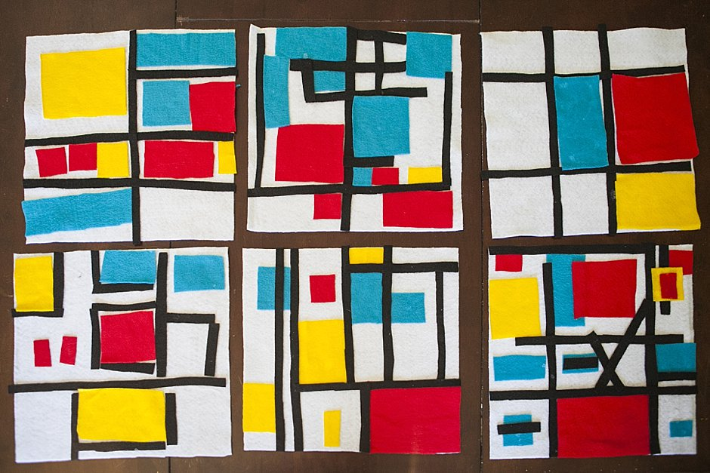
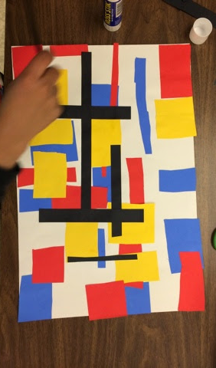
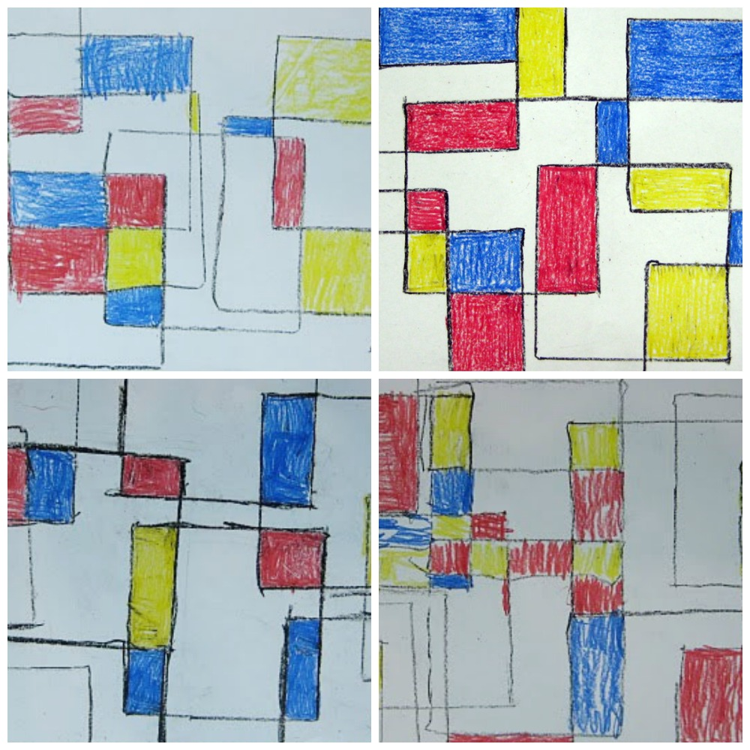
Examples:

Slide 35
Form II Home Learning 01/04/2020
Well done! You finished today’s lessons!
I’m looking forward to seeing you all back at school soon!
Miss Ardley

