Slide 1
Form II Home Learning 24/03/2020
Today we are learning:
English
Maths
History
Optional extras

Slide 2
Form II Home Learning Reminders
Don’t forget to read every day to an adult or sibling!
Practice your times tables every day!
Continue to practice your spellings!
Work through your maths bond and arithmetic books at your own pace.

Slide 3
Form II Useful Resources
https://www.bbc.co.uk/teach/supermovers Times tables, grammar and just for fun!
https://www.topmarks.co.uk/maths-games/7-11-years/ordering-and-sequencing-numbers Maths games
https://www.bbc.co.uk/teach/ks2-english/zbrwnrd English additional resources
https://www.bbc.co.uk/teach/ks2-maths/zm9my9q Maths additional resources
https://swiggle.org.uk/ Child safe search engine
https://www.twinkl.co.uk/go/lessons/view/arithmagic Arithmagic game. Code: TA5810

Slide 4
English LO: To recognise and use prepositions

Slide 5
English LO: To recognise and use time prepositions Write the date and learning objective in your lined book now!

Slide 6
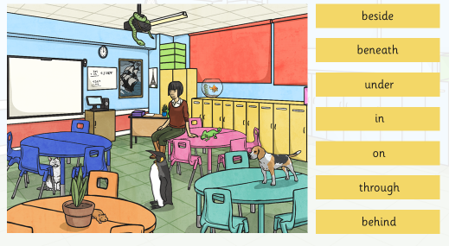
The pets have escaped! Can you describe where they are using these words to help you? Write 3 sentences in your lined book.

Slide 9
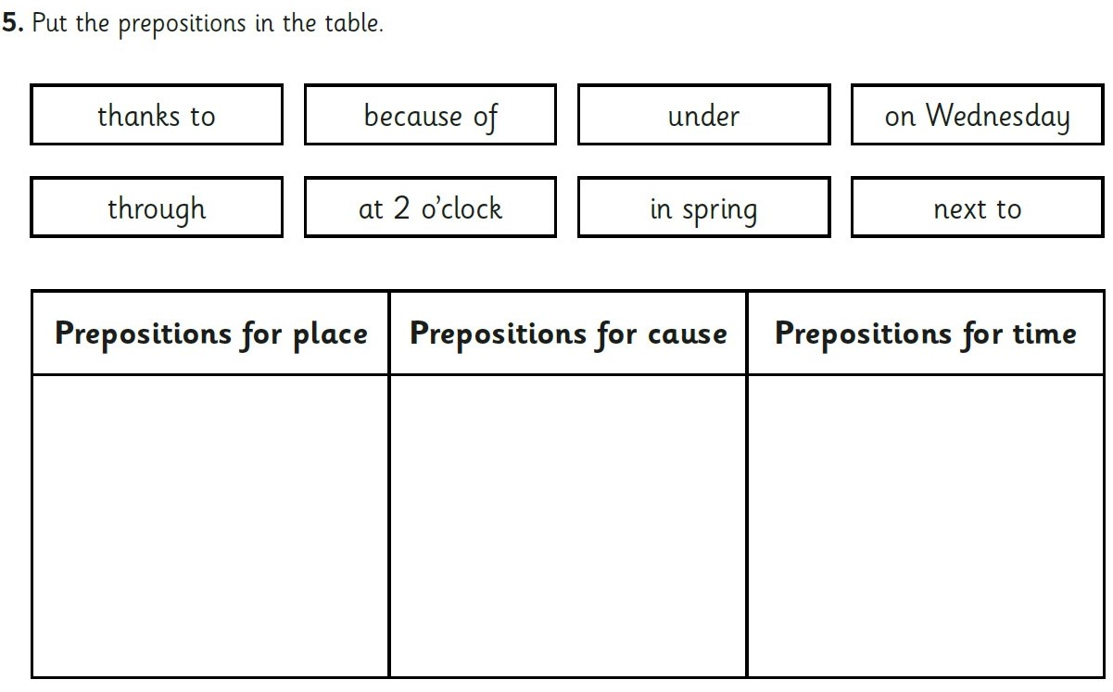
Book task
Copy the table into your lined book. Remember to use a ruler!

Slide 10
Book Task
Complete the following activity in your lined book.
Don’t forget joined up handwriting, capital letters and full stops!
Challenge: 4 sentences
Super challenge: 7 sentences
Supersonic challenge: 10 sentences

Slide 11
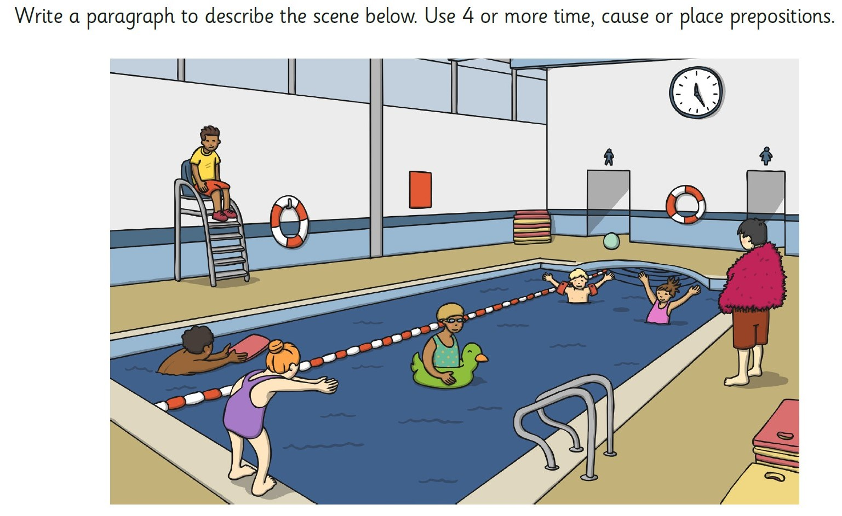

Slide 12
Optional extra task
Follow the link to Twinkl Go!
Complete the “Space alien preposition hotspots” activity
Complete the “Prepositions wordsearch” activity
https://www.twinkl.co.uk/go/lessons/view/english
Code: TA1267

Slide 13
English LO: To recognise and use prepositions How did you find this lesson? Colour a small traffic light at the end of your work. Red = I didn’t understand Yellow = I need a bit more practice Green = Got it!

Slide 14
Maths LO: To solve length problems

Slide 15
Maths LO: To solve length problems Write the date and learning objective in your squared book now!

Slide 16
Let’s recap yesterday’s learning!

Slide 20
Word problems – let’s look at this one together!
We need to work out the difference between the height of the two buildings.
To find the difference we take the smaller number away from the larger number.
38 – 25 = 13
Don’t forget to add the unit of measure!
13m or 13 meters.

Slide 21
Word problems – Try the next ones in your squared book!
Remember to number the problems so that you can check your answers at the end!

Slide 26
Word problems – let’s look at this one together!
Find the key information!
Spot can jump 36 centimetres (cm)
Gruff can jump 6 centimetres (cm) higher than spot.
We need to find 6 more than 36.
36 + 6 = 42
Don’t forget to add the unit of measure!
42cm or 42 centimetres
.

Slide 27
Word problems Answers
.

Slide 28
Maths LO: To solve length problems How did you find this lesson? Colour a small traffic light at the end of your work. Red = I didn’t understand Yellow = I need a bit more practice Green = Got it!

Slide 29
History LO: To understand the differences between Roman Soldiers and Celtic Warriors

Slide 30
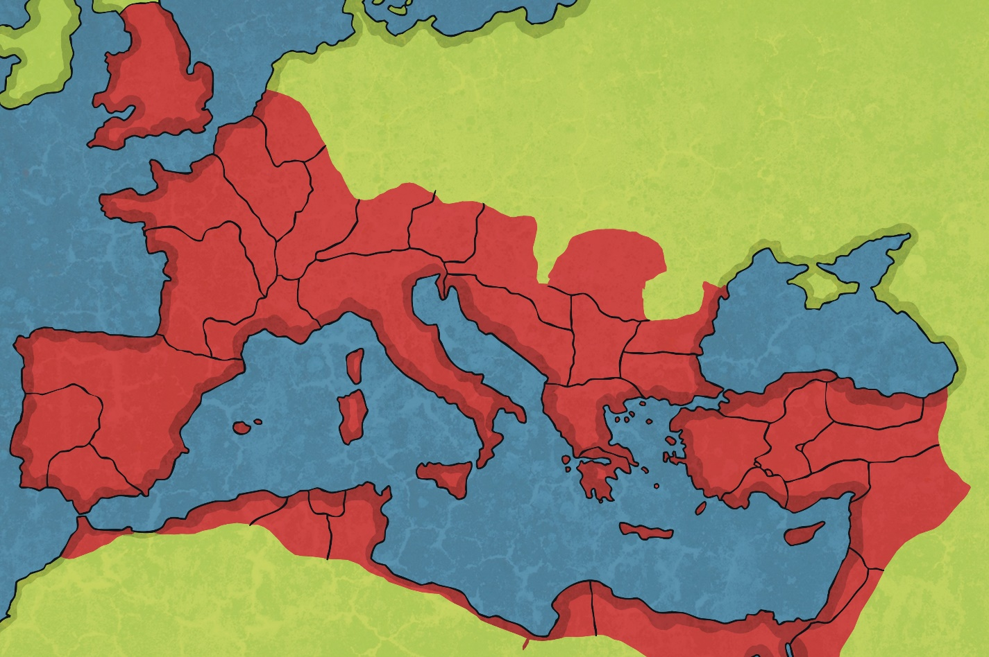
The Roman Army
The brilliance of the Roman army was the key to Rome’s success in building its empire.

Slide 31
The Start of the Roman Army
In the beginning, the soldiers were the better-off citizens who were sent home at the end of the war.
The Romans copied Greek armies and fought on foot with long spears.
As Roman power grew, more and more people were made to join the army.
How the Army Changed
As the army grew bigger, it had to fight further away from home.
Being a soldier became a full-time job, where the soldiers were highly trained and tough. They were no longer sent home at the end of a battle.

Slide 32
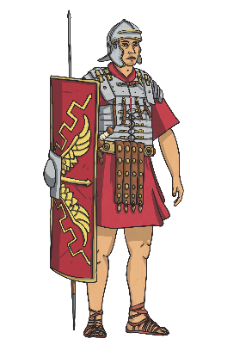
The Start of the Roman Army
Roman soldiers were grouped into larger numbers called legions. There were about 30 of these at different times.
Legions were divided into 10 cohorts of 480 men.
Cohorts were divided into 6 centuries of about 80 men led by a centurion.
Centuries were divided into 10 groups of 8 men who shared a tent or barrack room.

Slide 33
Online Task!
Follow the link to Twinkl Go!
https://www.twinkl.co.uk/go/lessons/view/history
Enter Code: TA7439
Watch the “A Roman Soldiers life for me” video clip

Slide 34
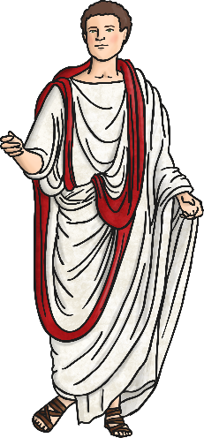
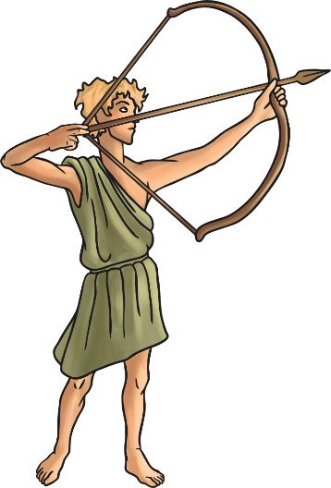
How Did You Become a Legionary?
The legions were made up of recommended Roman citizens.
Recruits had to be 25 and in the army for at least 20 years.
Legionaries were not allowed to be married whilst they were
in the army.
What If You Were Not a Roman Citizen?
Soldiers could join as an auxiliary. Auxiliaries often had
special skills such as horse riding and archery. The auxiliary
soldiers would receive citizenship when they retired.

Slide 35
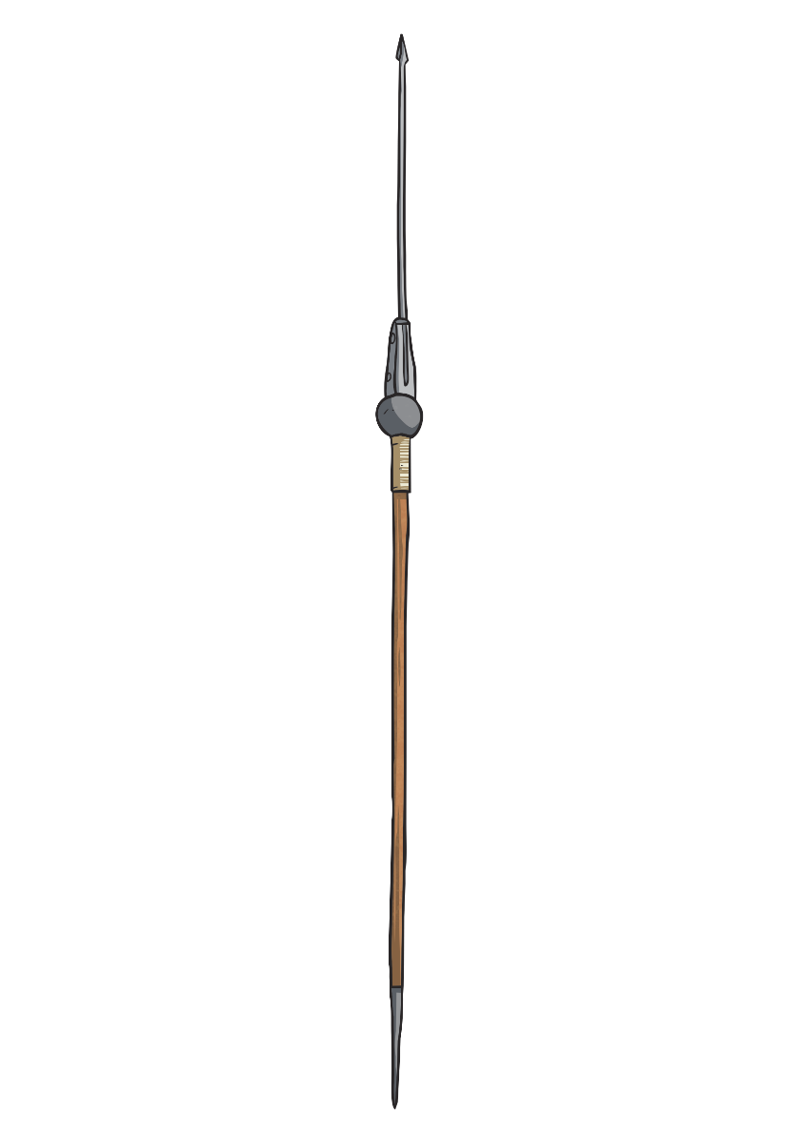
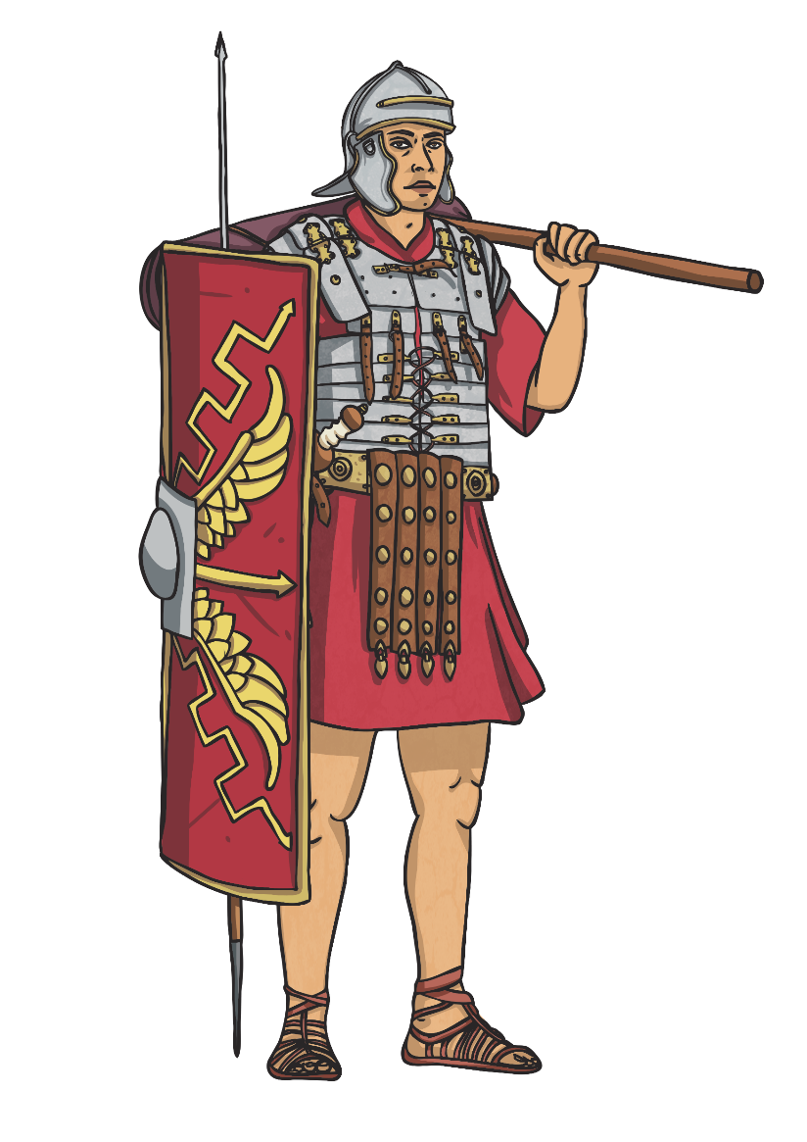
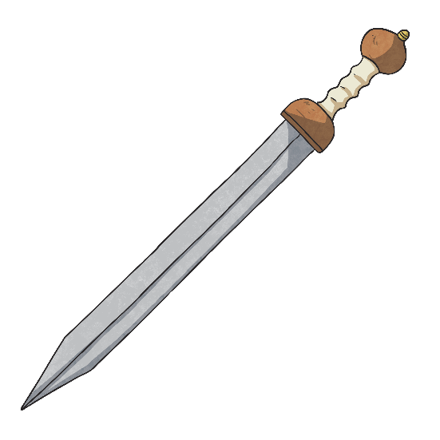
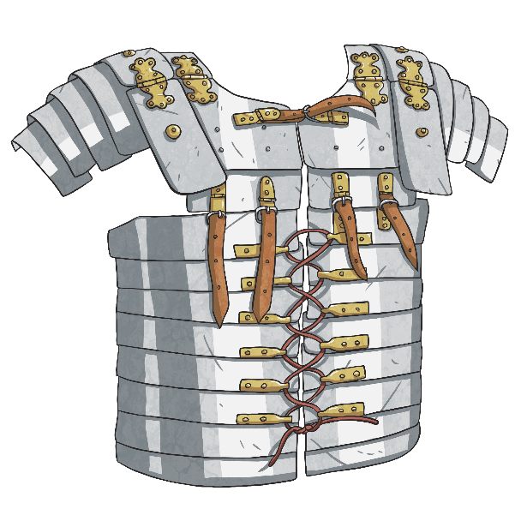
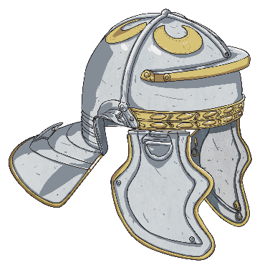
Legionary’s Uniform
What makes the legionary's uniform and equipment so effective?

Slide 36
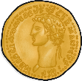
Legionary’s Training
Learn to build camps, swim, sling stones, ride horses, mount and dismount horses fully armed with his shield and no stirrups.
Do a drill once a day, twice if he was a recruit.
March 30km, three times a month, wearing his armour which weighed 20kg.
Learn how to use a sword, spear and fight mock battles with weapons which had covered tips for safety.

Slide 37
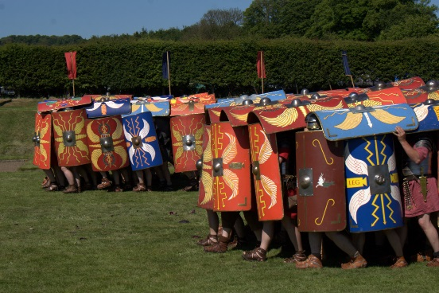
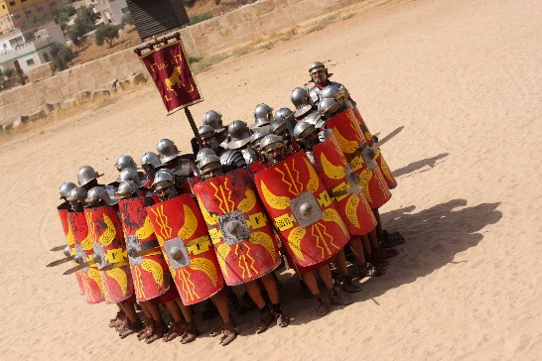
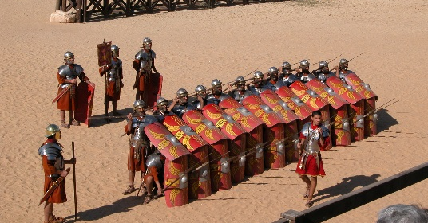
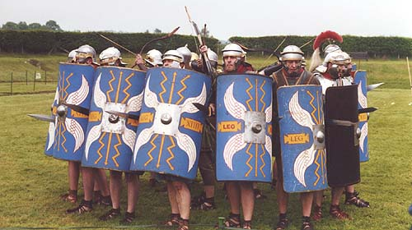
Legionary’s Training
The Turtle was used to advance towards the enemy by creating a shell out of shields around a group of soldiers.
The Wedge was used to divide the enemy by the legion creating a ‘V’.
The Repel Cavalry was used to protect against soldiers on horses. Soldiers used their shield as protection and threw spears.
The Orb was used when the army had been split. The legionaries would protect the archers and officers.

Slide 38
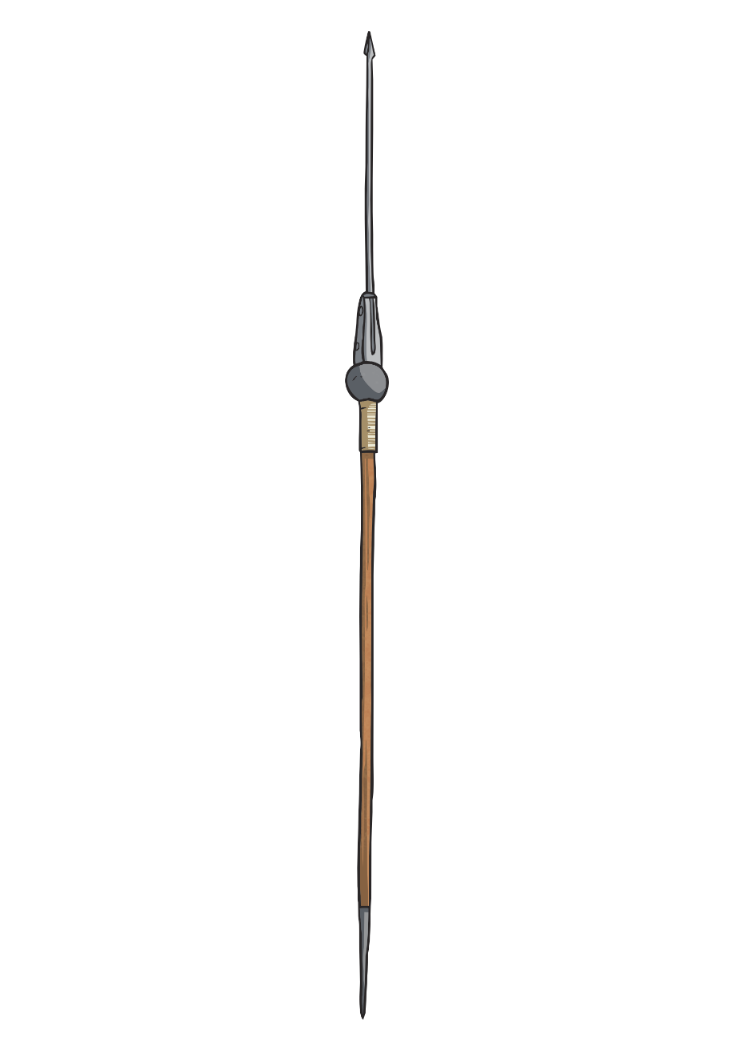
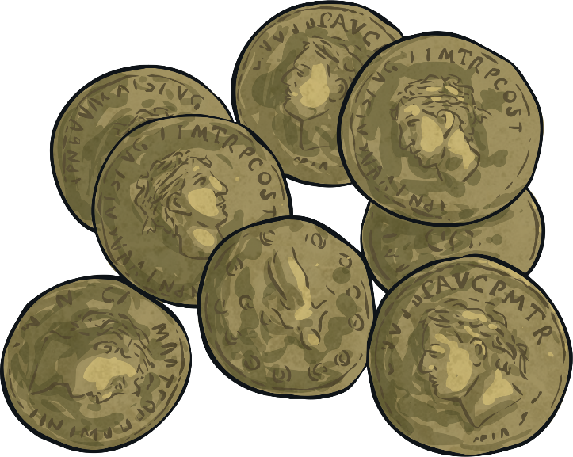
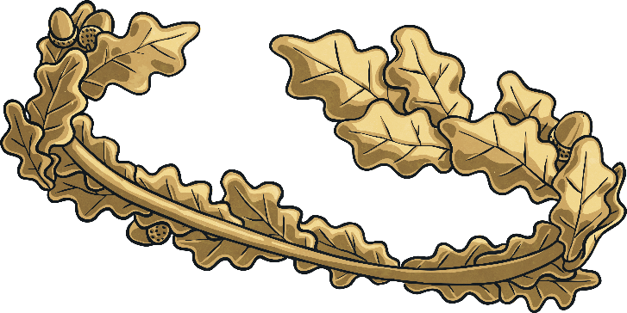
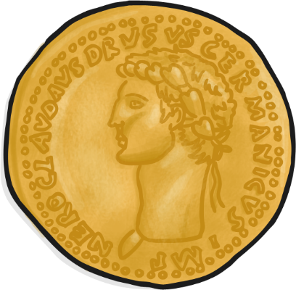
Punishments and Rewards
Discipline was very harsh. Soldiers were beaten if they did not follow orders.
Deserters and soldiers who left their post or fell asleep whilst on look-out were beaten to death by their fellow soldiers.
On a more positive note, there were awards for bravery for different ranks, such as medals, arm and neck bands. Gold crowns and silver spears were given to officers.

Slide 39
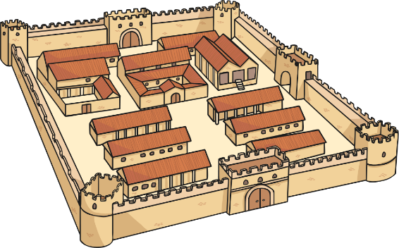
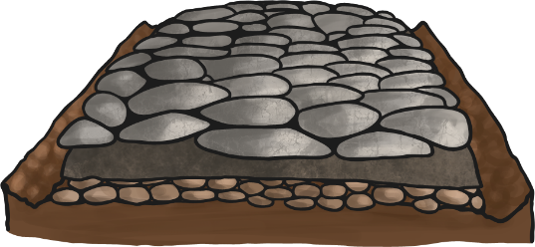
Questions
Surely soldiers did not spend all their time fighting. What other jobs did soldiers do?
As well as fighting major battles, the legions built forts, bridges and roads. When they were on a campaign, they built a camp and fortified them with banks and ditches at the end of the day.
What did soldiers do in their spare time?
During their spare time, Roman soldiers may have been able to play board games with counters and dice or visit the baths.

Slide 40
Online Task!
Follow the link to BBC Teach
https://www.bbc.co.uk/bitesize/clips/zbns34j
Watch the “Life as a Roman Soldier” video clip

Slide 41
Optional Online Task!
Follow the link to Twinkl Go!
https://www.twinkl.co.uk/go/lessons/view/history
Enter Code: TA7439
Complete the Roman Soldier labelling activity and the Roman and Celtic Warrior sorting activity.

Slide 42
Create a Job Advertisement!
Create a job advertisement for a Roman Soldier.
Include what the job involves, duties, pay, benefits and drawbacks.
Remember you are trying to convince people to sign up so the job needs to sound exciting!
See the templates on the next slide to give you some ideas.

Slide 43
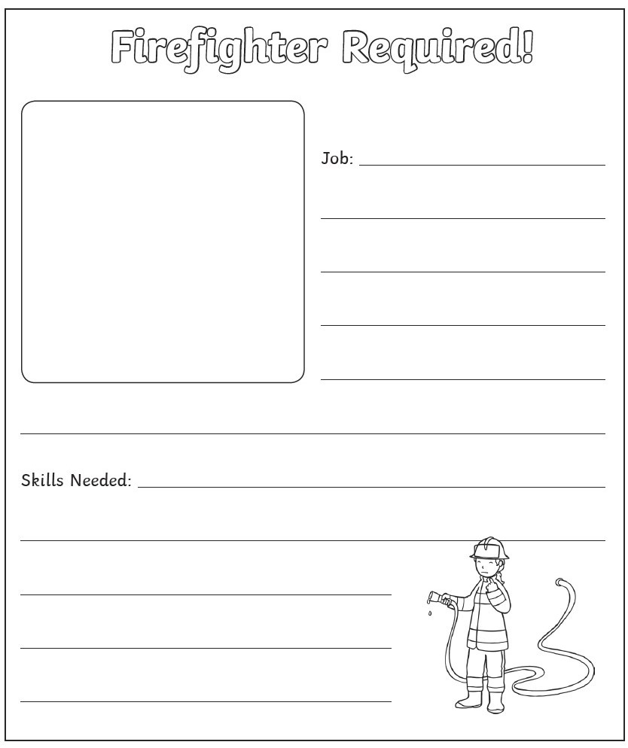
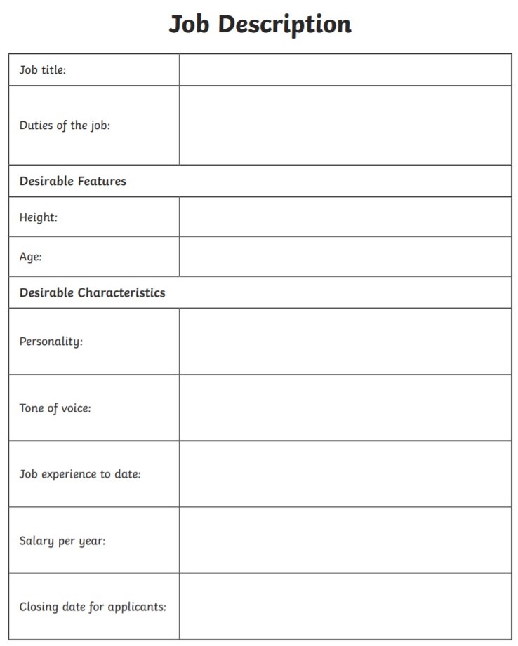

Slide 44
Optional extra tasks
Make your own Roman Soldier and/or Celtic warrior from junk modelling materials. Remember all of the key weapons and armour!
Paint or draw a Roman soldier and label their armour and weapons.
Make your own Roman shield from an old cereal box!

Slide 45
Form II Home Learning 24/03/2020
Well done! You finished today’s lessons!
I’m looking forward to seeing you all back at school soon!
Miss Ardley

