Slide 1
Form II Home Learning 25/03/2020
Today we are learning:
English
Maths
RE
Optional extras

Slide 2
Form II Home Learning Reminders
Don’t forget to read every day to an adult or sibling!
Practice your times tables every day!
Continue to practice your spellings!
Work through your maths bond and arithmetic books at your own pace.

Slide 3
Form II Useful Resources
https://www.bbc.co.uk/teach/supermovers Times tables, grammar and just for fun!
https://www.topmarks.co.uk/maths-games/7-11-years/ordering-and-sequencing-numbers Maths games
https://www.bbc.co.uk/teach/ks2-english/zbrwnrd English additional resources
https://www.bbc.co.uk/teach/ks2-maths/zm9my9q Maths additional resources
https://swiggle.org.uk/ Child safe search engine
https://www.twinkl.co.uk/go/lessons/view/arithmagic Arithmagic game. Code: TA5810

Slide 4
English LO: To read and answer questions about a text

Slide 5
English LO: To read and answer questions about a text Write the date and learning objective in your lined book now!

Slide 6
Book task
Read the legend of Romulus and Remus. It might be easier to print the text and question slides.
Answer the questions in your lined book.
Remember to answer in full sentences.
The answers are on the following slide so you can check your work!

Slide 7
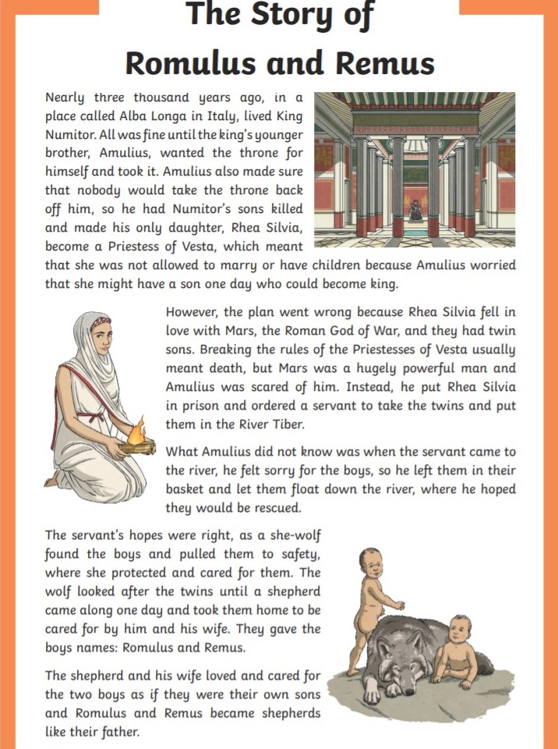

Slide 8
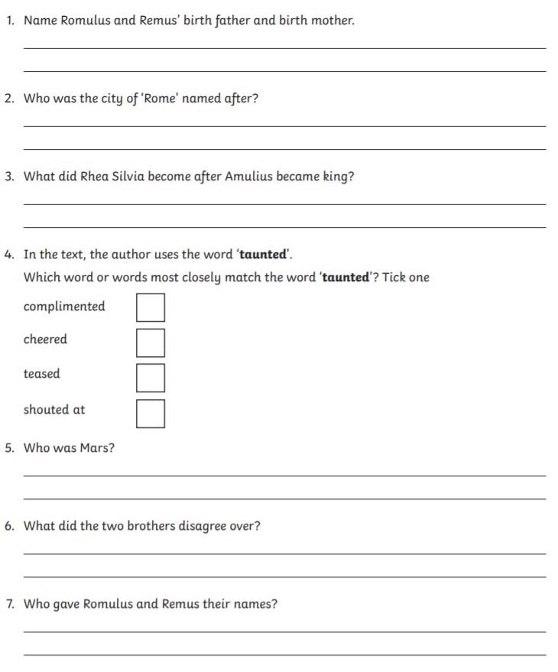
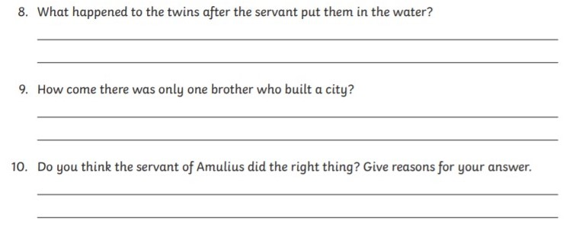

Slide 9
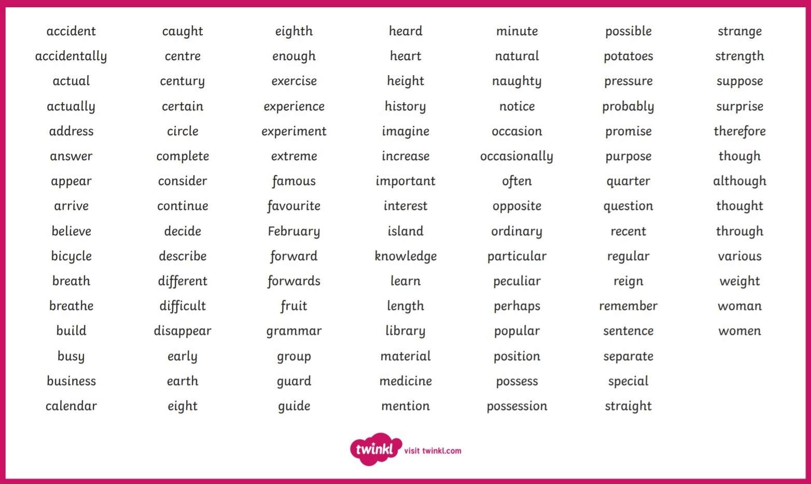
Spend 20 minutes learning 10-15 spellings using the “look, cover, write, check” method!

Slide 10
English LO: To read and answer questions about a text How did you find this lesson? Colour a small traffic light at the end of your work. Red = I didn’t understand Yellow = I need a bit more practice Green = Got it!

Slide 11
Maths LO: To measure capacity in the correct units

Slide 12
Maths LO: To measure capacity in the correct units Write the date and learning objective in your squared book now!

Slide 14
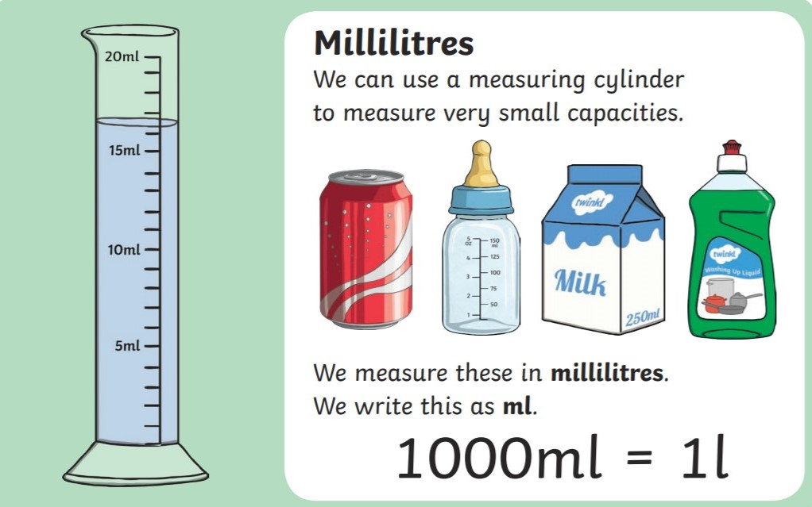

Slide 15
Online task
https://www.twinkl.co.uk/go/lessons/view/maths
Follow the link to Twinkl Go! Watch the “Capacity” video clip

Slide 16
Practical task
You will need:
A measuring jug
A variety of containers
Instructions:
First estimate the capacity of each container.
Fill each container with water.
Pour the water into the measuring jug.
Read the scale on the measuring jug to find out the capacity of each container.
Record your results in a table like the one shown here.
Container | Estimate | Capacity
Milk Bottle | 700ml | 1000ml 1L
Mug
Egg Cup

Slide 17
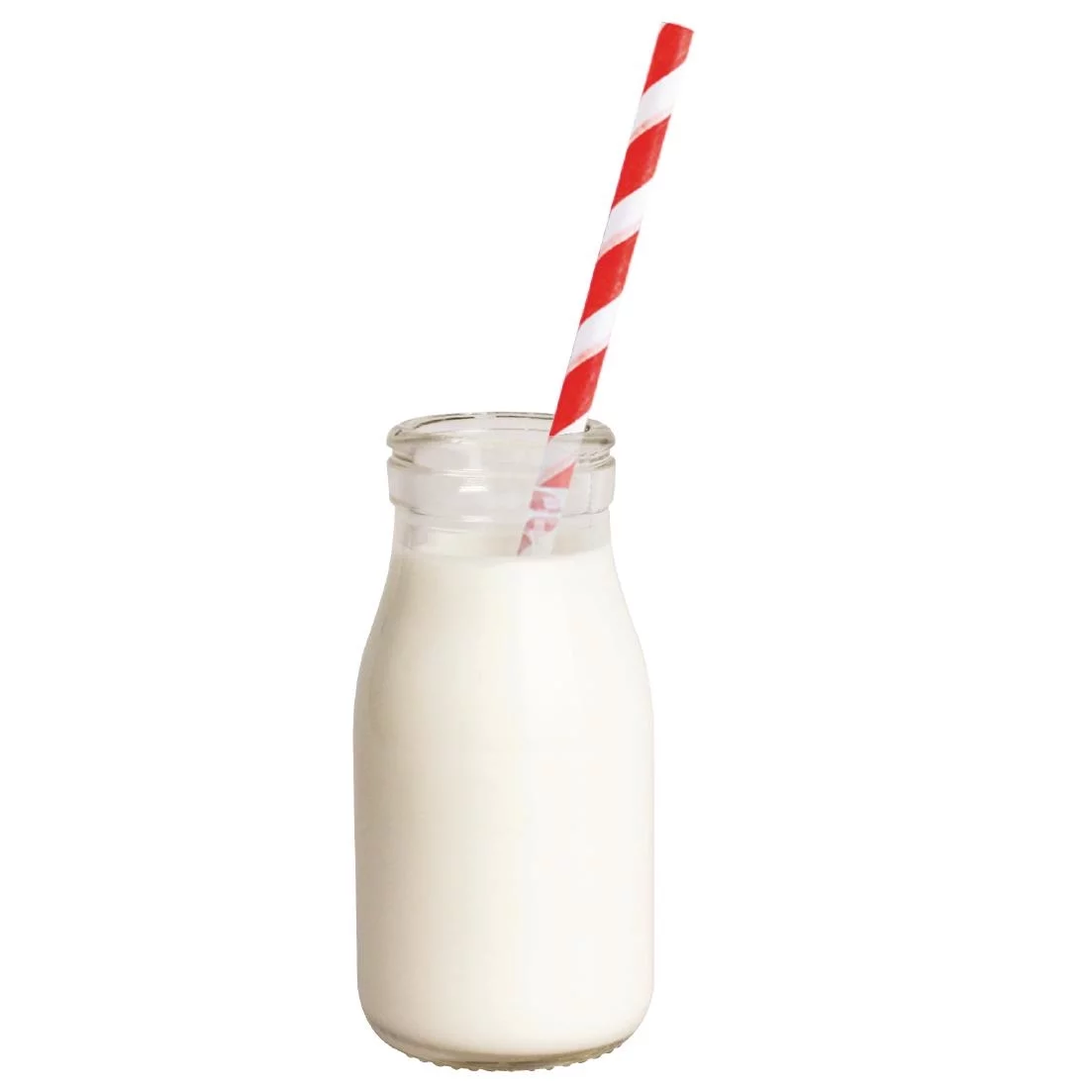
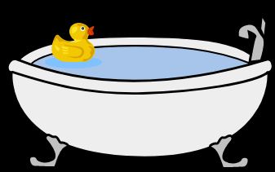
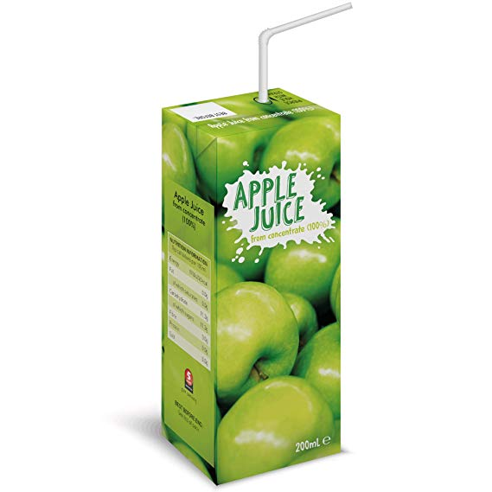
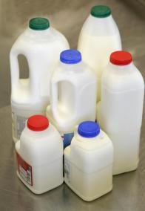
Book task
Draw a Venn diagram like the one shown.
Sort the containers into the correct section of the diagram.
You could print this slide and cut out the pictures, or simply write each container in the diagram.
Litres
Millilitres

Slide 18
Optional extra task
https://www.twinkl.co.uk/go/lessons/view/maths
Follow the link to Twinkl Go! Complete the “Capacity word mat” and “Capacity word search” activities.

Slide 19
Maths LO: To measure capacity in the correct units How did you find this lesson? Colour a small traffic light at the end of your work. Red = I didn’t understand Yellow = I need a bit more practice Green = Got it!

Slide 20
RE LO: To understand why Christians celebrate Lent

Slide 21
What Is Lent?
Lent begins on Ash Wednesday, which is the day after Pancake Day. It is the start of a very important time in the Christian Calendar.
Lent leads up to Easter, the time that Christians remember Jesus’ death and resurrection.
Lent is 40 days long (not including Sundays).

Slide 22
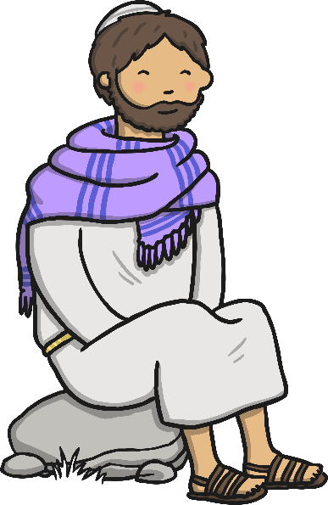
Jesus Goes into the Wilderness
Before Jesus began his teaching, he spent 40 days and 40 nights in the desert, to be with God. During this time, he had no food. Whilst Jesus was in the desert, the Devil appeared, trying to tempt Jesus.

Slide 23
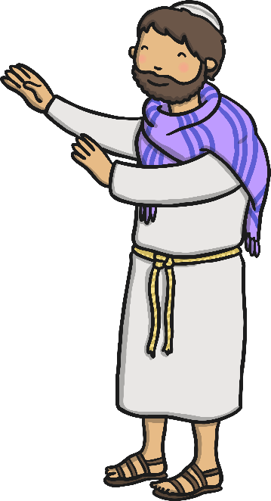
Jesus Goes into the Wilderness
The Devil knew that Jesus was hungry, so he told him that if he was indeed the Son of God, to turn the rocks nearby into bread. The Devil knew Jesus could do this, but Jesus knew it was a trap and told him ‘No!’.
No!

Slide 24
Jesus Goes into the Wilderness
Next, the Devil took Jesus to the Holy City and to the top of a temple. He told Jesus to throw himself off the temple. “If you are the Son of God,” he told Jesus, “then the angels will save you.” But Jesus knew it was a trick and he told the Devil that he was not to test God.
No!

Slide 25
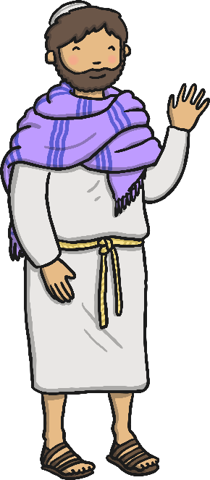
Jesus Goes into the Wilderness
Finally, the Devil took Jesus to a very high mountain and told him “All the kingdoms of the world will be yours if you worship me.”
But Jesus told him to leave and that he only worshipped and served God.
God was very pleased with Jesus and how he resisted the Devil’s temptations.
No!

Slide 26
Jesus Resisted Temptation
Jesus spent 40 days and 40 nights in the desert. He had no food. Whilst he was in the desert, the Devil tried to tempt him with food. The Devil made Jesus many promises, but each time Jesus told him ‘No!’.
Lent lasts 40 days, to remind Christians of Jesus’ sacrifices when he was in the desert and also of his refusal to be tempted by the Devil.

Slide 27
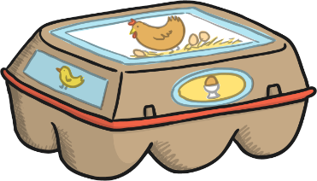
What Do Christians Do During Lent?
In the past, Christians would give up all ‘rich’ food and drink during Lent. This meant food such as meat, eggs, fats and milk products weren’t eaten. People used up their ‘rich’ foods before Lent began, by making pancakes; this is why we have Pancake Day.

Slide 28
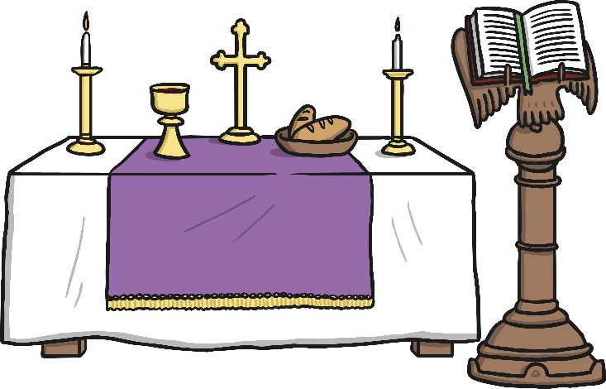
What Do Christians Do During Lent?
Today, many Christians mark Lent by trying to ‘give up’ something they like. It might be chocolate or something like video games. They do this to remember Jesus’ sacrifice when he was in the desert and to test their own self-discipline: to see if they can say no to temptation, just as Jesus did.
Lots of churches hold special Lent services.

Slide 29
When Does Lent Finish?
Lent ends at Easter, when Christians remember Jesus’ death on the cross and his resurrection.

Slide 30
What Would You Give up for Lent?
Lent is a time for Christians to remember Jesus’ sacrifice and how he resisted temptation.
If you were giving up something for Lent, what would it be?
Why would it be difficult for you to give it up?
?
?
?

Slide 31
Lent Comic Strip!
Create a comic strip retelling the story of Lent!
You could do this on plain paper or in your lined book.
Don’t forget the date and Learning Objective!

Slide 32
Optional extra task
Find out more about Lent!
Follow the link to BBC Teach
https://www.bbc.co.uk/bitesize/topics/ztkxpv4/articles/z77jf4j

Slide 33
Form II Home Learning 25/03/2020
Well done! You finished today’s lessons!
I’m looking forward to seeing you all back at school soon!
Miss Ardley

