Slide 1
Form II Home Learning 26/03/2020
Today we are learning:
English
Maths
Geography
Optional extras

Slide 2
Form II Home Learning Reminders
Don’t forget to read every day to an adult or sibling!
Practice your times tables every day!
Continue to practice your spellings!
Work through your maths bond and arithmetic books at your own pace.

Slide 3
Form II Useful Resources
https://www.bbc.co.uk/teach/supermovers Times tables, grammar and just for fun!
https://www.topmarks.co.uk/maths-games/7-11-years/ordering-and-sequencing-numbers Maths games
https://www.bbc.co.uk/teach/ks2-english/zbrwnrd English additional resources
https://www.bbc.co.uk/teach/ks2-maths/zm9my9q Maths additional resources
https://swiggle.org.uk/ Child safe search engine
https://www.twinkl.co.uk/go/lessons/view/arithmagic Arithmagic game. Code: TA5810

Slide 4
English LO: To recognise the features of Instructions

Slide 5
English LO: To recognise the features of Instructions Write the date and learning objective in your lined book now!

Slide 6
What features should instructions include?
A title
Bossy verbs
A list of what is needed
Time conjunctions
Numbered steps, in order
Prepositions

Slide 7
Book Task
Print the next two slides, which show an example of an instructions text.
Underline the Bossy Verbs in Red.
Underline the Prepositions in Green.
Underline the Time Conjunctions in Blue.
Circle the list of what you need in Yellow.
Circle the numbered steps in Black.
Underline the Title in Pink.

Slide 8
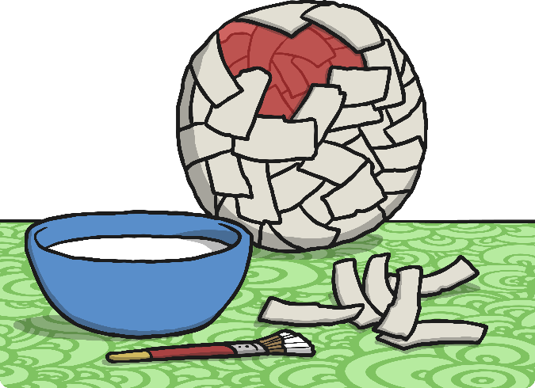
How to Make a Papier Mâché Globe
Are you learning about the continents of the world? Read on to discover how to make a papier mâché globe of your own to help you to remember them.
You will need:
a round balloon
lots of strips of newspaper about 2cm wide
a bowl of water and flour mixture (one cup of flour and two cups of water)
an atlas
a continents of the world sheet
some blue paint and paintbrush
a pack of felt tip pens
a pair of scissors
some glue

Slide 9
First of all, blow up the balloon gently. Don’t let it burst.
Ask a grown-up to help you tie the balloon if it is tricky.
Dip the strips of newspaper in the flour and water mix and slowly wrap the strips all around the balloon until it is covered.
Cover the balloon at least three or four times.
Leave the balloon to go solid. Place it in a warm, dry place.
Next, paint the whole globe blue to show the water.
Leave to dry.
Colour in the seven continents neatly on the activity sheet.
Cut out the continents but be careful with the scissors.
Stick the continents in the right position on the globe. Use an atlas to help you if you are unsure.
Label the oceans and carefully draw the line of the equator. Finally, label the continents of North America, South America, Africa, Antarctica, Australasia, Europe and Asia.

Slide 10
English LO: To recognise the features of instructions How did you find this lesson? Colour a small traffic light at the end of your work. Red = I didn’t understand Yellow = I need a bit more practice Green = Got it!

Slide 11
Optional extra task
Follow the instructions to make the globe!
This will help to revise our Geography learning about the continents and oceans!
This task is also cross-curricular with Art and Design!

Slide 12
Maths LO: To measure mass in the correct units

Slide 13
Maths LO: To measure mass in the correct units Write the date and learning objective in your squared book now!

Slide 14
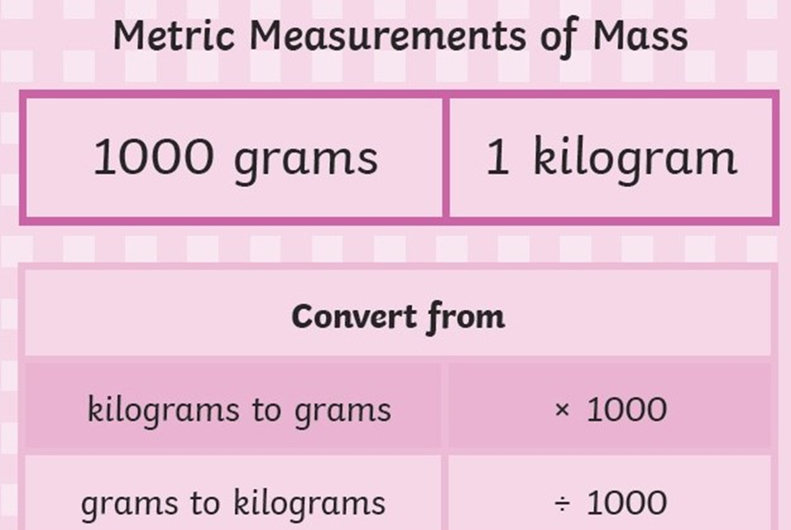

Slide 15
Practical task
Create a table in your squared book like the one shown.
Find a variety of objects to measure in grams.
Estimate the mass of the object first, then measure it accurately!
Challenge: Measure in grams
Super Challenge: Measure in grams and convert to Kilograms
Supersonic Challenge: Write a list of your objects in order of mass, lightest to heaviest
Object | Estimate | Mass
Box of Lego | 800g | 1120g 1.2Kg

Slide 16
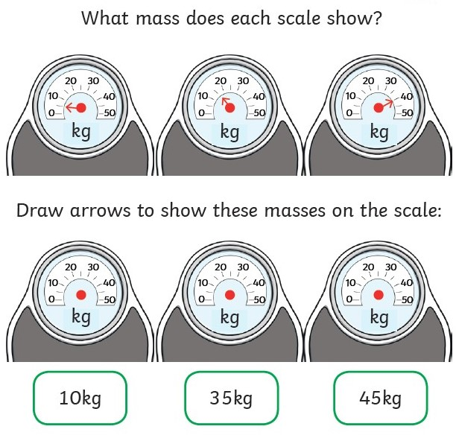
Book tasks
Copy and complete!

Slide 17
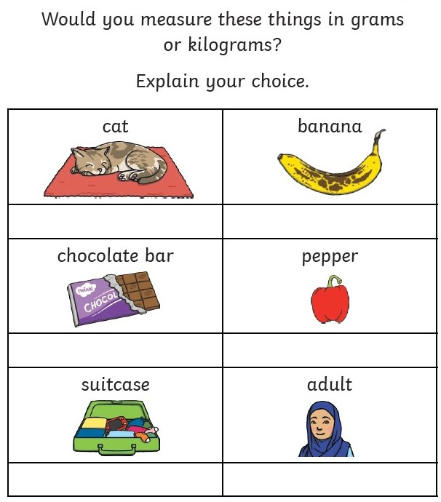
Book tasks
Copy and complete!

Slide 18
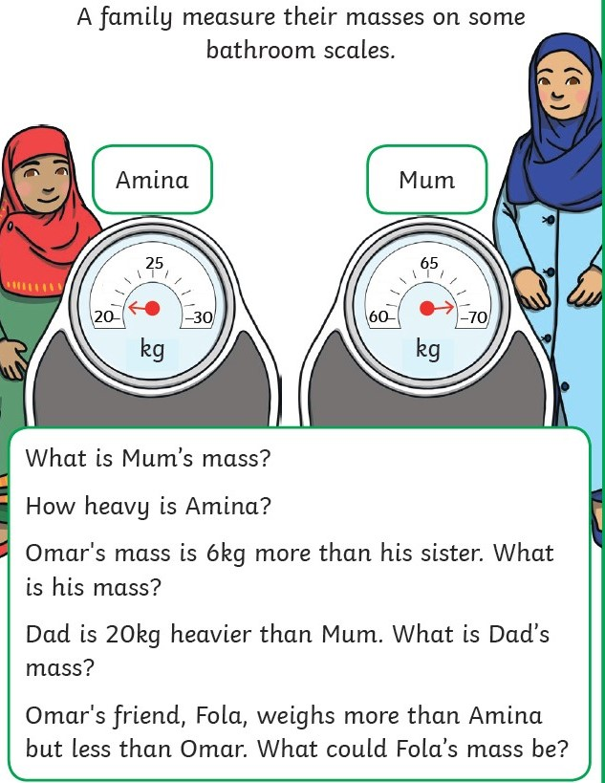
Book tasks
Copy and complete!

Slide 19
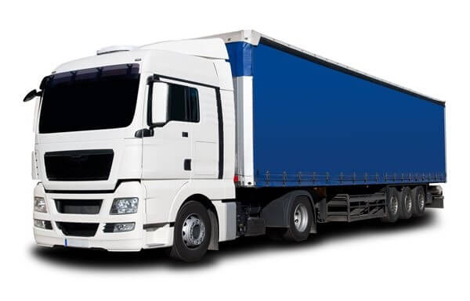
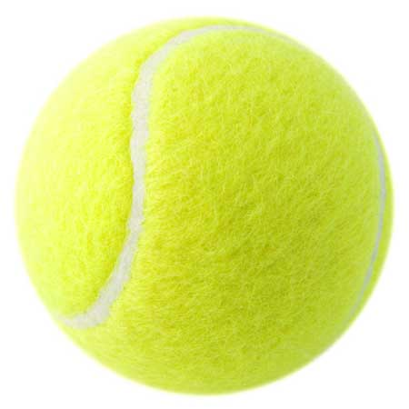
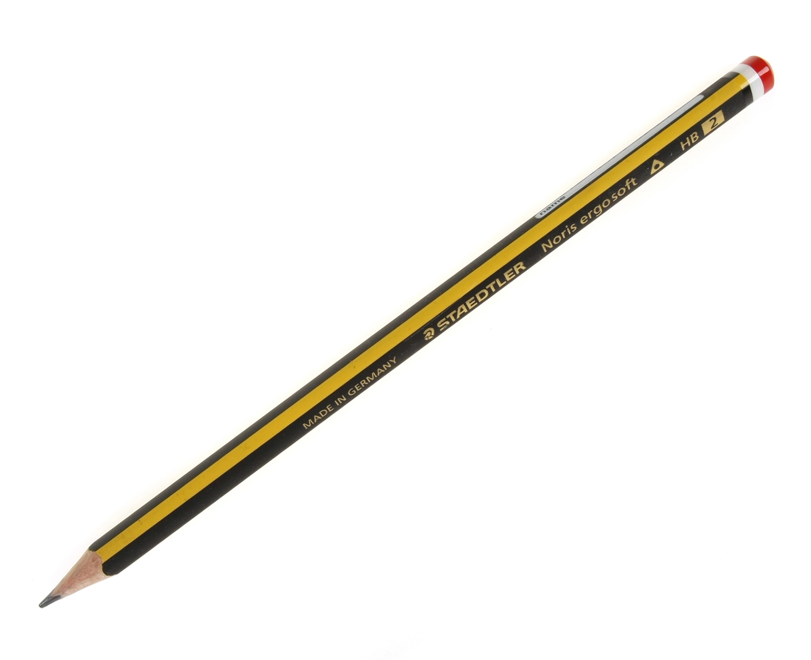
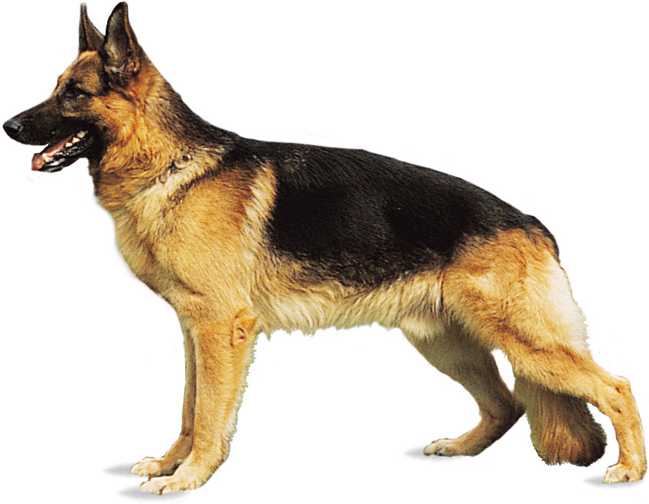
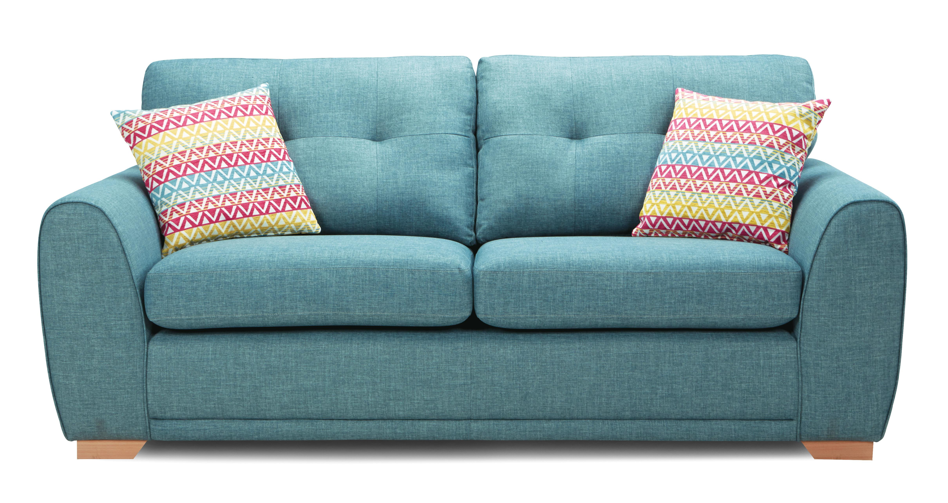
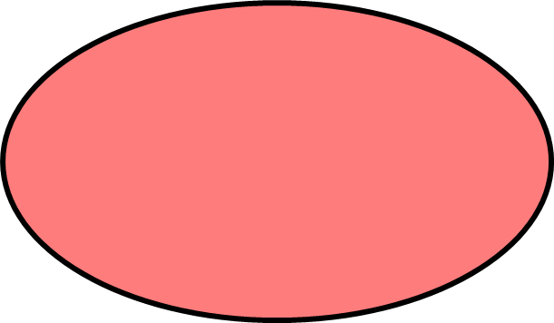
Optional extra task
Draw a Venn diagram like the one shown.
Sort the objects into the correct section of the diagram.
You could print this slide and cut out the pictures, or simply write each object in the diagram.
grams
kilograms

Slide 20
Maths LO: To measure mass in the correct units How did you find this lesson? Colour a small traffic light at the end of your work. Red = I didn’t understand Yellow = I need a bit more practice Green = Got it!

Slide 21
Geography LO: To identify different types of settlement

Slide 22
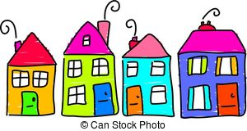
What is a settlement?
A settlement is a place where people live in groups. A group of homes in the same area is a settlement.
Some settlements are very small, some are very large!
Some settlements start off small, and as time goes on they grow. Over the years, more people decide to live in a settlement and it begins to change.
Lets look at some different types of settlement!

Slide 23
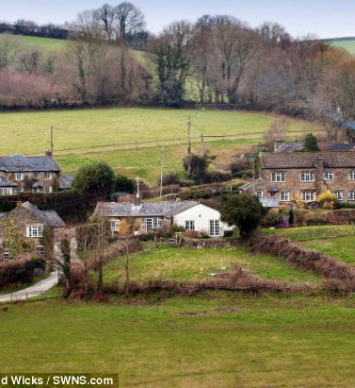
Hamlets
A hamlet is the smallest type of settlement
Usually there are just a handful of houses and nothing else!
Hamlets are usually found in rural locations
Rural means in the countryside, far away from towns and cities
Most settlements start off as a hamlet

Slide 24
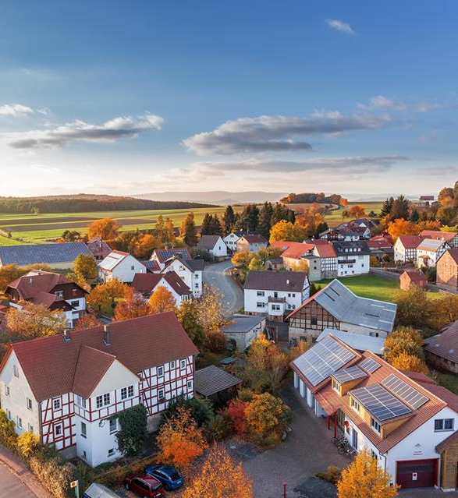
Villages
Villages are a bit larger than hamlets.
Villages have more homes and sometimes also have a church, a school, a shop, a pub or a doctors surgery.
If more people decide to live in a hamlet, they need these local amenities, so the settlement grows into a village.

Slide 25
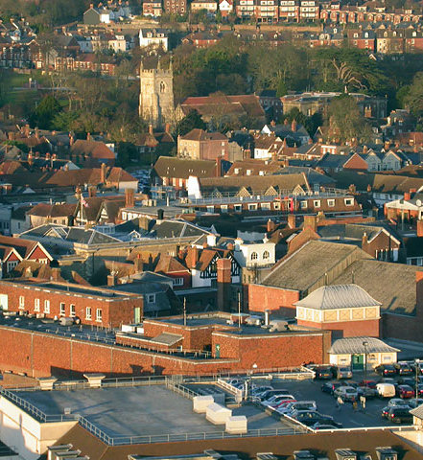
Towns
If lots of people decide to live in a settlement, it might become a town.
A town has lots of homes!
A town also has lots of schools, shops, restaurants, places of worship and offices.
A town might also have a cinema, a swimming pool, a leisure centre, a bowling alley or a train station.

Slide 26
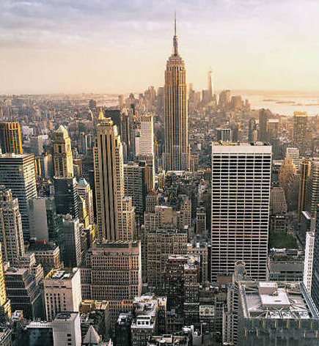
Cities
Cities are the largest type of settlement!
Cities often have high rise buildings, so that many people can live and work together.
Many people live in flats or apartments in cities.
Many people work in tower block offices.
Cities have all the amenities towns have, and often also have a hospital, an airport, a cathedral, museums and art galleries.

Slide 27
Follow the link to BBC Bitesize https://www.bbc.co.uk/bitesize/topics/zx72pv4/articles/zrbvjhv

Slide 28
Would you rather?
Which type of settlement would you prefer to live in?
Why did you choose this type of settlement?
Write your explanation in your lined book. Don’t forget to write the date and Learning Objective!

Slide 29
Optional extra task
Design your own settlement!
Draw a map of your own imaginary village, town or city.
Include the amenities you think will be needed.
Think about where the amenities are – are the important buildings easy or difficult to get to?

Slide 30
Form II Home Learning 26/03/2020
Well done! You finished today’s lessons!
I’m looking forward to seeing you all back at school soon!
Miss Ardley

