Slide 1
Form II Home Learning 27/03/2020
Today we are learning:
English
Maths
Science
Optional extras

Slide 2
Form II Home Learning Reminders
Don’t forget to read every day to an adult or sibling!
Practice your times tables every day!
Continue to practice your spellings!
Work through your maths bond and arithmetic books at your own pace.

Slide 3
Form II Useful Resources
https://www.bbc.co.uk/teach/supermovers Times tables, grammar and just for fun!
https://www.topmarks.co.uk/maths-games/7-11-years/ordering-and-sequencing-numbers Maths games
https://www.bbc.co.uk/teach/ks2-english/zbrwnrd English additional resources
https://www.bbc.co.uk/teach/ks2-maths/zm9my9q Maths additional resources
https://swiggle.org.uk/ Child safe search engine
https://www.twinkl.co.uk/go/lessons/view/arithmagic Arithmagic game. Code: TA5810

Slide 4
English LO: To use commas to write a list

Slide 5
English LO: To use commas to write a list Write the date and learning objective in your lined book now!

Slide 6
What is a List?
Commas are one of the most commonly used punctuation marks
in English.
A comma tells a reader to take a short pause when they are reading but not as long as a full stop.
Practise reading out loud with the following paragraph, thinking about what to do when you reach a full stop or a comma.
The parrot was bright, blue and beautiful. He had green wings, a silver beak and yellow feet.

Slide 7
Commas vs Full Stops
Comma hunt – pick a page of your reading book and see how many commas you can count. Which are there more of - commas or
full stops?
Commas
Full Stops
Read the words in your head – can you pause in the right places for the right amount of time?
Commas have lots of uses in English - today we will be looking at how commas are used to separate items on a list.

Slide 8
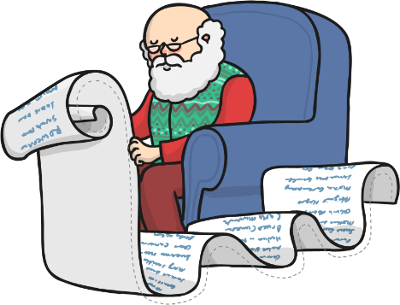
What is a List?
A list is a collection of items, words or phrases.
Can you think of any occasions when we use lists?
We could do this using ‘and’ to link all of the items together but there are problems with this. Read the list below out loud:
When we use lists in our writing, we need to turn them into
full sentences.
Dear Santa, for Christmas I would like a bike and a laptop and a dog and a horse and a teddy bear and a
building brick set
and a pencil
sharpener and
a trumpet.
Could you get to the end of the sentence without running out of breath?
Did the sentence sound nice or have a boring rhythm
to it?

Slide 9
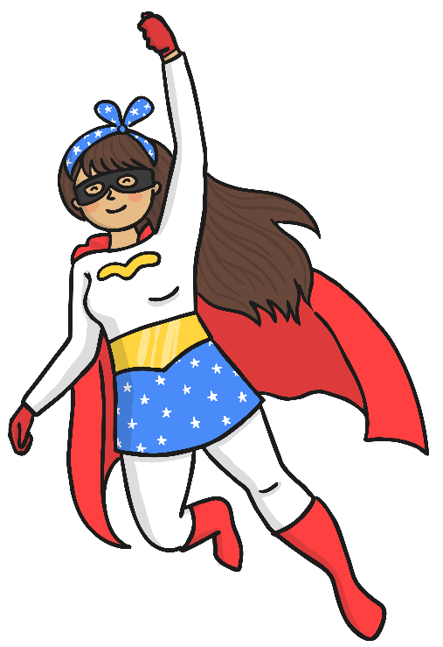
Commas to the Rescue!
Replacing the ‘and’s with commas will give your reader a pause for breath and give your sentence much more character.
Always use ‘and’ just before the last item in the list, to finish your sentence correctly!
Look at this example:
,
,
The superhero wore a cape and gloves and a mask and boots.
The superhero wore a cape, gloves, a mask and boots.

Slide 10
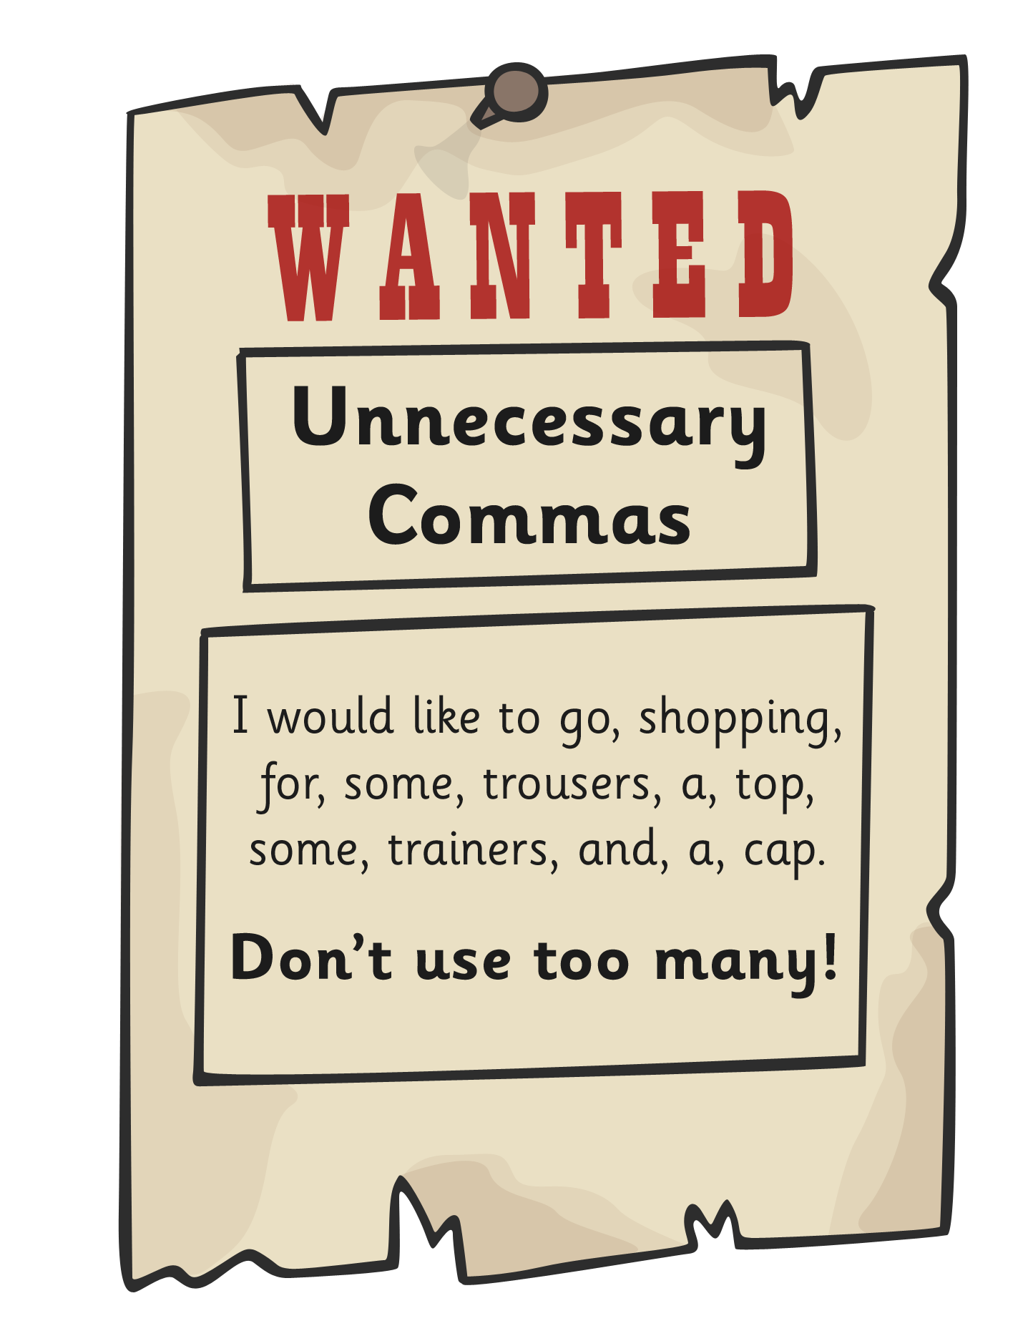
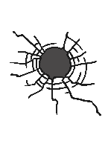
Which commas are not needed?

Slide 11
Choose the sentence that uses commas correctly!
No need to write this in your lined book, a scrap piece of paper will do.
You can check your answers at the end!

Slide 15
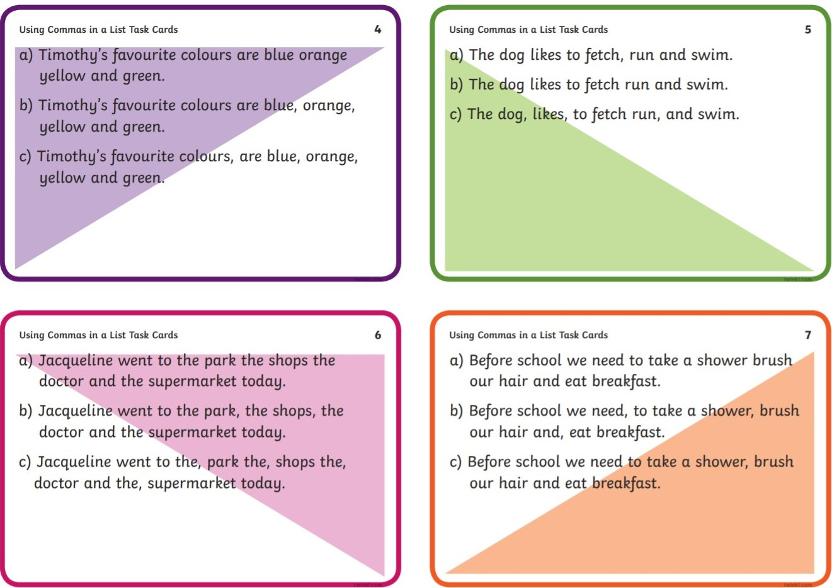

Slide 16
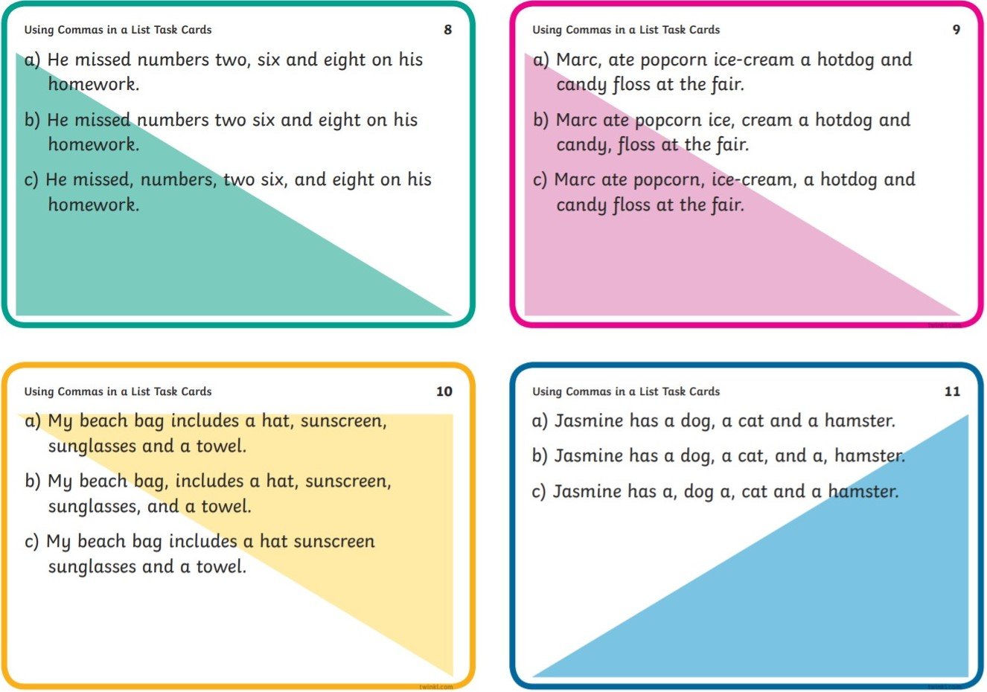

Slide 17
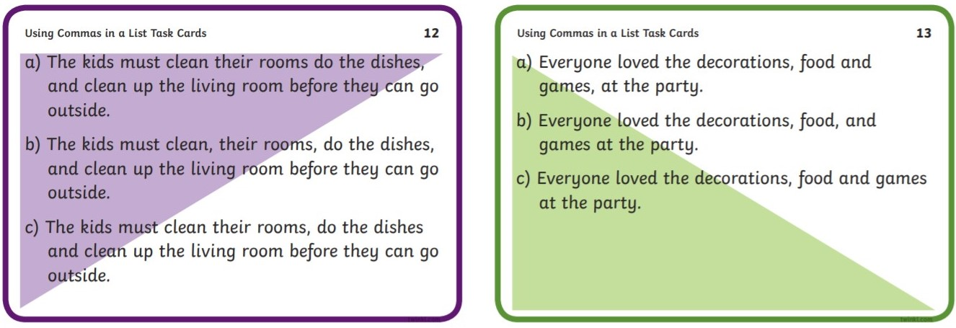

Slide 19
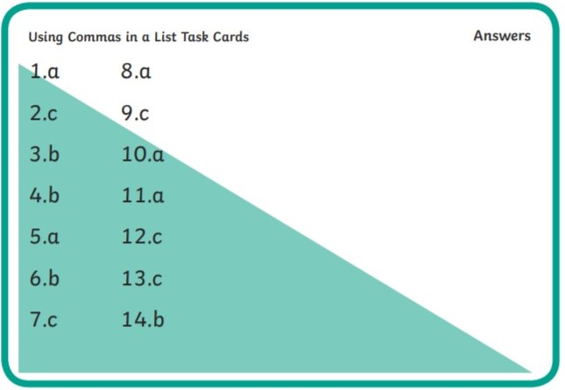

Slide 20
Book task
Write a shopping list for each child. The first one has been done for you.
Remember to write in full sentences, like the example!

Slide 21
Example:
Now it’s your turn!

Slide 22
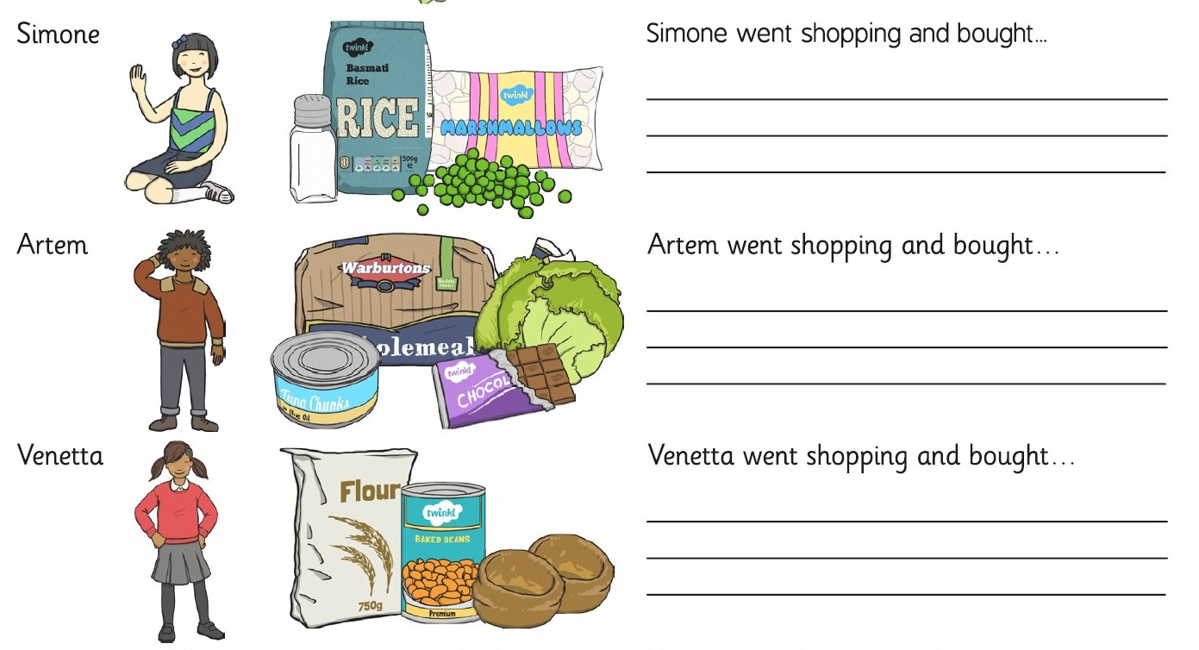

Slide 24
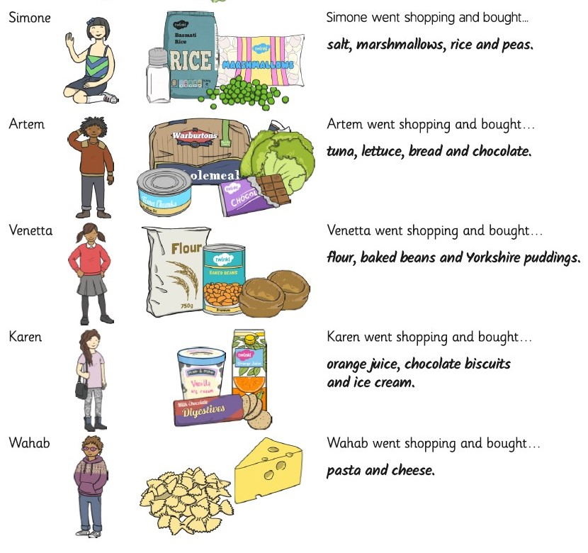
Answers!

Slide 25
Optional extra task
We can use lists in our stories!
We can describe settings and characters using something called “power of 3”.
Write 3 adjectives in a list to describe something in more detail.
Have a look at the example and then try your own in your lined book!

Slide 27
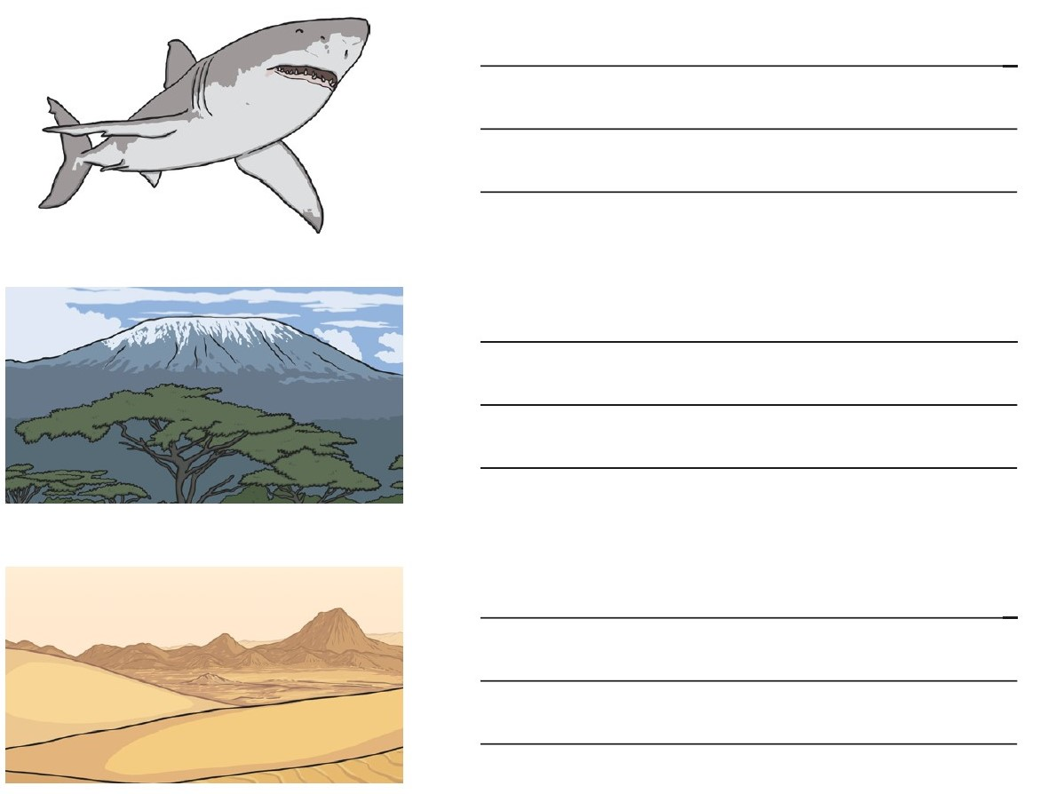

Slide 28
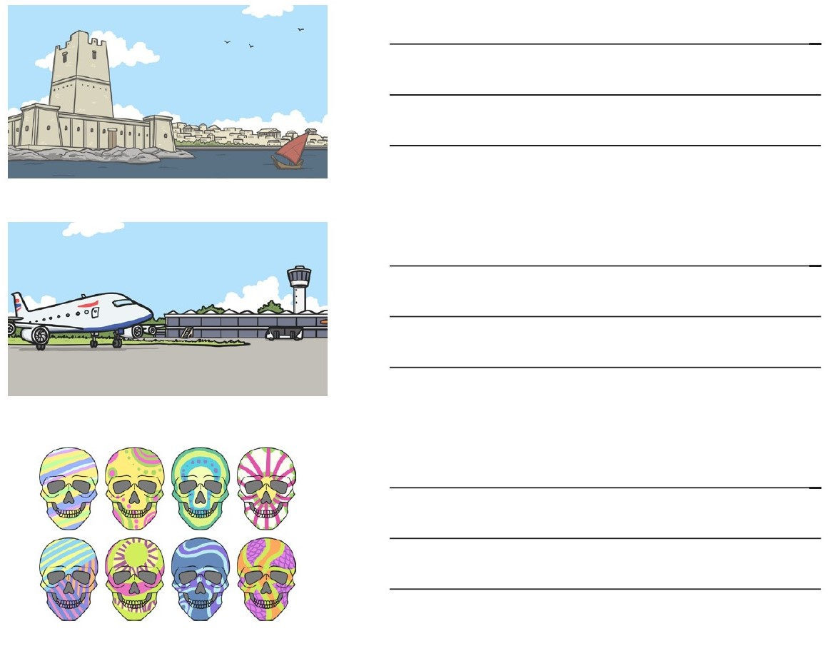

Slide 29
English LO: To use commas to write a list. How did you find this lesson? Colour a small traffic light at the end of your work. Red = I didn’t understand Yellow = I need a bit more practice Green = Got it!

Slide 30
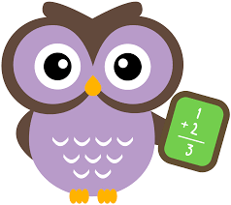
Maths LO: To choose the correct unit of measure

Slide 31
Maths LO: To choose the correct unit of measure Write the date and learning objective in your squared book now!

Slide 32
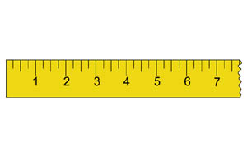
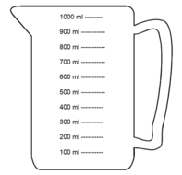
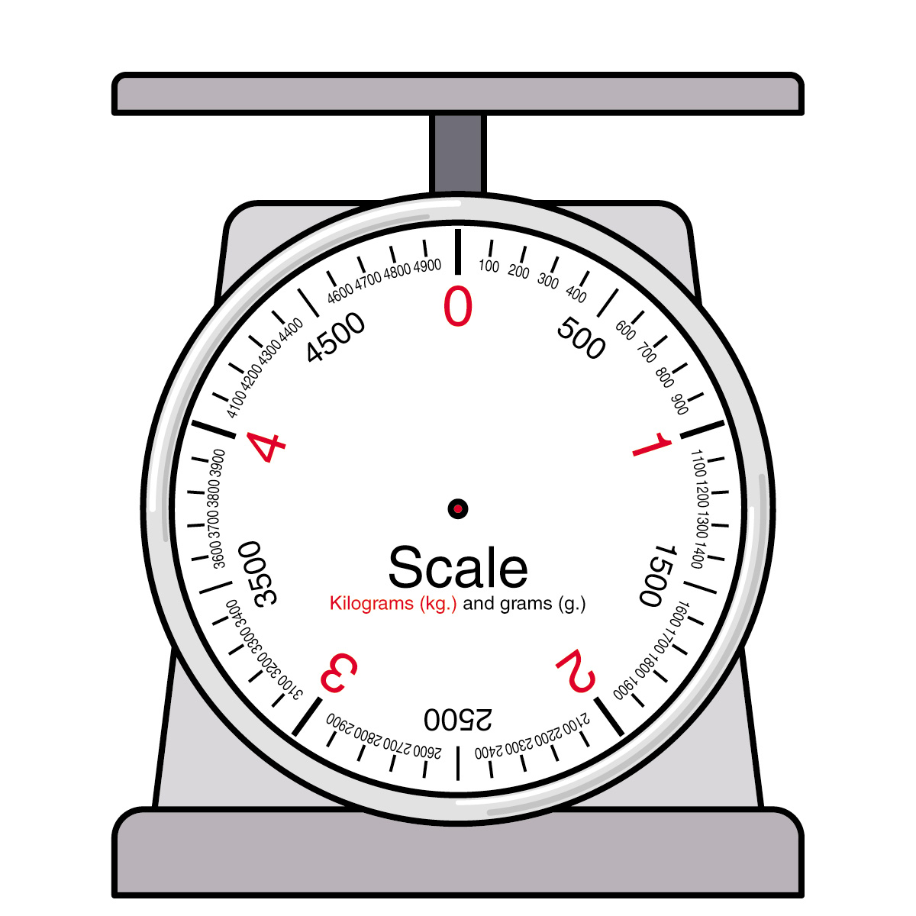
Let’s Recap!
Length = How long something is. We measure length in mm, cm or m (millimetres, centimetres or meters)
Capacity = how much liquid a container can hold. We measure capacity in ml or L (millilitres or litres)
Mass = how heavy something is. We measure mass in g and Kg (grams or kilograms)

Slide 33
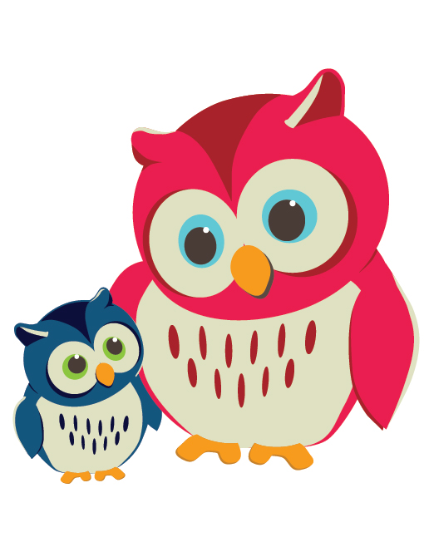
Which Unit would you choose to measure the following items?
You could print the following slide and label the pictures, or you could tell someone in your family the answers!

Slide 34
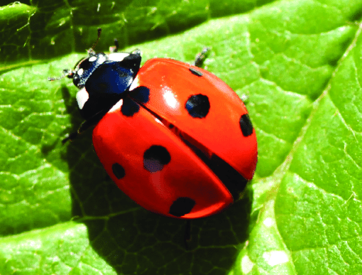
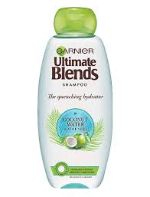
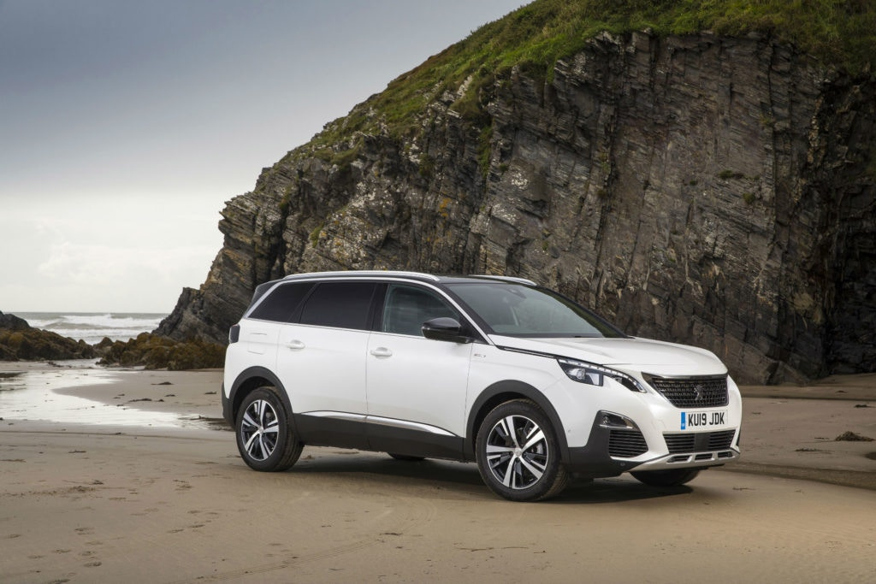
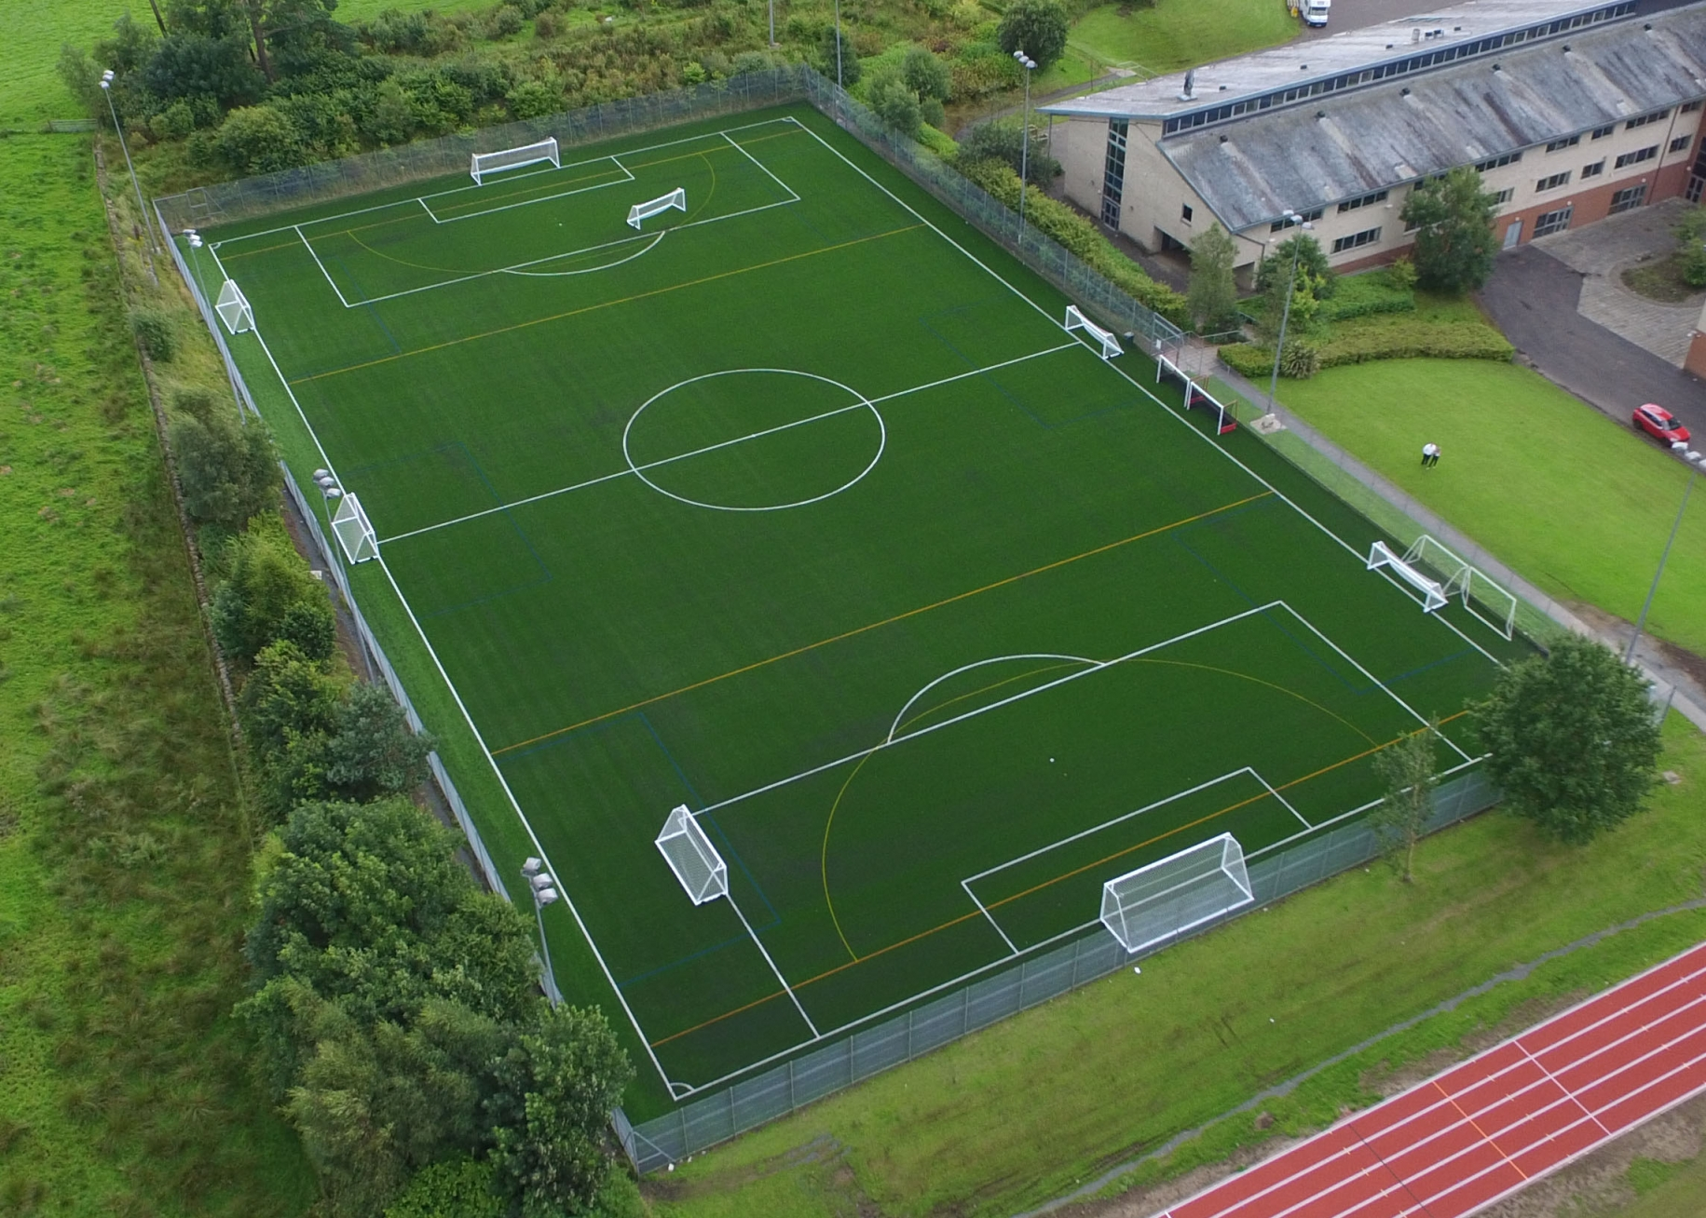
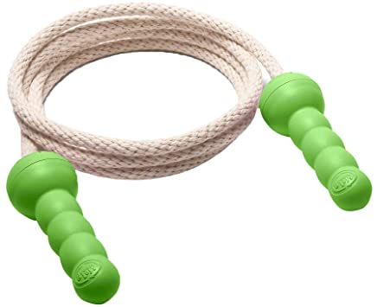
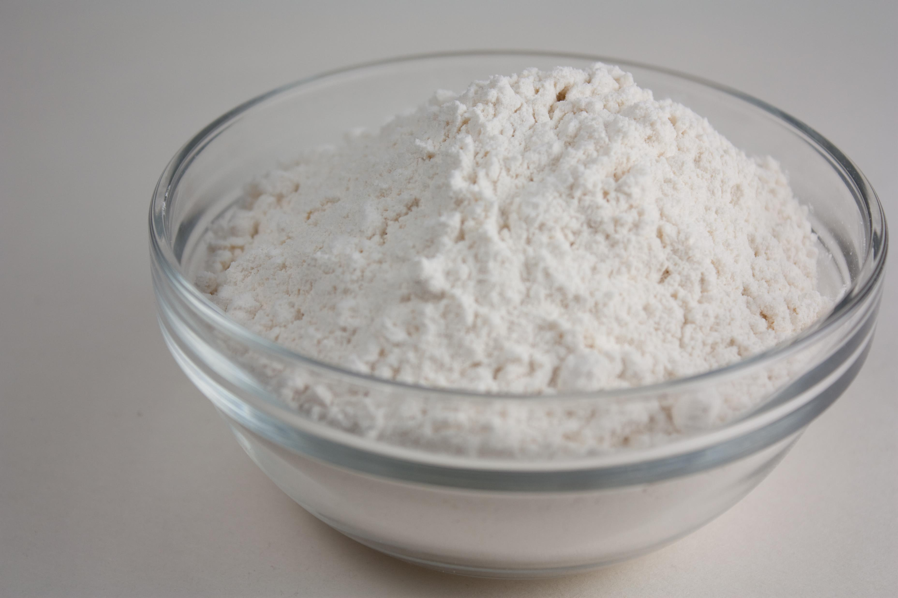
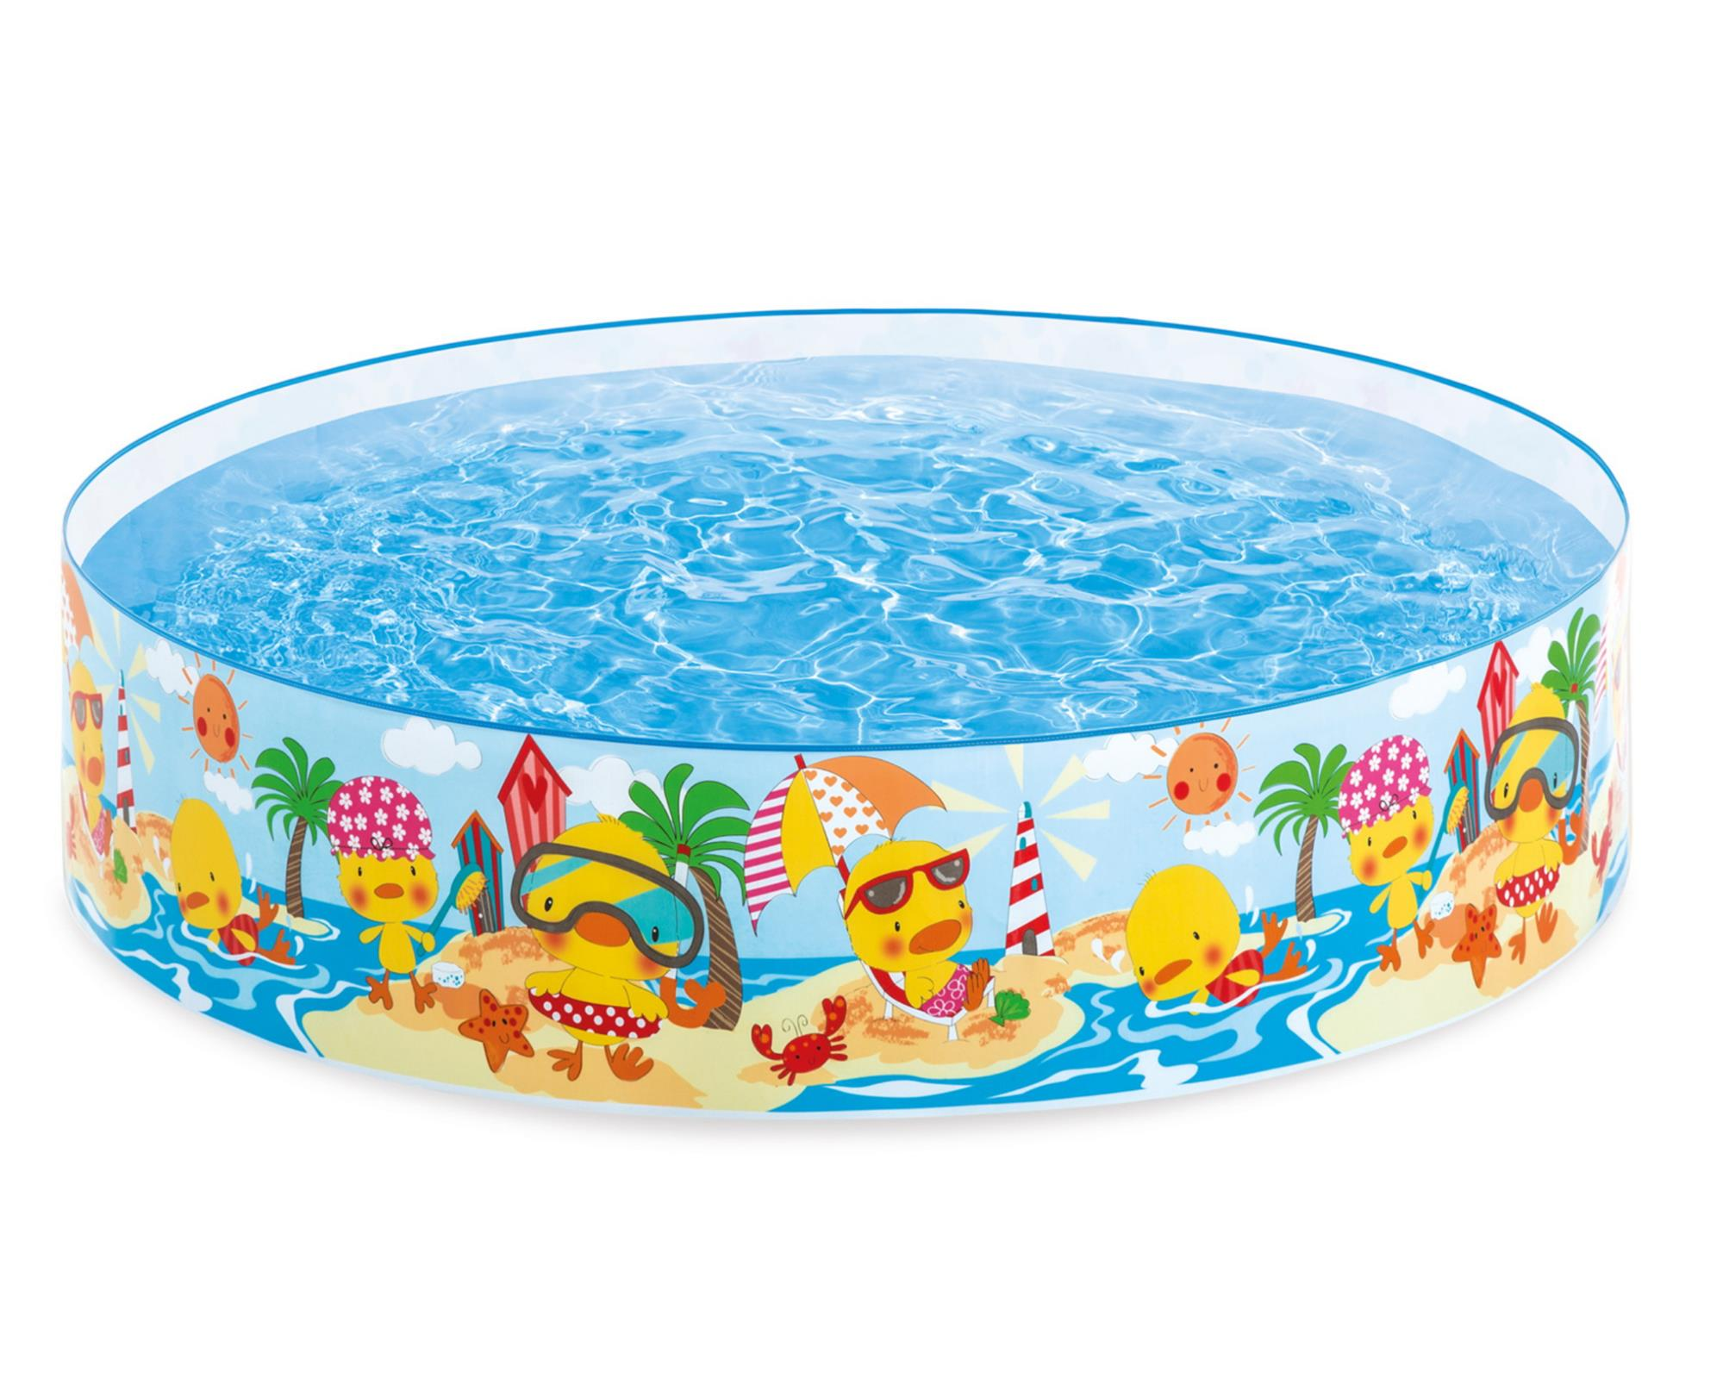
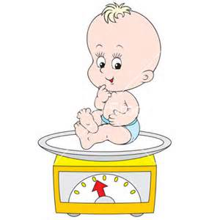

Slide 35
Book tasks
Can you complete the chilli challenges for measurement?
Choose one chilli, two chillies or even three chillies if you're feeling super confident!
You could print the slides, cut out the chilli challenges and stick them in your book, or you could copy the question carefully instead.
You can check your answers at the end!

Slide 36
One Chilli

Slide 37
One Chilli

Slide 38
One Chilli

Slide 39
Two chillies

Slide 40
Two chillies

Slide 41
Two chillies

Slide 42
Three chillies

Slide 43
Three chillies

Slide 44
Three chillies

Slide 45
Maths LO: To choose the correct unit of measure How did you find this lesson? Colour a small traffic light at the end of your work. Red = I didn’t understand Yellow = I need a bit more practice Green = Got it!

Slide 46
Science LO: To make a healthy meal

Slide 47
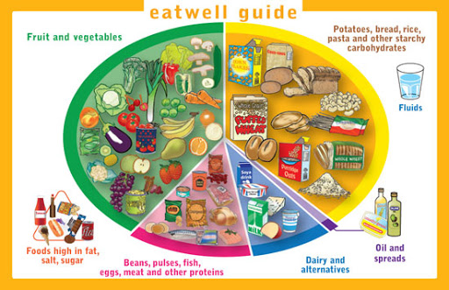
Do you remember what a “Healthy Plate” looks like?

Slide 48
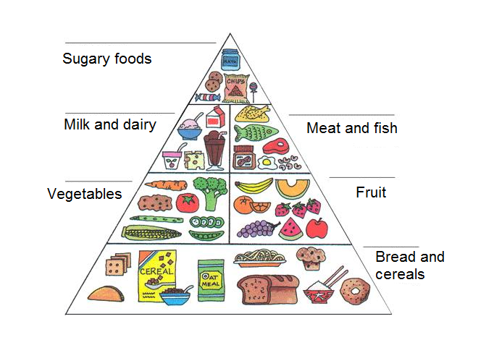
A food pyramid tells us which foods we should eat lots of, and which foods we should only have occasionally:

Slide 49
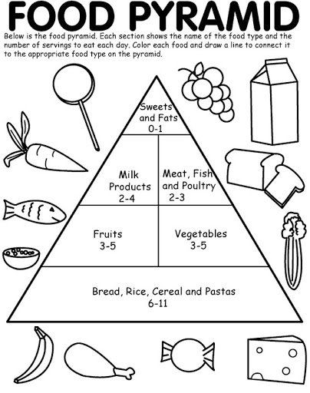
Book Task: Where do these foods belong on the food pyramid? Print this slide. Draw labels to the correct section. Colour the foods!

Slide 50
Practical task!
Help a grown-up to make one of your meals today.
Which food groups does it contain? Could it be made healthier?
Don’t forget! It’s important to wash your hands with soap and water before you prepare or eat your meal!

Slide 51
Optional extra task
Write a set of instructions explaining how to make the meal you prepared.
Don’t forget to include all of the features of instructions we have been learning about!
Bossy verbs, time conjunctions, prepositions, bullet points, sub-headings, commas.

Slide 52
Form II Home Learning 27/03/2020
Well done! You finished today’s lessons!
I’m looking forward to seeing you all back at school soon!
Miss Ardley

