Slide 1
Form II Home Learning 02/04/2020
Today we are learning:
English
Maths
Geography
Optional extras

Slide 2
Form II Home Learning Reminders
Don’t forget to read every day to an adult or sibling!
Practice your times tables every day!
Continue to practice your spellings!
Work through your maths bond and arithmetic books at your own pace.

Slide 3
Form II Useful Resources
https://www.bbc.co.uk/teach/supermovers Times tables, grammar and just for fun!
https://www.topmarks.co.uk/maths-games/7-11-years/ordering-and-sequencing-numbers Maths games
https://www.bbc.co.uk/teach/ks2-english/zbrwnrd English additional resources
https://www.bbc.co.uk/teach/ks2-maths/zm9my9q Maths additional resources
https://swiggle.org.uk/ Child safe search engine
https://www.twinkl.co.uk/go/lessons/view/arithmagic Arithmagic game. Code: TA5810

Slide 4
English LO: To write a detailed character description

Slide 5
English LO: To write a detailed character description Write the date and learning objective in your lined book now!

Slide 6
Let’s recap!
What have we learned this week?
Exciting adjectives
Synonyms
Power of 3

Slide 7
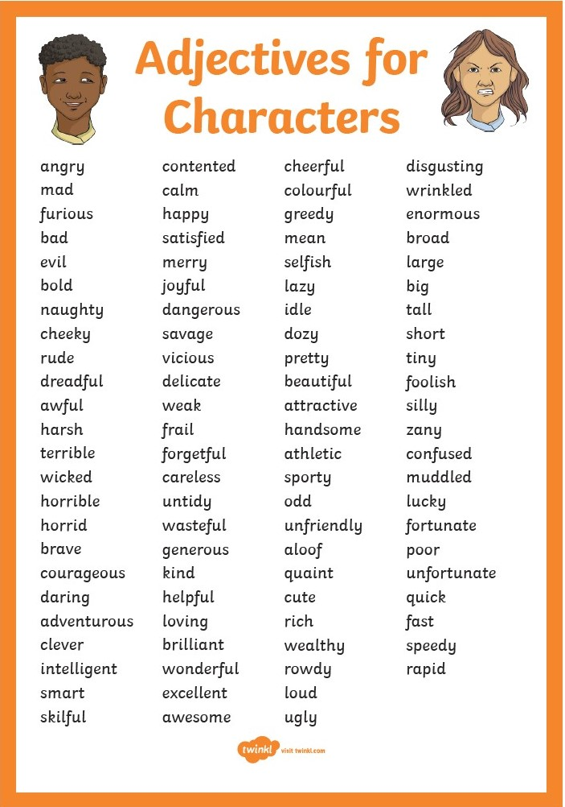
Exciting adjectives:

Slide 8
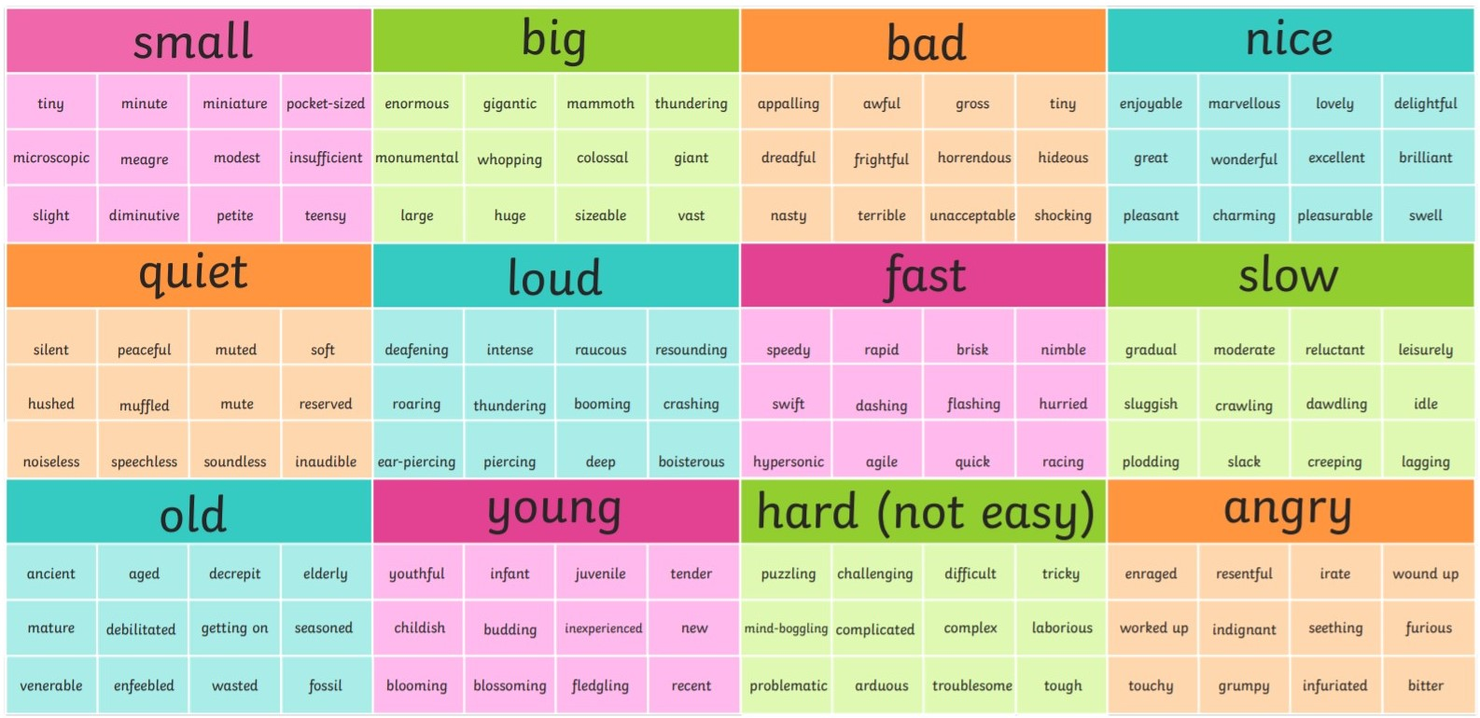
Synonyms:

Slide 9
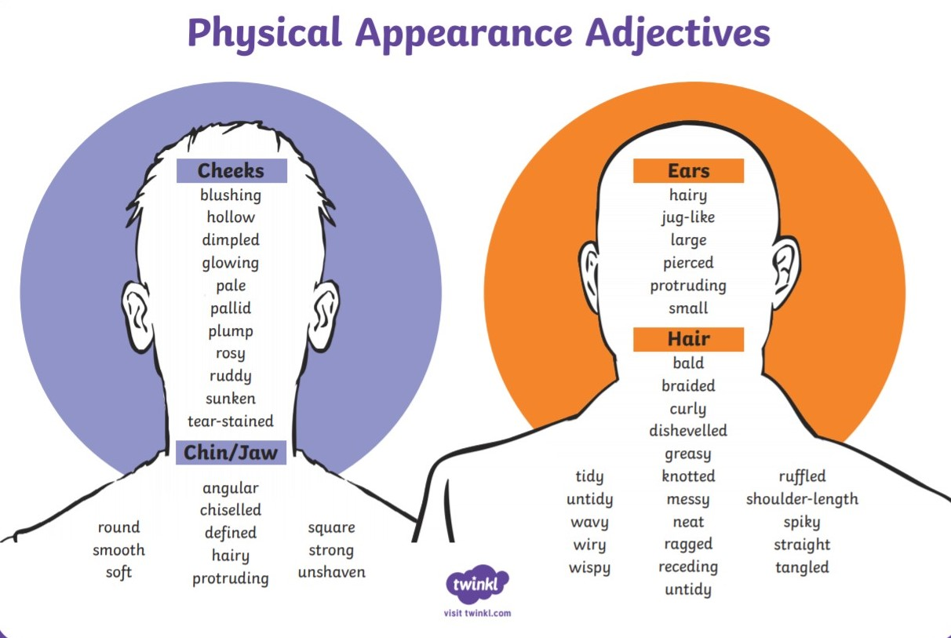
Power of three:
He had large, hairy, protruding ears.

Slide 10
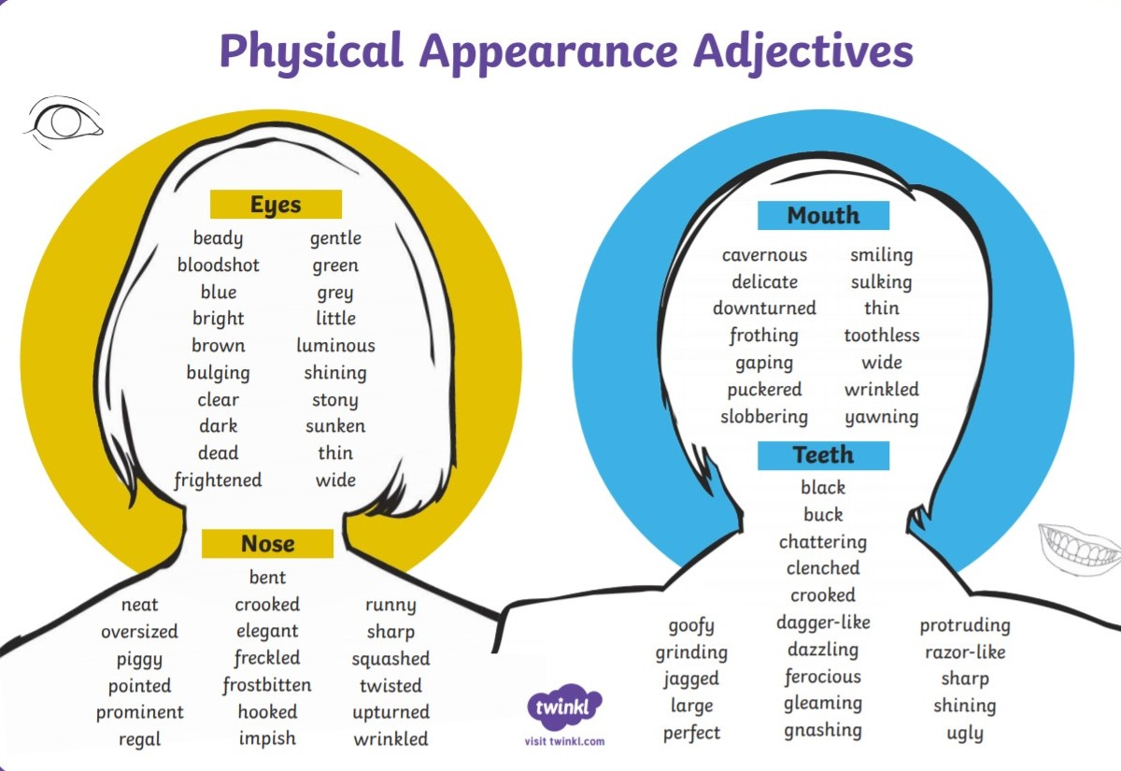
Power of three:
She had wide, luminous, blue eyes.

Slide 11
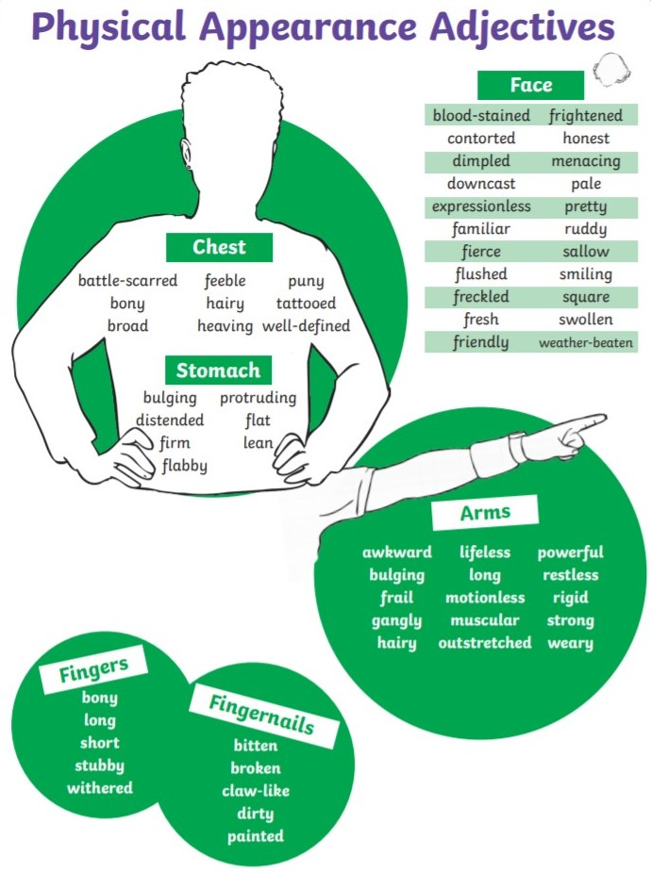
Power of three:
She had long, withered, bony fingers.

Slide 12
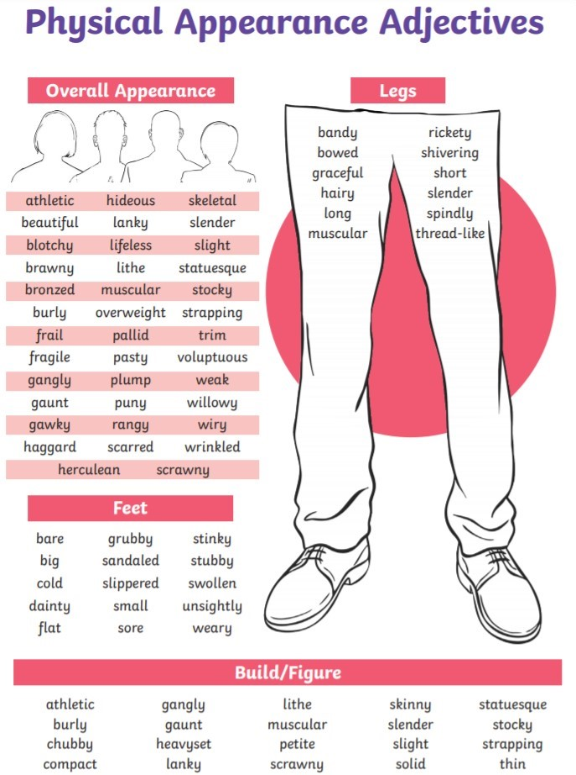
Power of three:
His stinky, grubby, bare feet stomped down the road.

Slide 13
Today we are going to use exciting adjectives, synonyms and power of three to write a detailed character description.
You need to create a picture in the readers mind!

Slide 14
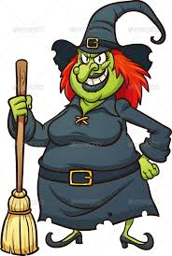
Example:
Wanda
Wanda, a bad and selfish witch, was plotting a plan as usual. She cackled and sang (although very badly) as she stirred her cauldron. Her enflamed orange hair was tangled and brittle like her mop. Dark black lipstick covered her thin, harsh, flaky lips and half of her teeth. Her ragged dress was filthy with ash from her dusty cauldron. Wanda was extremely rude and hated people.

Slide 15
We could use a synonym here!
Examples: awfully, terribly, hideously, screechily
Wanda
Wanda, a bad and selfish witch, was plotting a plan as usual. She cackled and sang (although very badly) as she stirred her cauldron. Her enflamed orange hair was tangled, and brittle like her mop. Dark black lipstick covered her thin, harsh, flaky lips and half of her teeth. Her ragged dress was filthy with ash from her dusty cauldron. Wanda was extremely rude and hated people.

Slide 16
Add an extra adjective to make a power of three!
Examples: dry, long, matted
Wanda
Wanda, a bad and selfish witch, was plotting a plan as usual. She cackled and sang (although very badly) as she stirred her cauldron. Her enflamed orange hair was tangled, and brittle like her mop. Dark black lipstick covered her thin, harsh, flaky lips and half of her teeth. Her ragged dress was filthy with ash from her dusty cauldron. Wanda was extremely rude and hated people.

Slide 17
Change this adjective to something more exciting!
Examples: Evil, fiendish, wicked
Wanda
Wanda, a bad and selfish witch, was plotting a plan as usual. She cackled and sang (although very badly) as she stirred her cauldron. Her enflamed orange hair was tangled, and brittle like her mop. Dark black lipstick covered her thin, harsh, flaky lips and half of her teeth. Her ragged dress was filthy with ash from her dusty cauldron. Wanda was extremely rude and hated people.

Slide 18
Book tasks
Choose two different characters to write a character description for.
Remember to include exciting adjectives, synonyms and power of three!
Use the previous slides to help you.
Write your descriptions in your lined book. Don’t forget the date and learning objective!

Slide 20
English LO: To write a detailed character description How did you find this lesson? Colour a small traffic light at the end of your work. Red = I didn’t understand Yellow = I need a bit more practice Green = Got it!

Slide 21
Maths LO: To explore lines of symmetry

Slide 22
Maths LO: To explore lines of symmetry Write the date and learning objective in your squared book now!

Slide 23
Reflection symmetry is where one half of the image is the reflection of the other half. You could fold the image and have both halves match exactly.

Slide 24
Where is the line of symmetry on these shapes?

Slide 25
Reflection symmetry can be in different orientations.

Slide 26
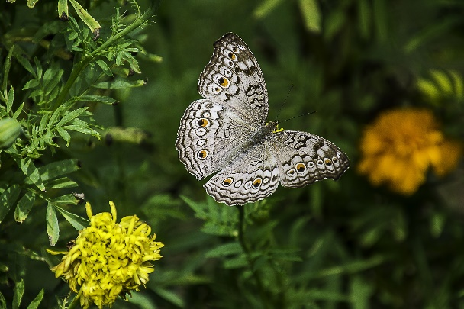
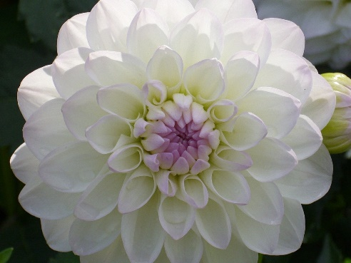
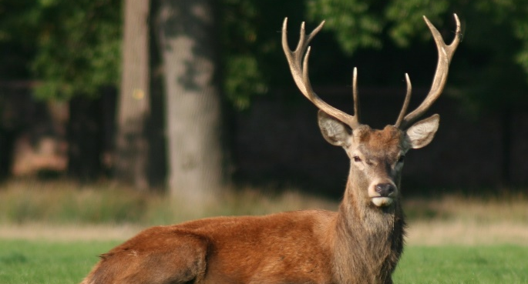
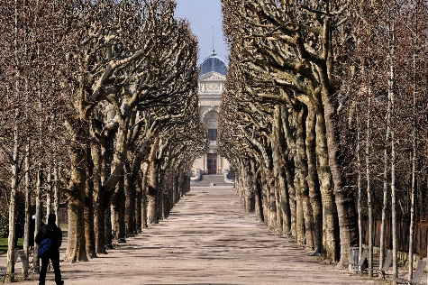
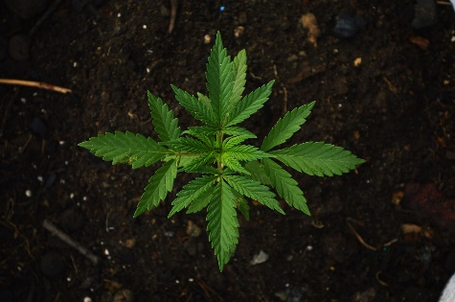
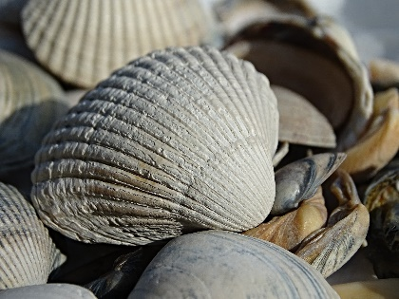
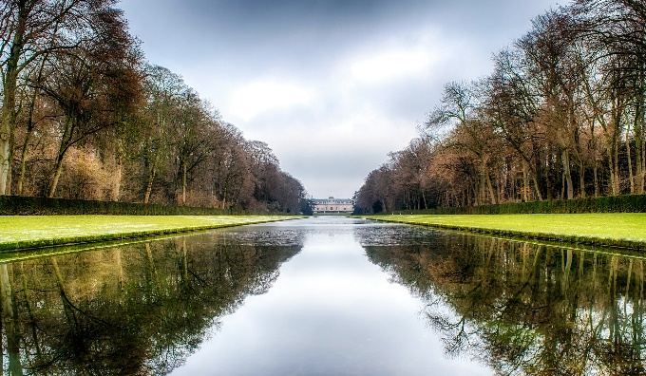
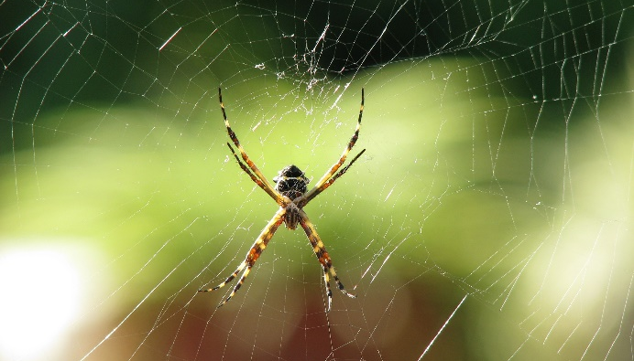
We can see symmetry in nature:

Slide 27
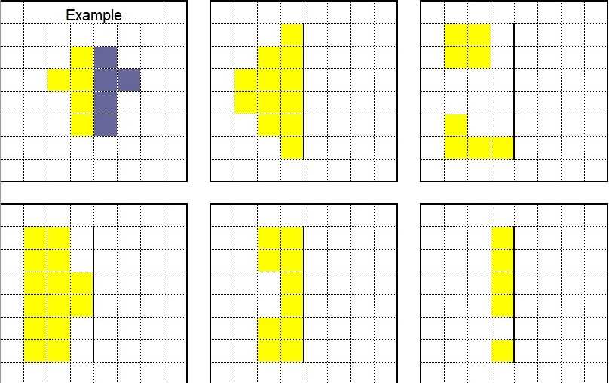
Book tasks
Copy and complete the pictures into your squared book.
Make sure both sides are symmetrical!
Remember to count the squares away from the mirror line.

Slide 28
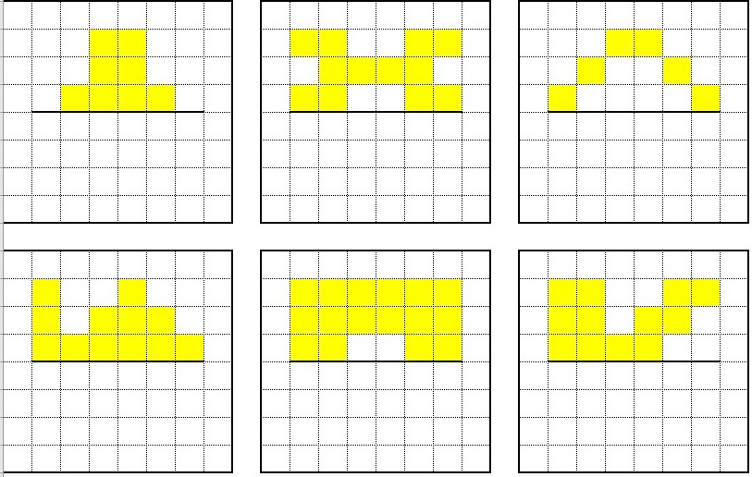
Book tasks
Copy and complete the pictures into your squared book.
Make sure both sides are symmetrical!
Remember to count the squares away from the mirror line.

Slide 29
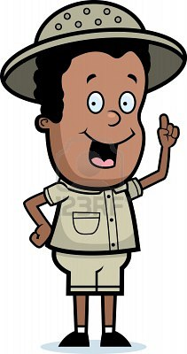
I think every regular polygon has the same number of lines of symmetry as its number of sides
A square has four sides,
so it must have four lines of symmetry.

Slide 30
I don’t think that is true for EVERY shape. Prove it!

Slide 31
Time to investigate!
Print or copy and complete the table in your squared book.
Shape | Number of sides | Number of lines of symmetry

Slide 32
Maths LO: To explore lines of symmetry How did you find this lesson? Colour a small traffic light at the end of your work. Red = I didn’t understand Yellow = I need a bit more practice Green = Got it!

Slide 33
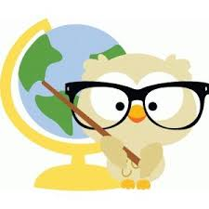
Geography LO: To explore island life Write the date and learning objective in your lined book now!

Slide 34
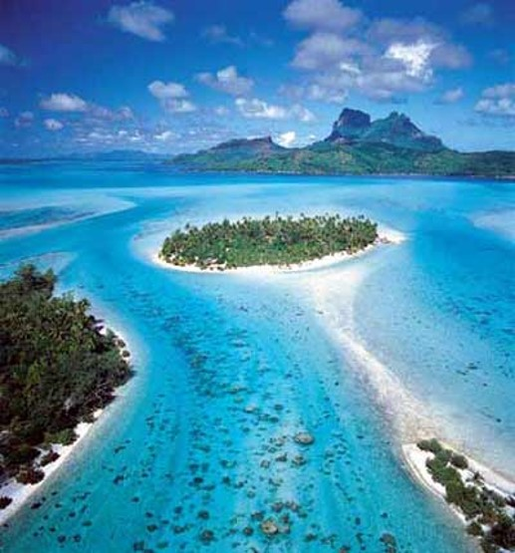
What is an island?
An island is an area of land surrounded completely by water. It may be in a river, a lake or the sea.
Islands can be different shapes and sizes. Some islands are large, like Britain, others are small and you could easily walk around them.

Slide 35
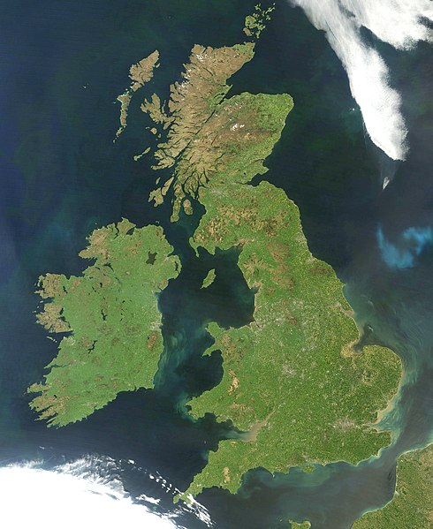
The Island of Great Britain
The United Kingdom of Great Britain and Northern Ireland includes the island of Great Britain and the north eastern part of the island of Ireland (Northern Ireland) and many smaller islands.

Slide 36
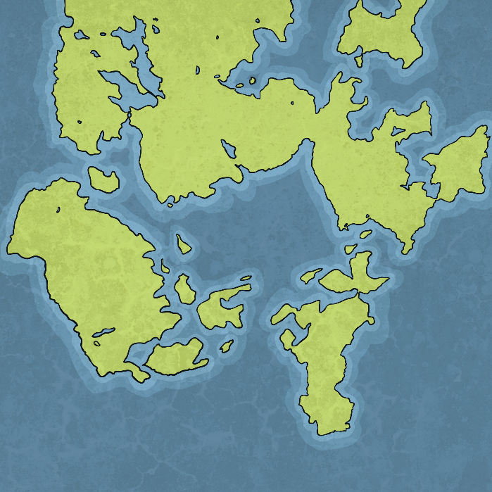
Where Do islands Come From?
Most islands were formed millions of years ago when the sea levels rose. This broke away pieces of land from the main continent they were attached to.
There are some types of islands that were formed in different ways.
Let’s take a look.

Slide 37
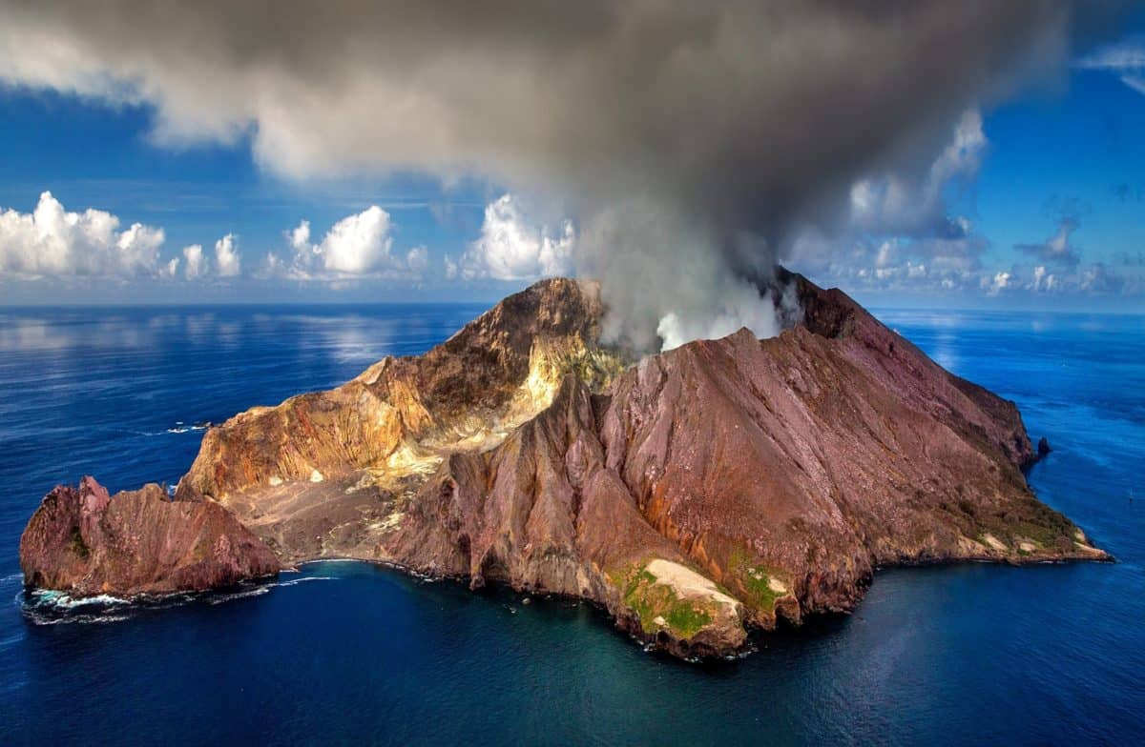
Volcano Islands
Volcano islands are created from volcanoes erupting layers of lava and solidifying over millions of years. They eventually become so tall that they reach the surface of the sea.

Slide 38
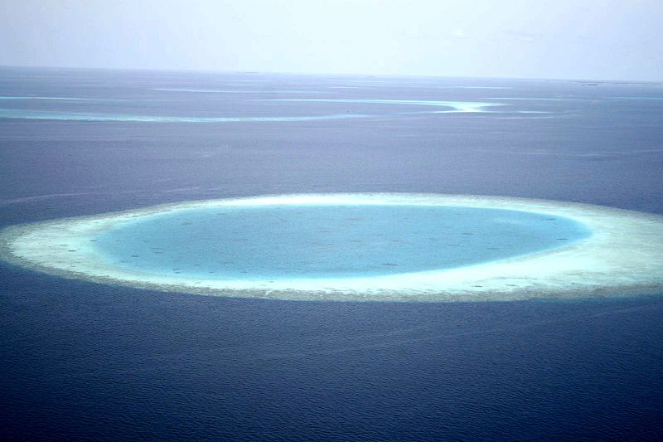
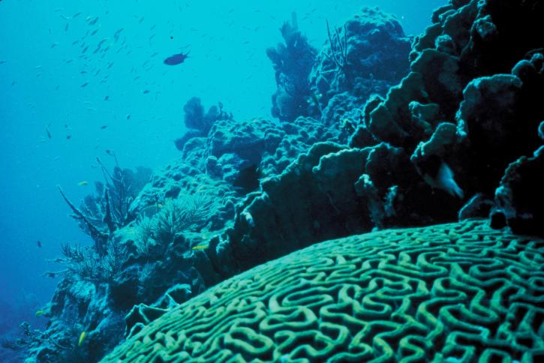
Coral Islands
Coral islands are made of lots of tiny corals. They make rocky reefs that eventually pile up to make islands over thousands of years. They are sometimes ring shaped.

Slide 39
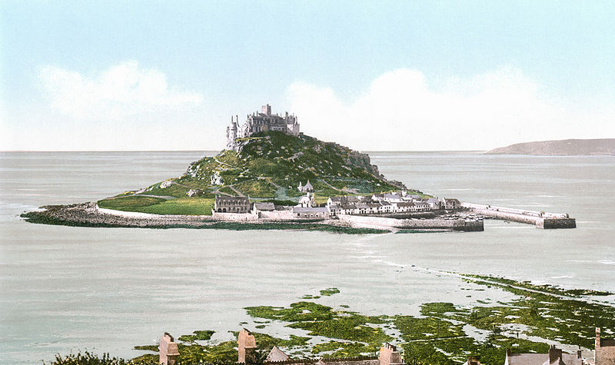
Tidal Islands
Some places are only islands at high tide. St Michael's Mount is an example of this.

Slide 40
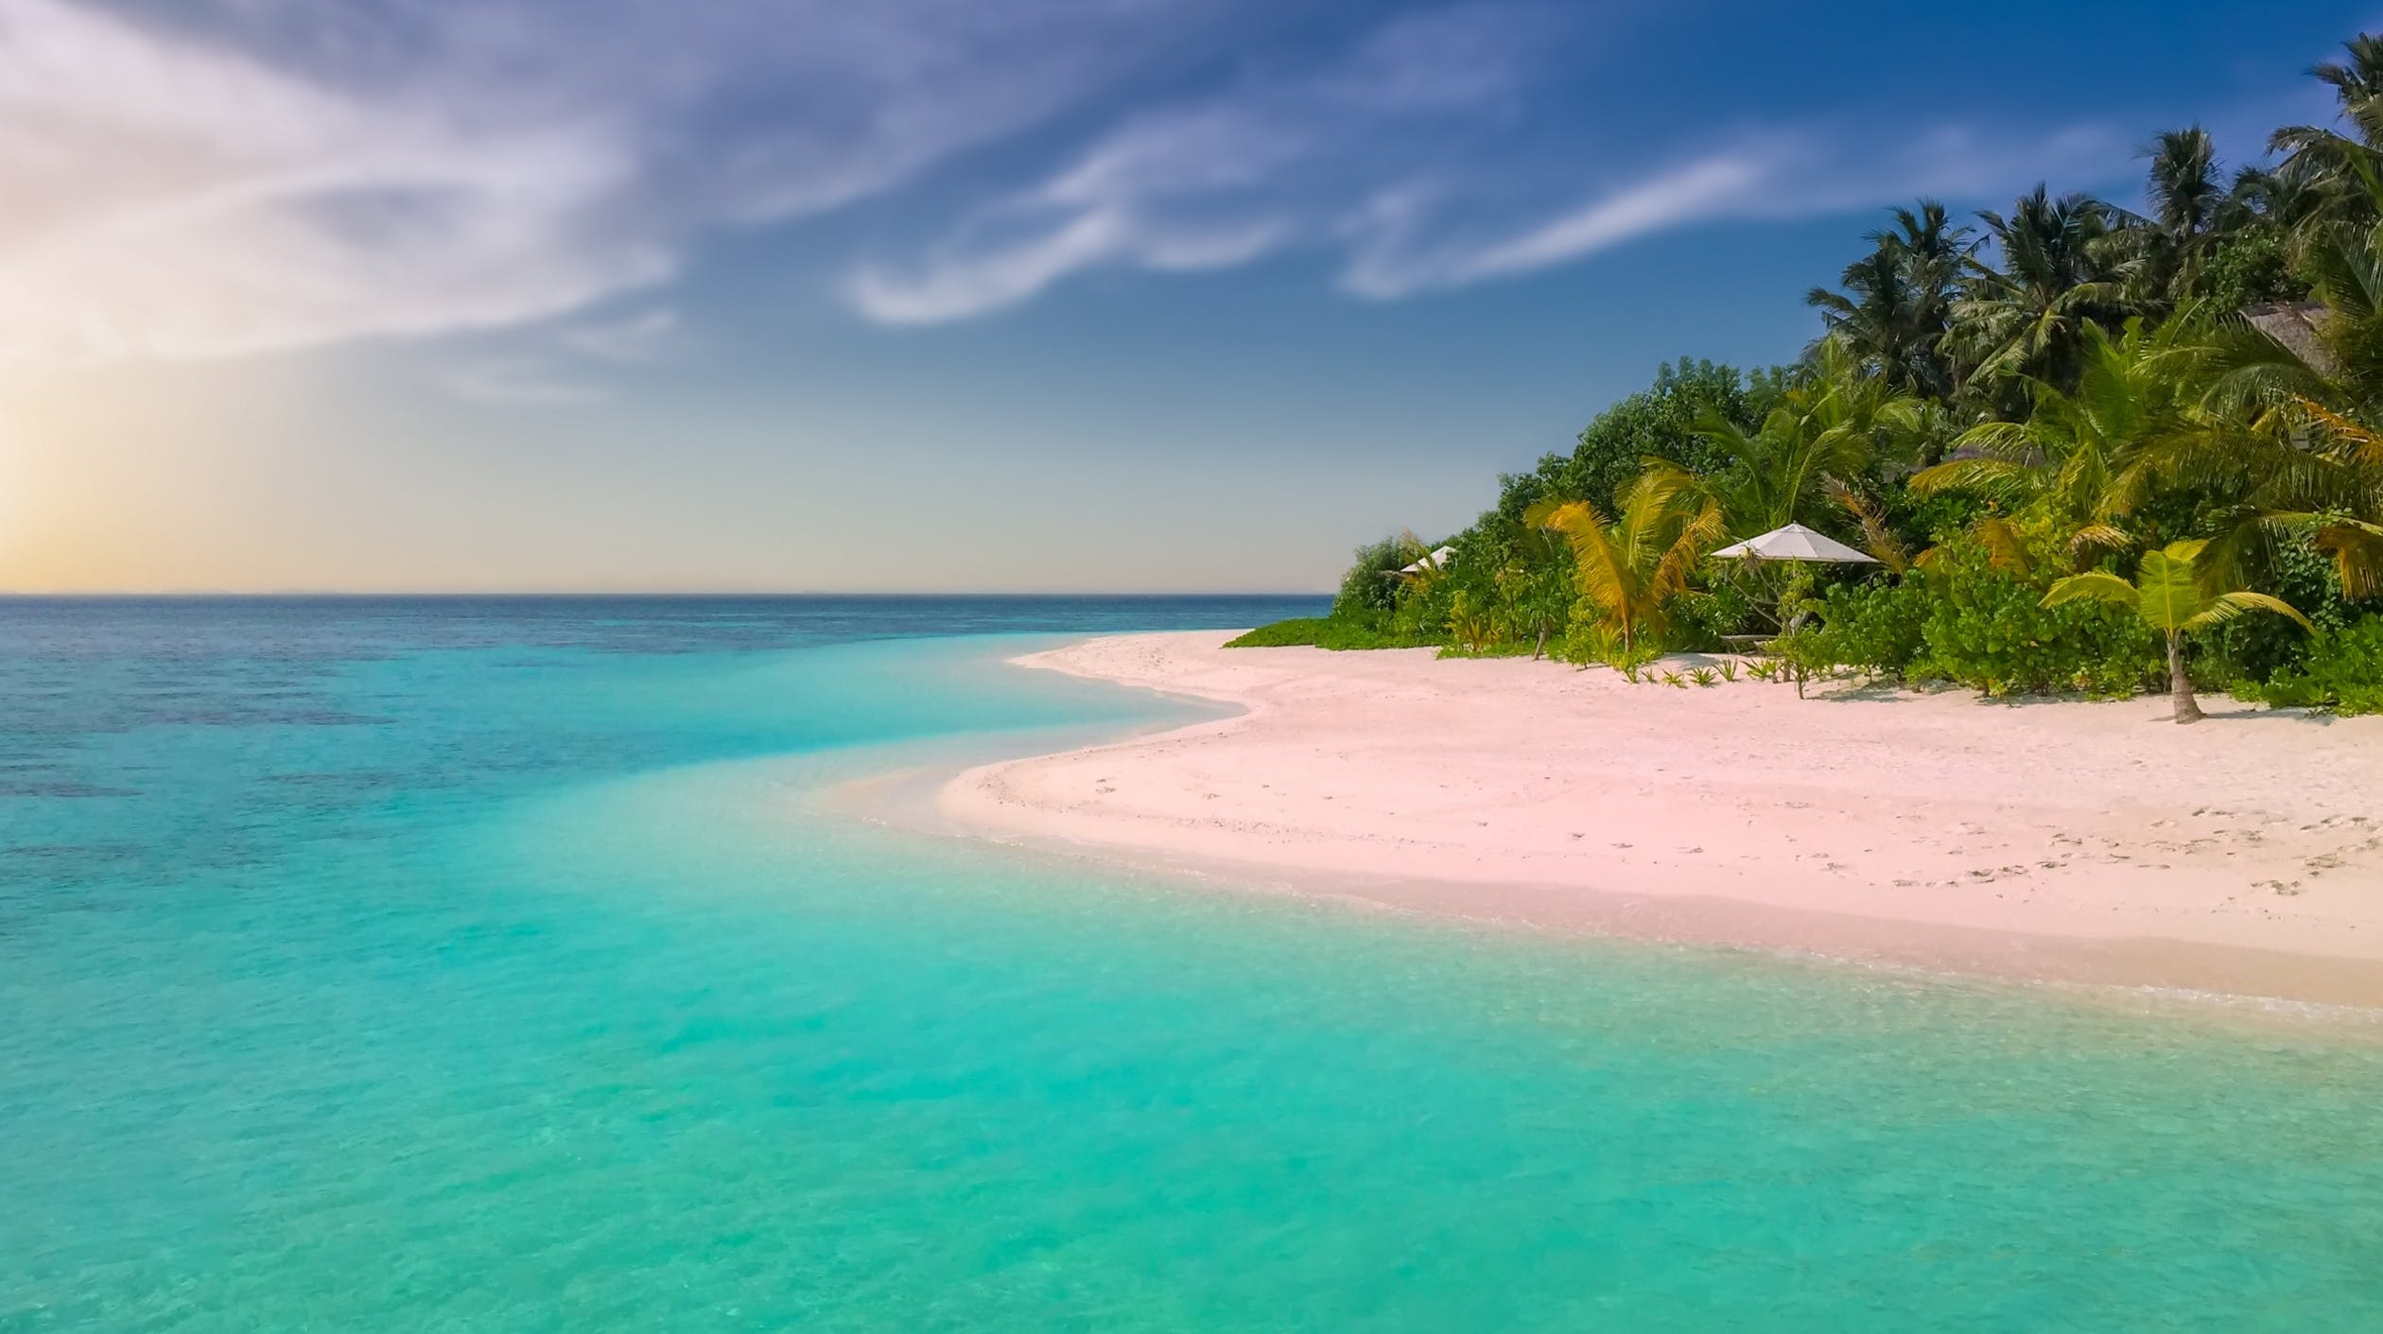
Hot Islands
Hot islands usually have hot, tropical climates. They often have white, sandy beaches and palm trees.

Slide 41
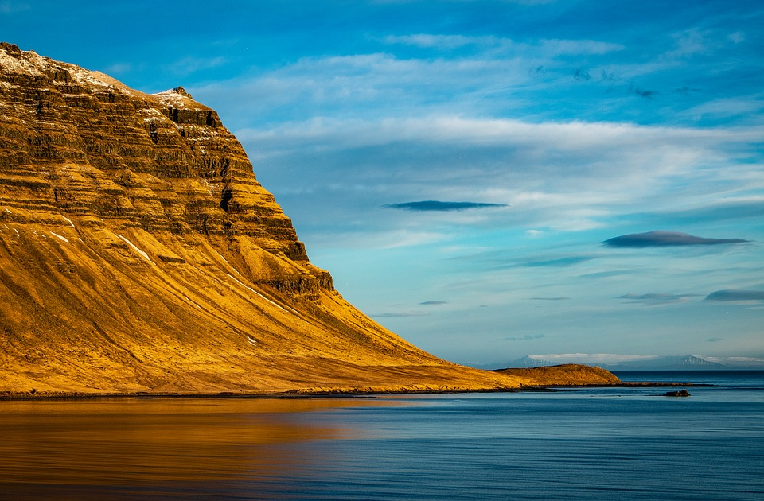
Cold Islands
Cold islands have a cold climate. One example is Iceland.

Slide 42
Book Task: Use the internet or an Atlas to find out the names of some of Britain’s islands.

Slide 43
Print this slide and complete the work sheet.
The answers are on the next slide!

Slide 44
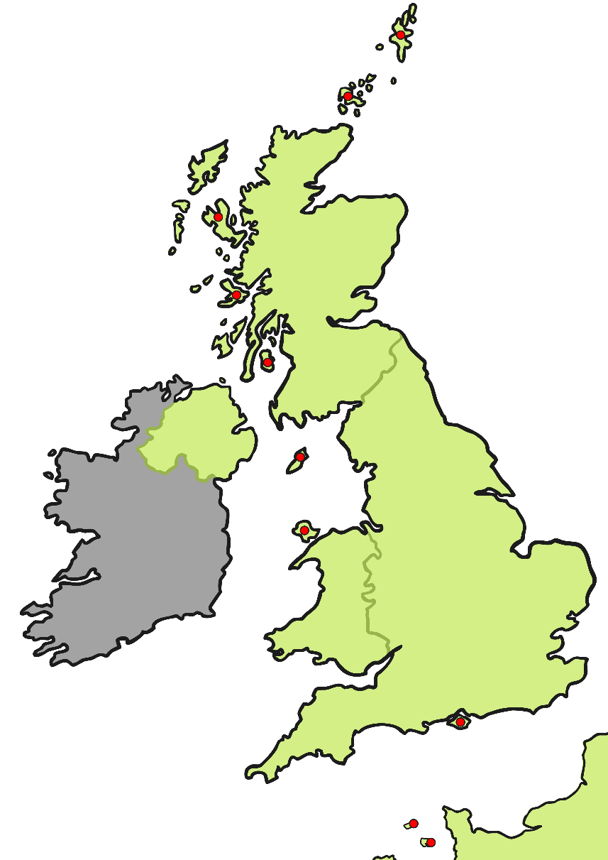
Answers!
Shetland
Skye
Orkney
Mull
Anglesey
Arran
Isle of Man
Isle of Wight
Jersey
Guernsey

Slide 45
Online Task:
Follow the links to find out more about life on two very different types of island.
https://www.bbc.co.uk/teach/class-clips-video/william-whiskerson-life-on-the-isles-of-scilly/zmmmhbk
https://www.bbc.co.uk/bitesize/topics/z3fycdm/articles/zk9cxyc

Slide 46
Answer the questions in your lined book!
How is living on a small island different from living on the mainland?
What are the benefits of living on a small island?
What might be more difficult on an island?
Why aren’t all islands inhabited?
What sort of things does an island need to have for people to live happily there?

Slide 47
Optional extra task
You could use junk modelling, paper mâché, paint, pencils or even materials found outside to make your island!
Design or make your own fantasy island!
Is it in a hot or cold climate?
Do lots or a few people live there?
What animals are found there?
Is it easily accessible or very remote?
How would you reach the island?

Slide 48
Form II Home Learning 26/03/2020
Well done! You finished today’s lessons!
I’m looking forward to seeing you all back at school soon!
Miss Ardley

