Slide 1
Form II Home Learning 30/03/2020
Today we are learning:
English
Maths
Science
Optional extras

Slide 2
Form II Home Learning Reminders
Don’t forget to read every day to an adult or sibling!
Practice your times tables every day!
Continue to practice your spellings!
Work through your maths bond and arithmetic books at your own pace.

Slide 3
Form II Useful Resources
https://www.bbc.co.uk/teach/supermovers Times tables, grammar and just for fun!
https://www.topmarks.co.uk/maths-games/7-11-years/ordering-and-sequencing-numbers Maths games
https://www.bbc.co.uk/teach/ks2-english/zbrwnrd English additional resources
https://www.bbc.co.uk/teach/ks2-maths/zm9my9q Maths additional resources
https://swiggle.org.uk/ Child safe search engine
https://www.twinkl.co.uk/go/lessons/view/arithmagic Arithmagic game. Code: TA5810

Slide 4
English LO: To explore how characters are described in stories

Slide 5
English LO: To explore how characters are described in stories Write the date and learning objective in your lined book now!

Slide 6
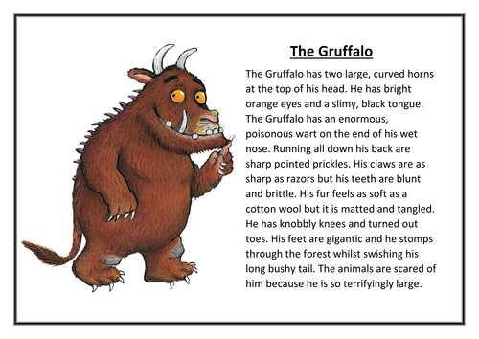
Have a look at this description of the Gruffalo.
Do you think it is a boring or interesting description?
Can you spot any adjectives?
Which to you think are the best describing words or phrases?

Slide 7
This description tells us lots about the character!
It tells us about colours, shape, texture and movement.
Sometimes there is more than one adjective used to describe a part of the Gruffalo.
Running down his back are sharp, pointed prickles.

Slide 8
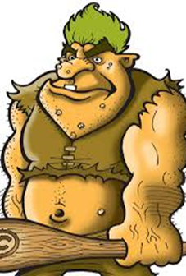
Book Task
Here is a different character. Can you write some sentences to describe them?
Remember to include colours, shape, texture and movement.
Can you describe different parts of the character using more than one adjective?

Slide 9
Read this description – could you improve yours now you have compared?
Deep inside the darkest cave lived a hideous creature known as Dink. Covered from head to toe in grotesque white pimples and crusty mud soaked skin, you can smell Dink before you can EVEN see him. On the very top of his head lives a family of lice that play all day in his bright green, unwashed hair. His enormous muscles escape from his tiny clothes which are soaked in sweat. Not only is Dink disgusting he also has a terrible attitude.

Slide 10
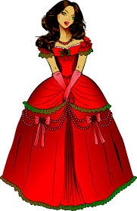
Book Task
Here is a different character. Can you write some sentences to describe them?
Remember to include colours, shape, texture and movement.
Can you describe different parts of the character using more than one adjective?

Slide 11
Read this description – could you improve yours now you have compared?
On the very top of a magical mountain lived an enchanting and beautiful princess called Annabella. Her auburn hair was thick, shiny and glossy and tumbled down her shoulders in waves. She wore a crimson dress that glistened in the light and long, silk, pink gloves on her tiny hands. Annabella was quite a shy girl that blushed when talking.

Slide 12
Optional extra tasks
Look at some of your home reading books. Can you find any super sentences used to describe characters?
Choose a character from your favourite story. Describe the character to someone in your family. See if they can guess who you are describing!

Slide 13
English LO: To explore how characters are described in stories How did you find this lesson? Colour a small traffic light at the end of your work. Red = I didn’t understand Yellow = I need a bit more practice Green = Got it!

Slide 14
Maths LO: To recognise and name 3D shapes

Slide 15
Maths LO: To recognise and name 3D shapes Write the date and learning objective in your squared book now!

Slide 16
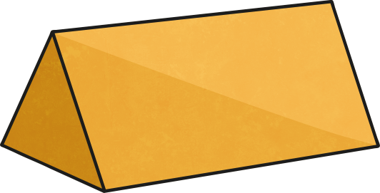
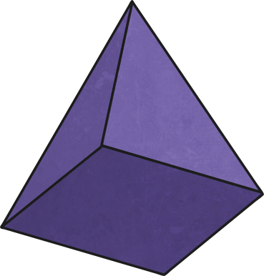
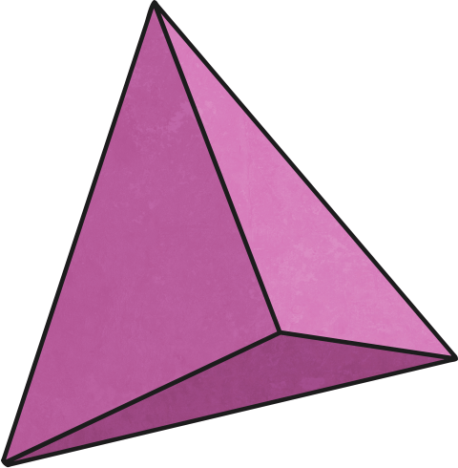
Can you name these shapes?

Slide 17
Can you name these shapes?
Cylinder
Cube
Cone
Sphere
Cuboid
Square based pyramid
Triangular Prism
Triangular based pyramid

Slide 18
Let’s recap!
Faces are the flat surfaces on a 3D shape.
Edges are where the faces meet eachother.
Vertices are the pointy bits!

Slide 19
Can you find any of these 3D shapes in your home?

Slide 20
How many faces does this shape have?
How many faces does this shape have?
How many faces does this shape have?

Slide 21
How many faces does this shape have? 6
How many faces does this shape have? 1
How many faces does this shape have? 5

Slide 22
How many edges does this shape have?
How many edges does this shape have?
How many edges does this shape have?

Slide 23
How many edges does this shape have? 2
How many edges does this shape have? 0
How many edges does this shape have? 9

Slide 24
How many vertices does this shape have?
How many vertices does this shape have?
How many vertices does this shape have?

Slide 25
How many vertices does this shape have? 0
How many vertices does this shape have? 8
How many vertices does this shape have? 1

Slide 26
Book Task
Print the next slide.
Complete the table and stick it in your squared book, underneath the date and learning objective!

Slide 28
Optional extra task
Print and complete the 3D shapes colouring challenges on the next three slides!

Slide 32
Maths LO: To recognise and name 3D shapes How did you find this lesson? Colour a small traffic light at the end of your work. Red = I didn’t understand Yellow = I need a bit more practice Green = Got it!

Slide 33
Science LO: To explore food chains

Slide 34
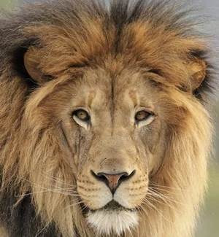
What is a food chain?
A food chain shows us “what eats what” in the animal kingdom!
All animals get their energy from eating plants, other animals or both.

Slide 35
What is a food chain?
At the bottom of the food chain are the plants. They are known as the producers

Slide 36
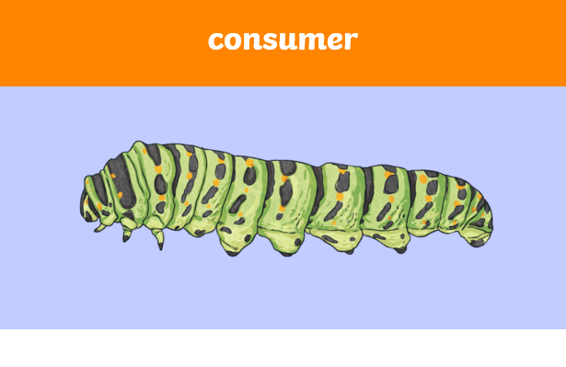
What is a food chain?
The next animals in the food chain are called the consumers.

Slide 37
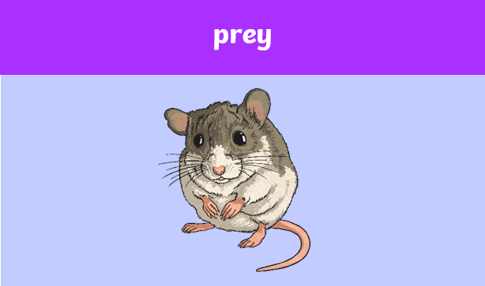
What is a food chain?
Animals that are then eaten by other animals are called Prey.

Slide 38
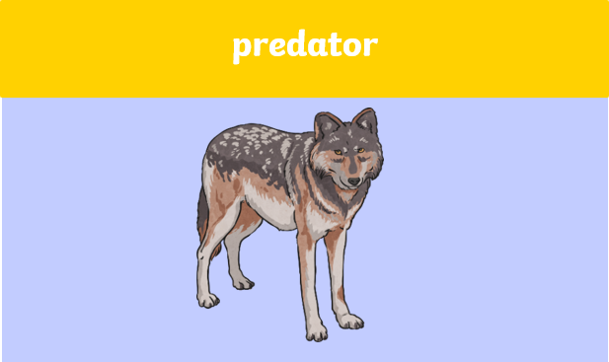
What is a food chain?
Animals that eat other animals are at the top of the food chain. They are called predators.

Slide 39
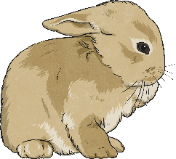
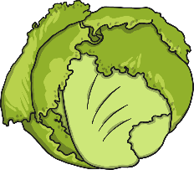
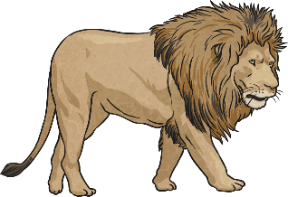
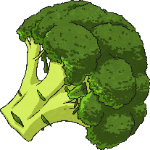
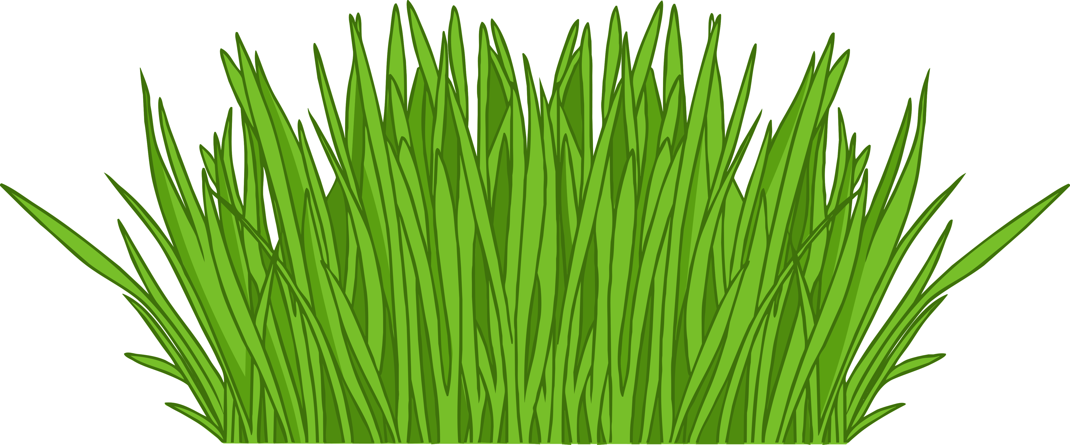
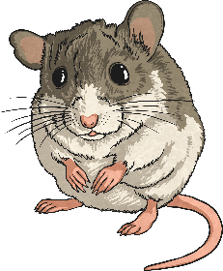
Consumers or Producer?
Producers are plants that make their own food.
Consumers are animals that eat food.
Which are consumers and which are producers?
rabbit
lettuce
lion
broccoli
grass
mouse

Slide 40
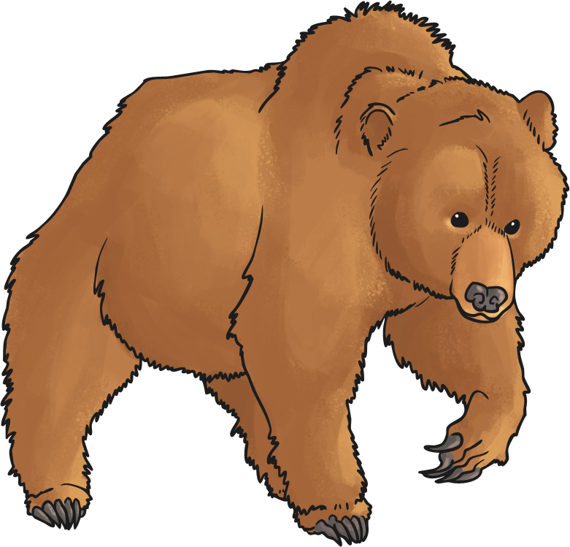
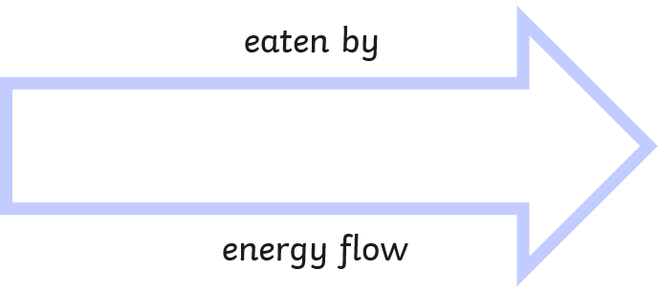
Food chains use arrows to show how the energy from food moves from one living thing to the next:

Slide 41
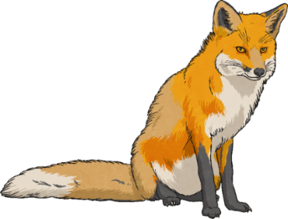
What is wrong with this food chain?

Slide 42
The arrow is pointing the wrong way!

Slide 43
That’s better!

Slide 44
Book Task: Print the next slides. Use the photos and arrows to make as many food chains as you can. Stick some examples into your lined book. Don’t forget the date and learning objective!

Slide 45
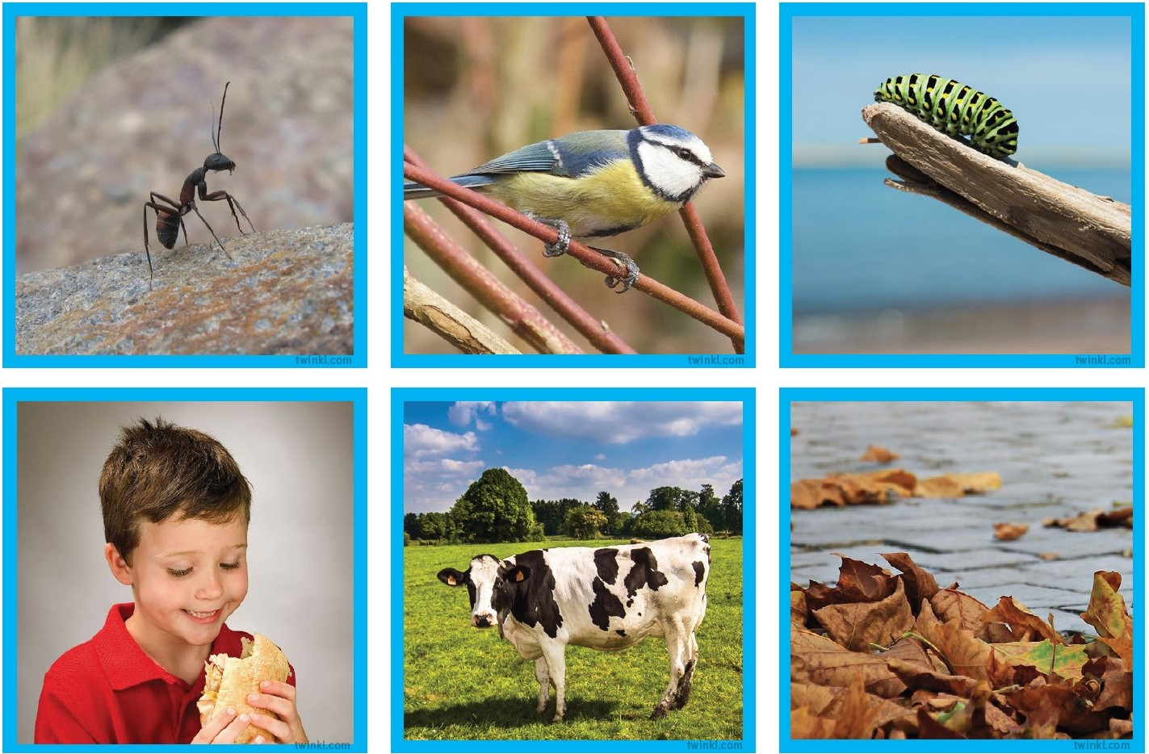

Slide 46
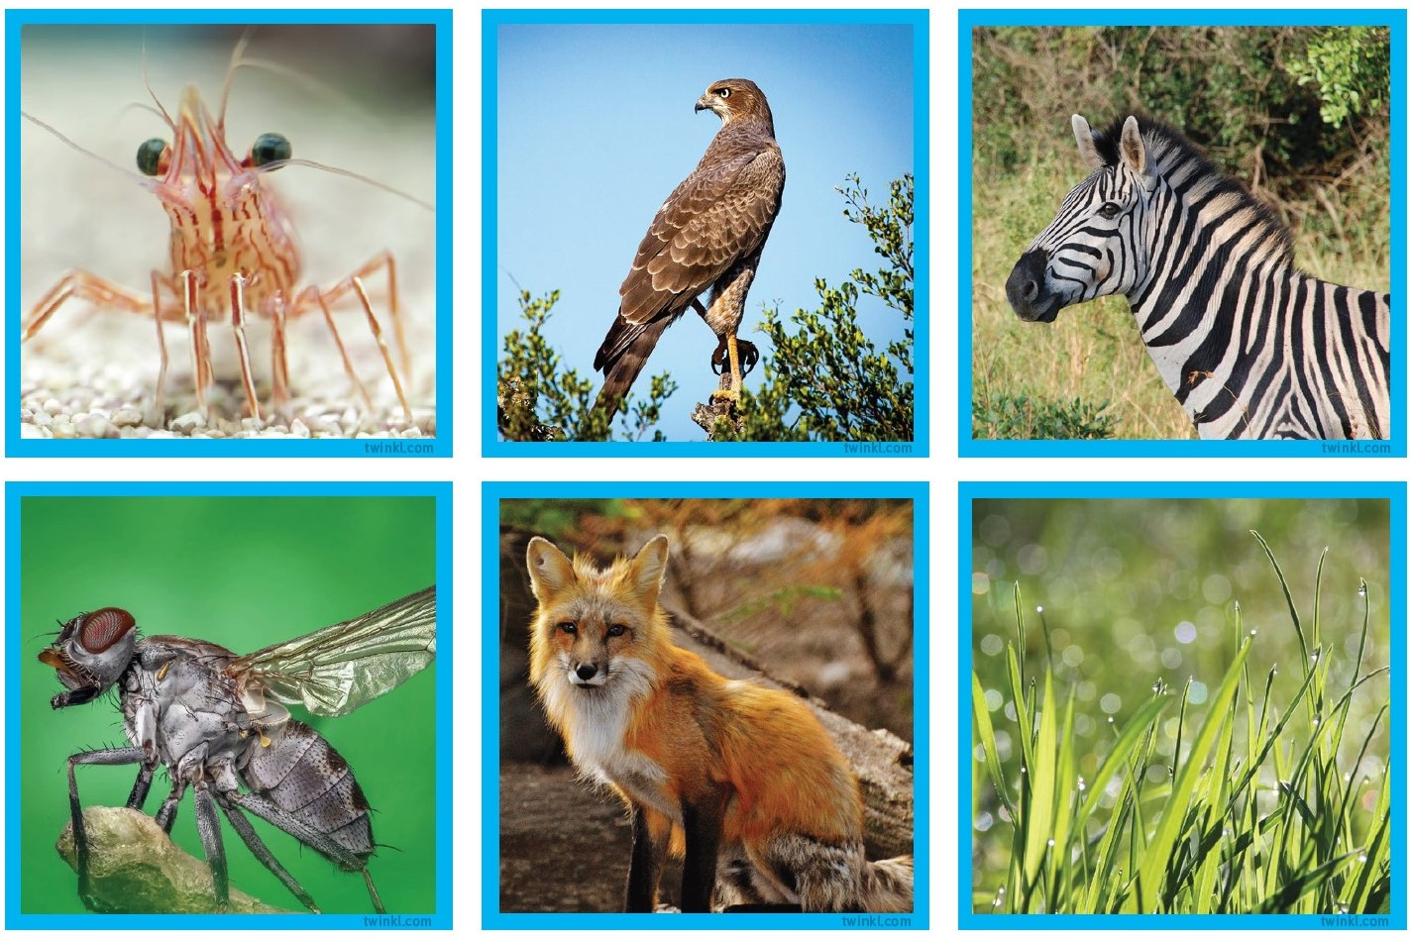

Slide 47
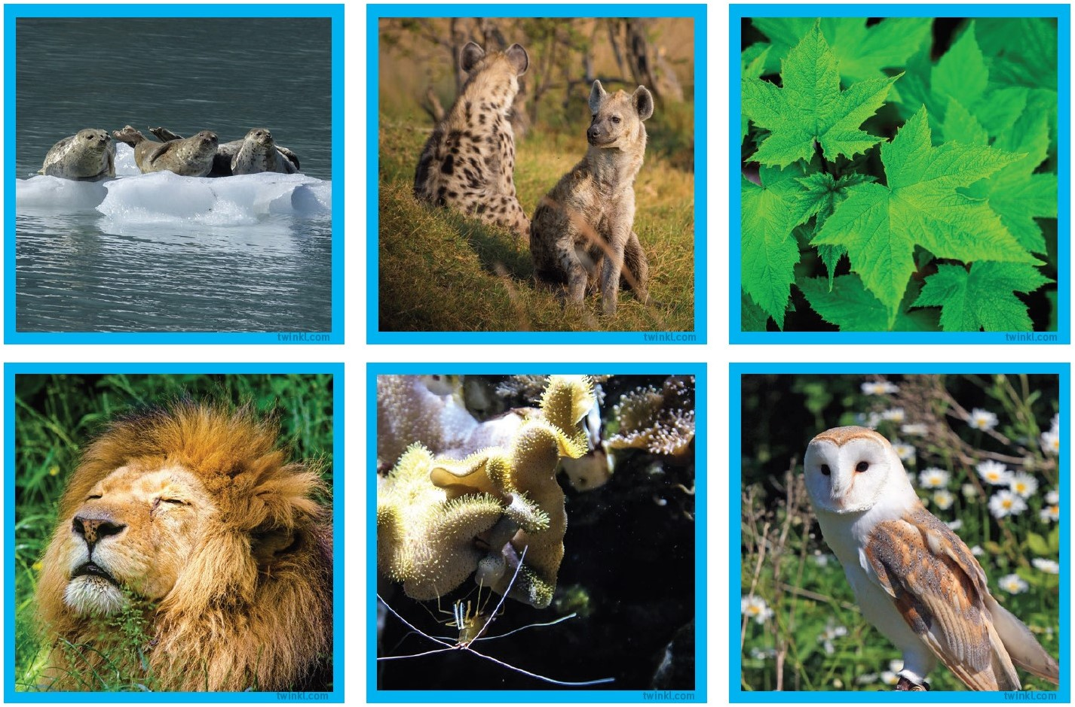

Slide 48
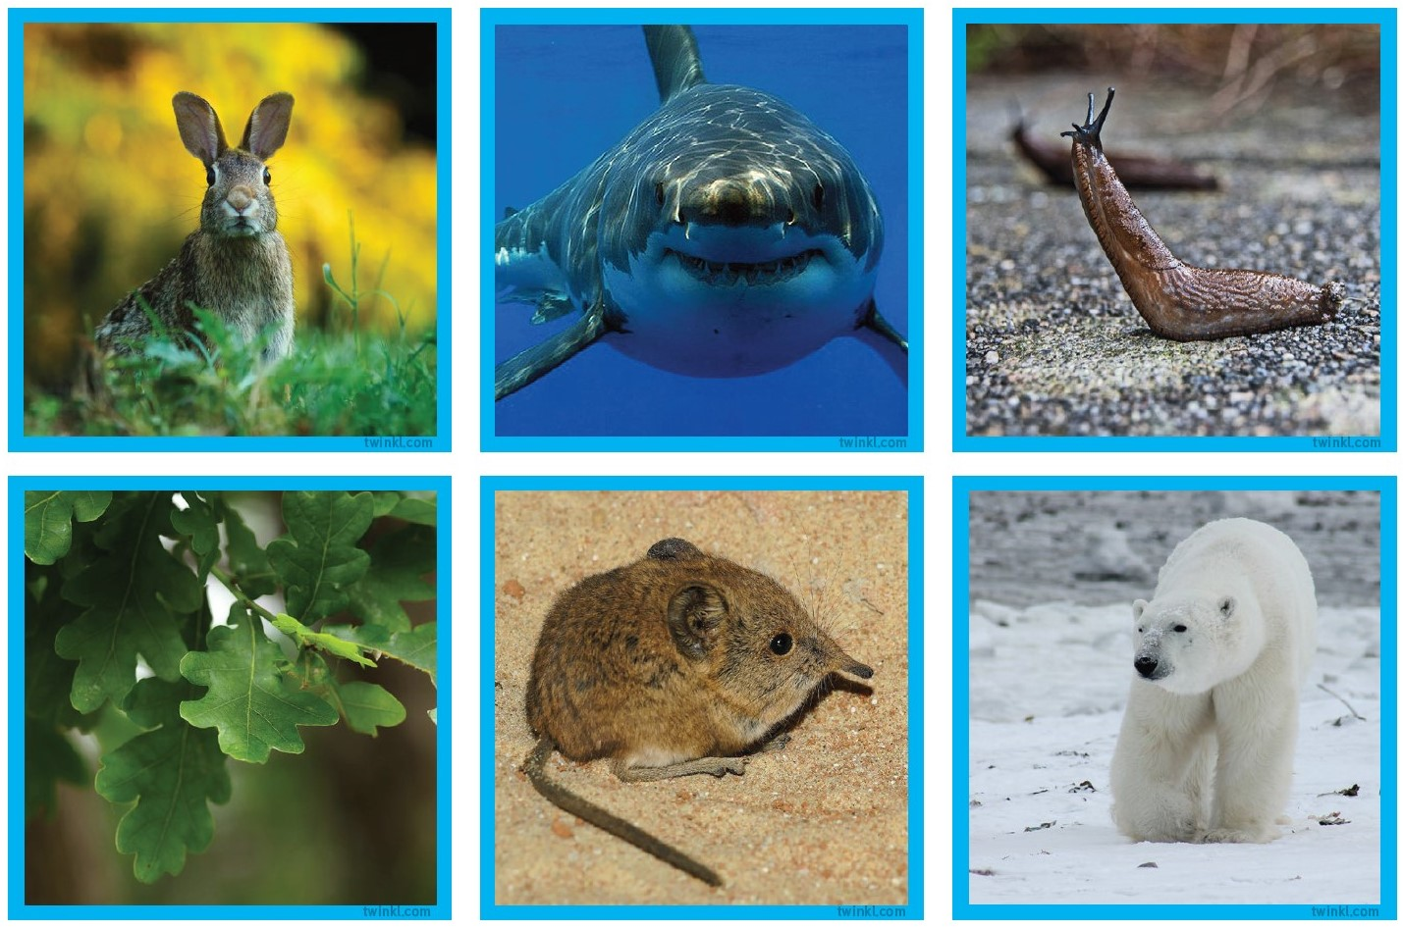

Slide 49
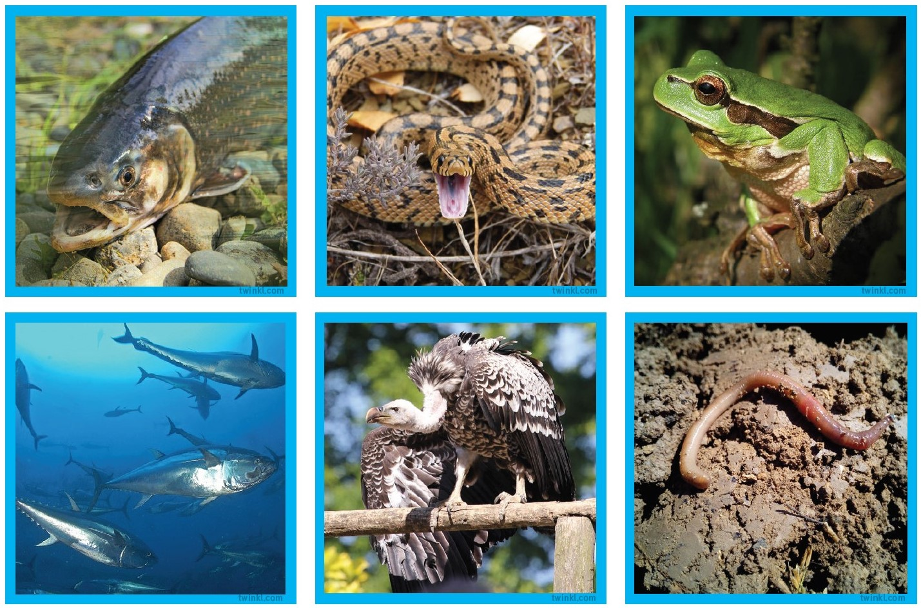

Slide 50
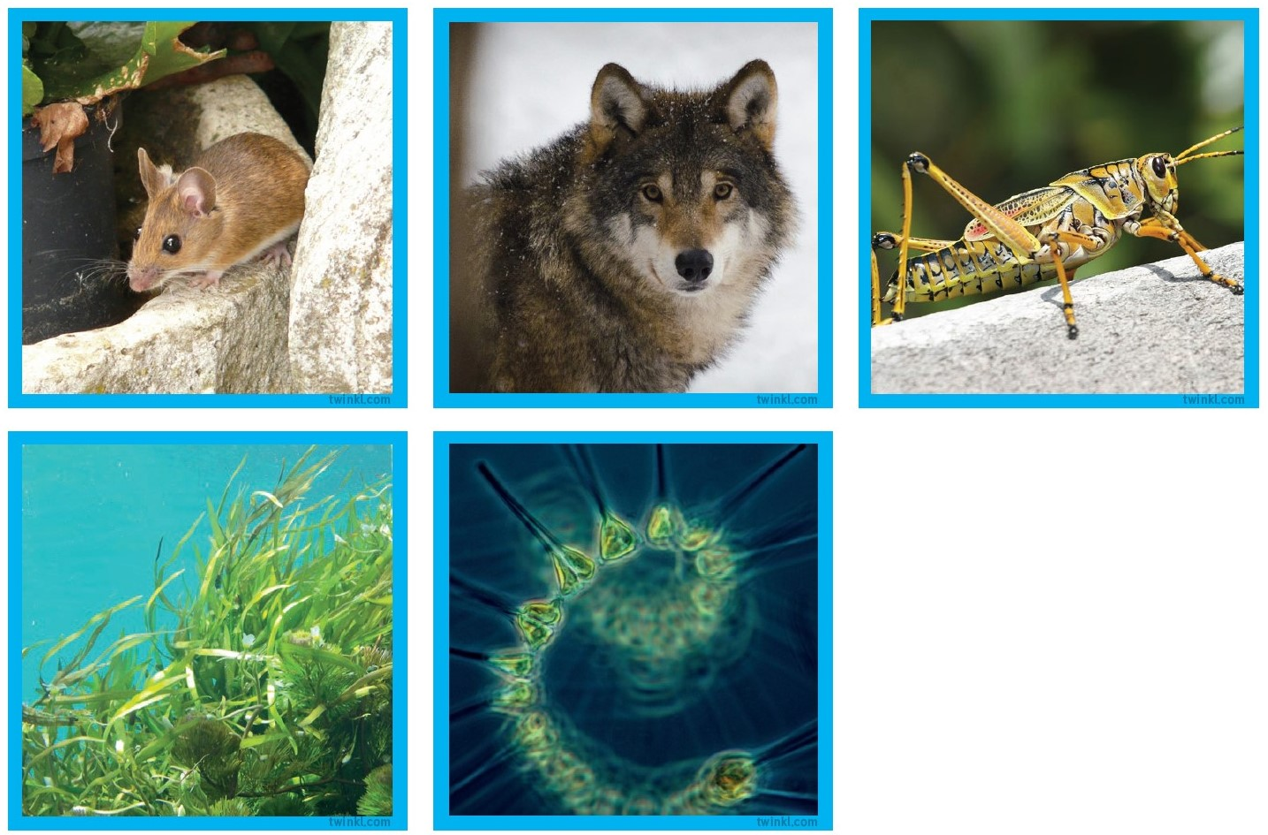

Slide 52
Food chain challenge!
What is the longest food chain you can make?

Slide 53
Form II Home Learning 30/03/2020
Well done! You finished today’s lessons!
I’m looking forward to seeing you all back at school soon!
Miss Ardley

