Slide 1
Form II Home Learning 31/03/2020
Today we are learning:
English
Maths
History
Optional extras

Slide 2
Form II Home Learning Reminders
Don’t forget to read every day to an adult or sibling!
Practice your times tables every day!
Continue to practice your spellings!
Work through your maths bond and arithmetic books at your own pace.

Slide 3
Form II Useful Resources
https://www.bbc.co.uk/teach/supermovers Times tables, grammar and just for fun!
https://www.topmarks.co.uk/maths-games/7-11-years/ordering-and-sequencing-numbers Maths games
https://www.bbc.co.uk/teach/ks2-english/zbrwnrd English additional resources
https://www.bbc.co.uk/teach/ks2-maths/zm9my9q Maths additional resources
https://swiggle.org.uk/ Child safe search engine
https://www.twinkl.co.uk/go/lessons/view/arithmagic Arithmagic game. Code: TA5810

Slide 4
English LO: To find synonyms for boring adjectives

Slide 5
English LO: To find synonyms for boring adjectives Write the date and learning objective in your lined book now!

Slide 6
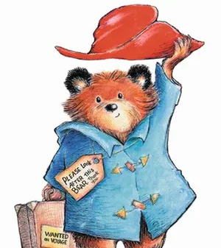
Have a look at this character. How could we describe them?

Slide 7
Red hat
Soft fur
Blue coat
Happy face
Friendly smile
Old suitcase

Slide 8
Red hat
Soft fur
Blue coat
Happy face
Friendly smile
Old suitcase
These are simple adjectives, but they might not be the best adjectives we could choose.
Can you think of any better or more interesting adjectives?

Slide 9
Red hat
Soft fur
Blue coat
Happy face
Friendly smile
Old suitcase
Crimson hat
Velvety fur
Sapphire coat
Cheerful face
Welcoming smile
Old-fashioned suitcase
Words that have a similar meaning to each other are called synonyms. We have found some synonyms for these adjectives!

Slide 10
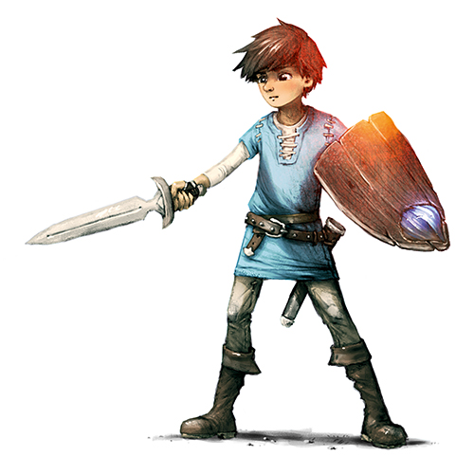
How many synonyms can you find for these adjectives?
Hard shield
Messy hair
Sharp sword

Slide 11
How many synonyms can you find for these adjectives?
Hard
Solid
Unbreakable
Tough
Durable

Slide 12
How many synonyms can you find for these adjectives?
Messy
Untidy
Scruffy
Unkempt

Slide 13
How many synonyms can you find for these adjectives?
Sharp
Pointed
Razor-sharp
Jagged

Slide 14
Book Task:
Print the following pictures of characters.
Label the pictures like the example shown.
Try to find the most interesting adjectives you can!
Use a thesaurus to find synonyms!

Slide 17
Optional extra tasks
Make your own thesaurus!
Find as many synonyms as you can for these overused words:
Went
Said
Big
Then

Slide 18
English LO: To find synonyms for boring adjectives How did you find this lesson? Colour a small traffic light at the end of your work. Red = I didn’t understand Yellow = I need a bit more practice Green = Got it!

Slide 19
Maths LO: To solve shape problems

Slide 20
Maths LO: To solve shape problems Write the date and learning objective in your squared book now!

Slide 21
Recap! Can you name these shapes?

Slide 22
Can you name these shapes?
Cylinder
Cube
Cone
Sphere
Cuboid
Square based pyramid
Triangular Prism
Triangular based pyramid

Slide 23
Let’s recap!
Faces are the flat surfaces on a 3D shape.
Edges are where the faces meet eachother.
Vertices are the pointy bits!

Slide 24
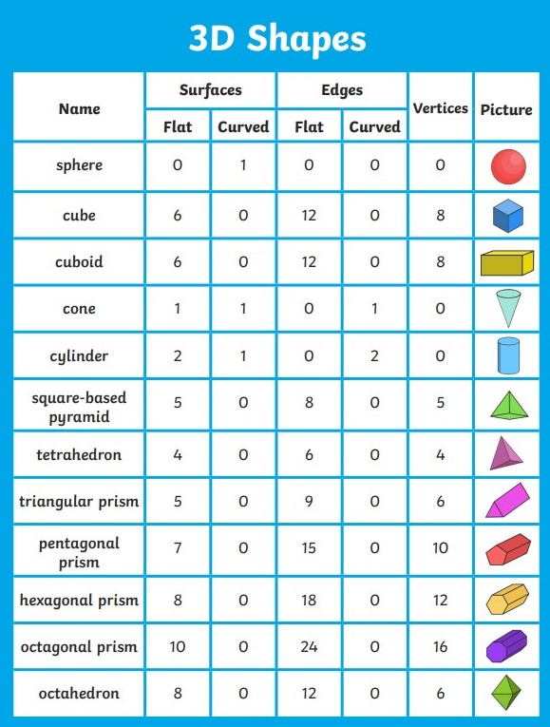
This will help us later!

Slide 25
Book Task
Can you solve the shape riddles ?
You could print the riddles and stick them in your squared book or copy them instead!

Slide 26
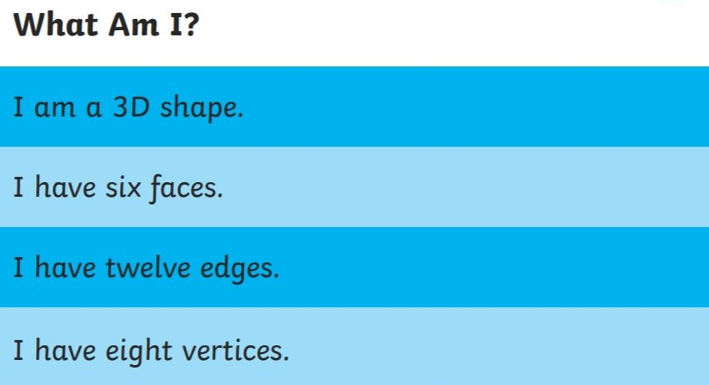
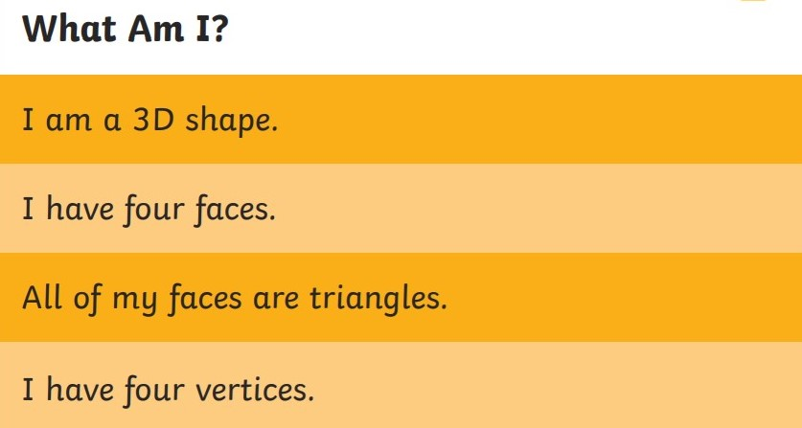
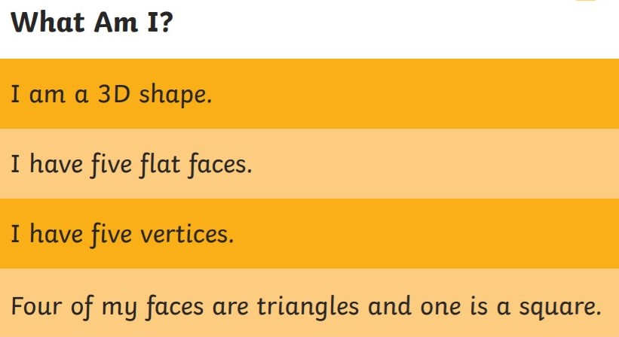
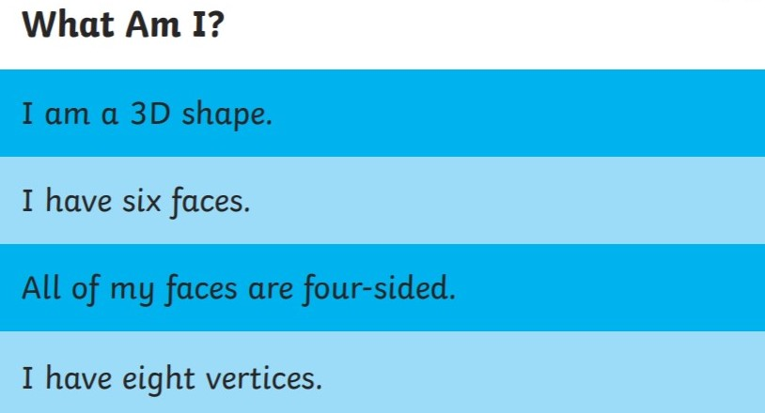
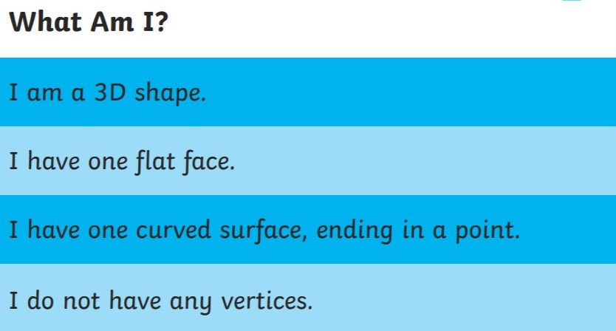
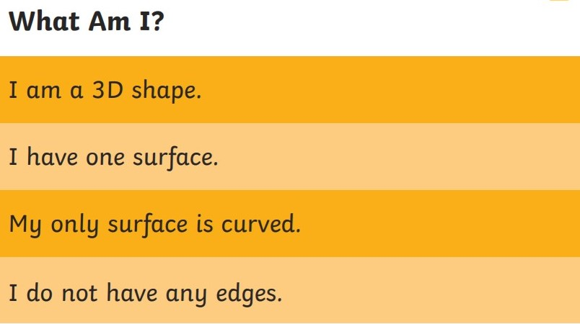

Slide 27
Have a look if you are stuck!

Slide 28
Answers!
Cube or Cuboid
Triangular based pyramid
Square based pyramid
Cube or Cuboid
Cone
Sphere

Slide 29
Optional extra task
Write some of your own shape riddles for someone else to solve!

Slide 30
Maths LO: To solve 3D shape problems How did you find this lesson? Colour a small traffic light at the end of your work. Red = I didn’t understand Yellow = I need a bit more practice Green = Got it!

Slide 31
History LO: To find out what Roman homes were like

Slide 32
Online Task:
Follow the links to watch the video clips about Roman Towns and Roman Villas!
https://www.bbc.co.uk/bitesize/clips/z7k8q6f
https://www.bbc.co.uk/bitesize/clips/zq49wmn

Slide 33
Roman Houses
The Romans built lots of cities that were well fortified with city walls. They also introduced lots of luxuries into civilisation, such as public baths, roads and even plumbing!
As a Roman, the type of house you would live in would depend on whether you were rich or poor and whether you lived in the town or the country.

Slide 34
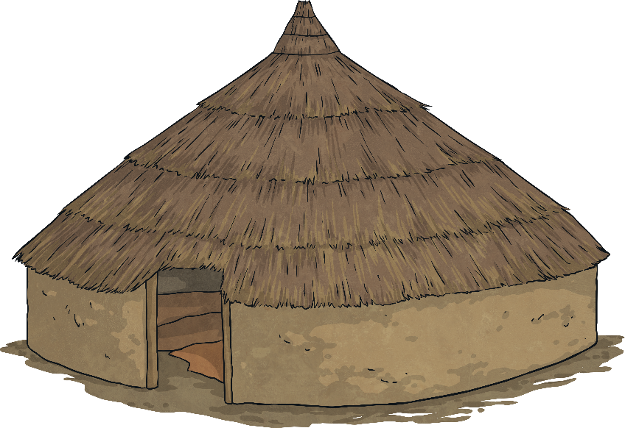
Wooden Huts
Poor Romans in the countryside lived in small villages of wooden huts with thatched roofs.
Each hut would be very small, usually only having one room with a fire in the centre. This fire would be used for light, heat and for cooking. The floor would have been covered with animal skins and there would be simple furniture, such as benches for beds.

Slide 35
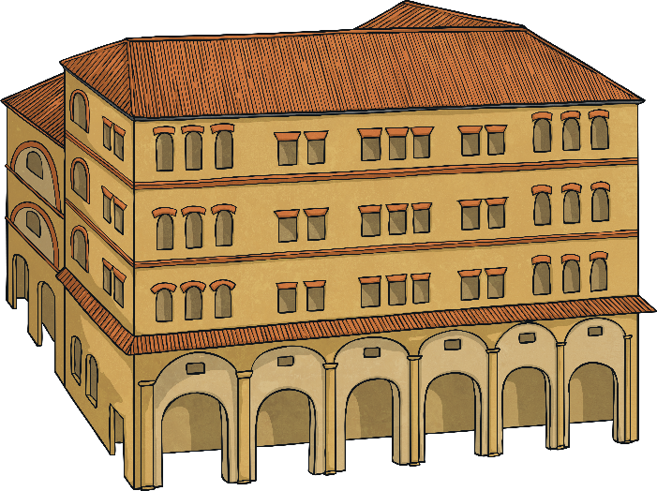
Insulae
Poor Romans in towns and cities lived in Insulae.
These were like apartment blocks built of wood, mud bricks and, later on, concrete.
They were usually six to eight three-storey buildings grouped around a central courtyard.
They were very poorly built, often dirty and noisy; however, they did have running water!

Slide 36
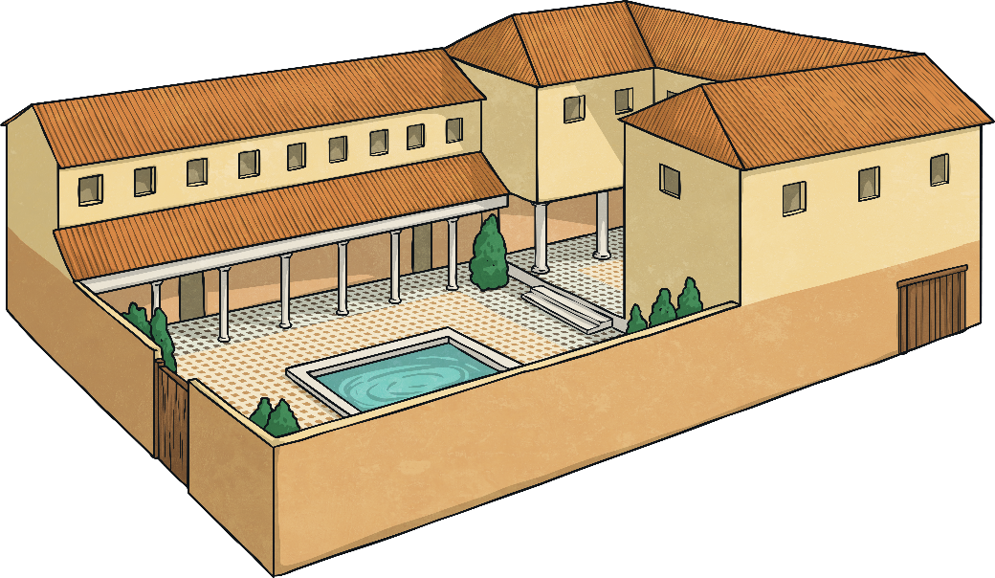
Domus
A domus was a type of house in the city in which a rich Roman would have lived.
A domus was a very grand single-storey building, often with marble pillars, statues and mosaics on walls and floors.
They would have had multiple rooms, including bedrooms, a dining room, kitchen, courtyards, gardens and places to relax and entertain guests.

Slide 37
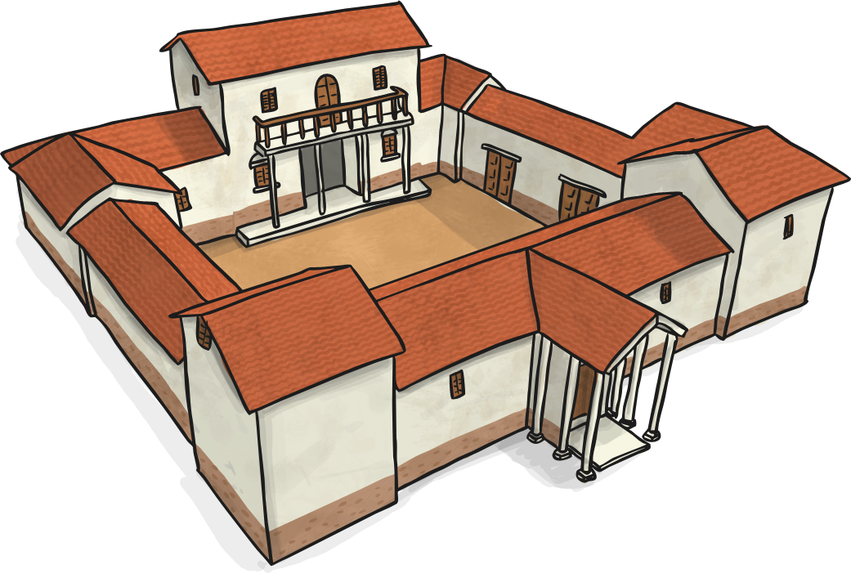
Villa
A Roman villa was a luxurious estate for rich Romans in the countryside.
They were much larger and more comfortable than a domus and had even more rooms, including servants quarters and exercise rooms.
Some villas even had underfloor heating! A hypocaust was a system which pumped hot air from a fire around a system of tunnels underneath the villa’s main floor.

Slide 38
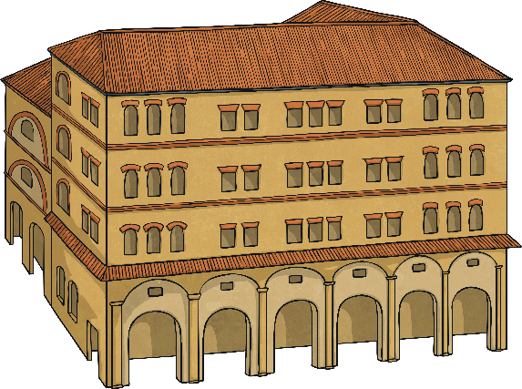
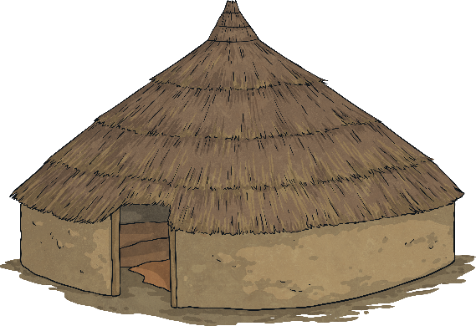
Roman Houses
Which type of Roman house would you have liked to have lived in?
Why?

Slide 39
House for Sale!
Make a poster advertising a Roman Villa for sale.
You can use the template to give you some ideas, but you could make yours however you like!

Slide 41
Form II Home Learning 31/03/2020
Well done! You finished today’s lessons!
I’m looking forward to seeing you all back at school soon!
Miss Ardley

