Slide 1
Form II Home Learning 03/04/2020
Today we are learning:
English
Maths
RE
Optional extras

Slide 2
Form II Home Learning Reminders
Don’t forget to read every day to an adult or sibling!
Practice your times tables every day!
Continue to practice your spellings!
Work through your maths bond and arithmetic books at your own pace.

Slide 3
Form II Useful Resources
https://www.bbc.co.uk/teach/supermovers Times tables, grammar and just for fun!
https://www.topmarks.co.uk/maths-games/7-11-years/ordering-and-sequencing-numbers Maths games
https://www.bbc.co.uk/teach/ks2-english/zbrwnrd English additional resources
https://www.bbc.co.uk/teach/ks2-maths/zm9my9q Maths additional resources
https://swiggle.org.uk/ Child safe search engine
https://www.twinkl.co.uk/go/lessons/view/arithmagic Arithmagic game. Code: TA5810

Slide 4
English LO: To answer questions about a text

Slide 5
English LO: To answer questions about a text Write the date and learning objective in your lined book now!

Slide 6
This text is part of the Easter story told from the point of view of Peter, one of Jesus’ disciples.
You might find it useful to complete today’s RE lesson about Easter before completing this reading comprehension!

Slide 7
Read the text carefully.
Answer the questions in your lined book.
You can go back and read the text as many times as you need to!
Don’t forget the date and Learning Objective!
Don’t forget to answer in full sentences and check that they make sense!
The answers are on the slides after the questions for you to check your work afterwards!

Slide 11
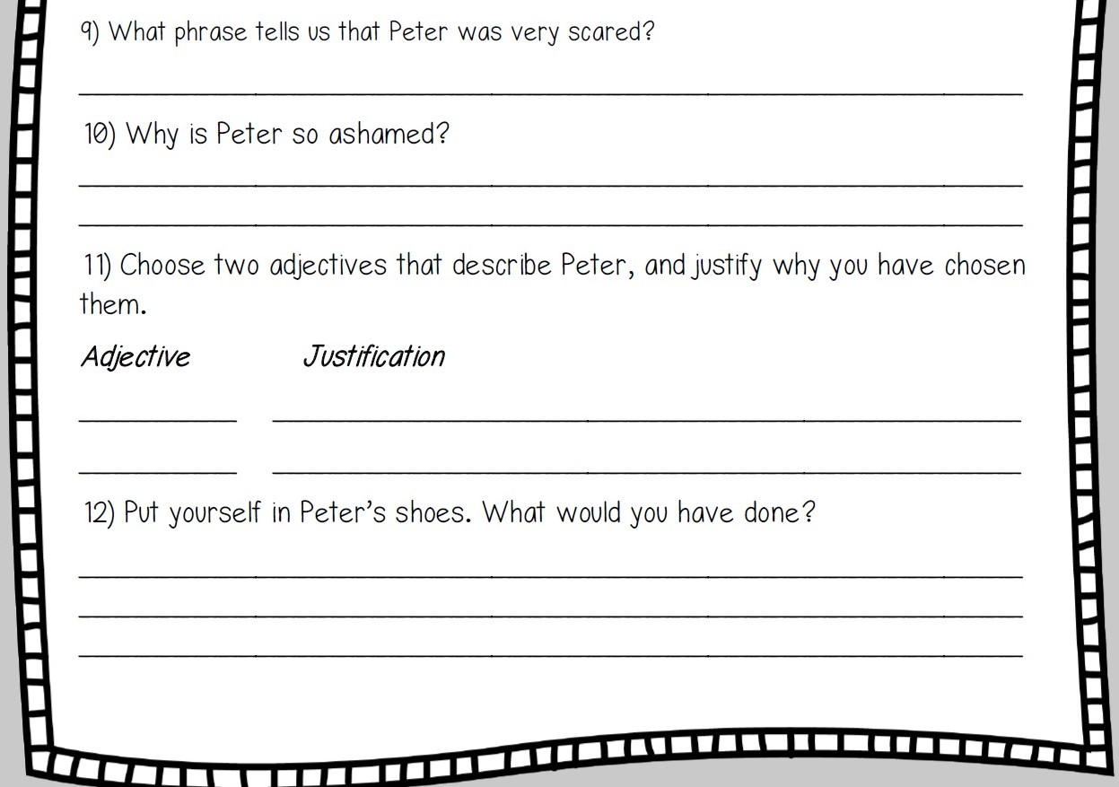

Slide 14
English LO: To answer questions about a text How did you find this lesson? Colour a small traffic light at the end of your work. Red = I didn’t understand Yellow = I need a bit more practice Green = Got it!

Slide 15
Maths LO: To explore rotational symmetry

Slide 16
Maths LO: To explore rotational symmetry Write the date and learning objective in your squared book now!

Slide 17
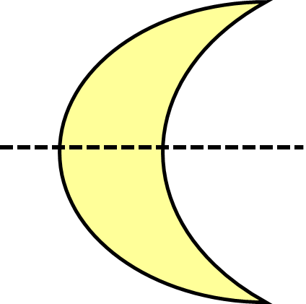
Let’s recap! Reflection symmetry is where one half of the image is the reflection of the other half. You could fold the image and have both halves match exactly.

Slide 18
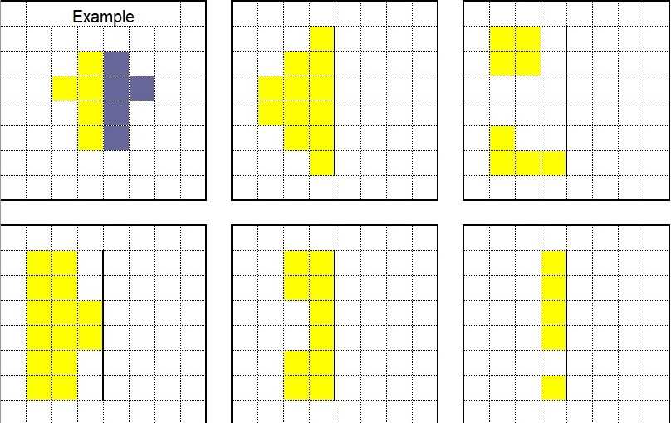
Let’s recap!
How did you find yesterdays task?
We completed the symmetrical images by counting the squares away from the mirror line.

Slide 19
Rotational Symmetry

Slide 20
What is Rotational Symmetry?
A shape has rotational symmetry if it looks the same after being rotated.
The amount of times you can rotate it onto itself before you get back to the start is call the order of rotational symmetry.

Slide 21
1
Order of rotational symmetry:
Half turn

Slide 22
2
Order of rotational symmetry:
The shape looks the same!

Slide 23
1
Order of rotational symmetry:
Quarter turn

Slide 24
2
Order of rotational symmetry:
Quarter turn

Slide 25
3
Order of rotational symmetry:
Quarter turn

Slide 26
4
Order of rotational symmetry:
Quarter turn

Slide 27
1
Order of rotational symmetry:
Only 1 full turn makes this shape look the same!

Slide 28
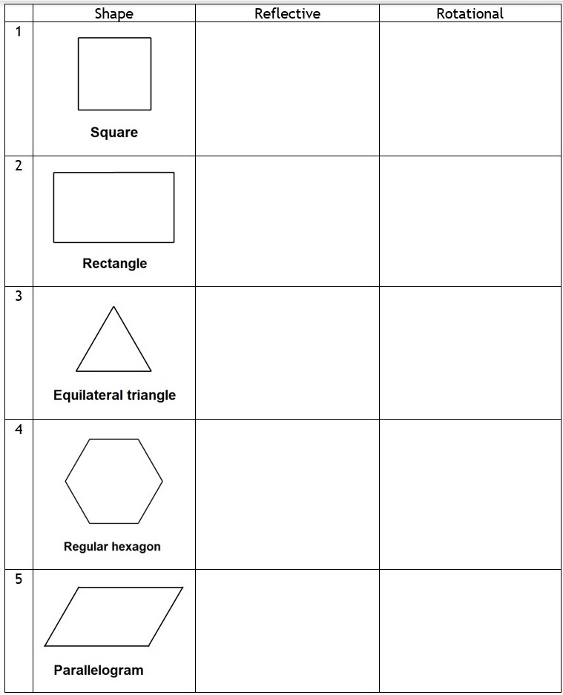
Use your knowledge of reflective and rotational symmetry to complete this table! You could copy and complete into your squared book, or print and stick it in.
To help you find the order of rotational symmetry:
Print and cut out the shapes.
Draw a dot in one corner of each shape.
Draw around the shape onto a piece of paper.
How many times can you turn the shape inside the lines until the dot gets back to where it started?
That it the order of rotational symmetry!

Slide 29
Use your knowledge of reflective and rotational symmetry to complete this table! You could copy and complete into your squared book, or print and stick it in.
To help you find how many lines of reflective symmetry:
Cut out the shapes.
Draw a line with a ruler onto the shape.
Fold the shape along the line.
Does one side fit exactly on top of the other?
If it does, that is a line of symmetry!

Slide 31
Maths LO: To explore rotational symmetry How did you find this lesson? Colour a small traffic light at the end of your work. Red = I didn’t understand Yellow = I need a bit more practice Green = Got it!

Slide 32
Religious Education LO: To understand why Christians celebrate Easter Write the date and learning objective in your lined book now!

Slide 33
Read the following Story of Easter

Slide 34
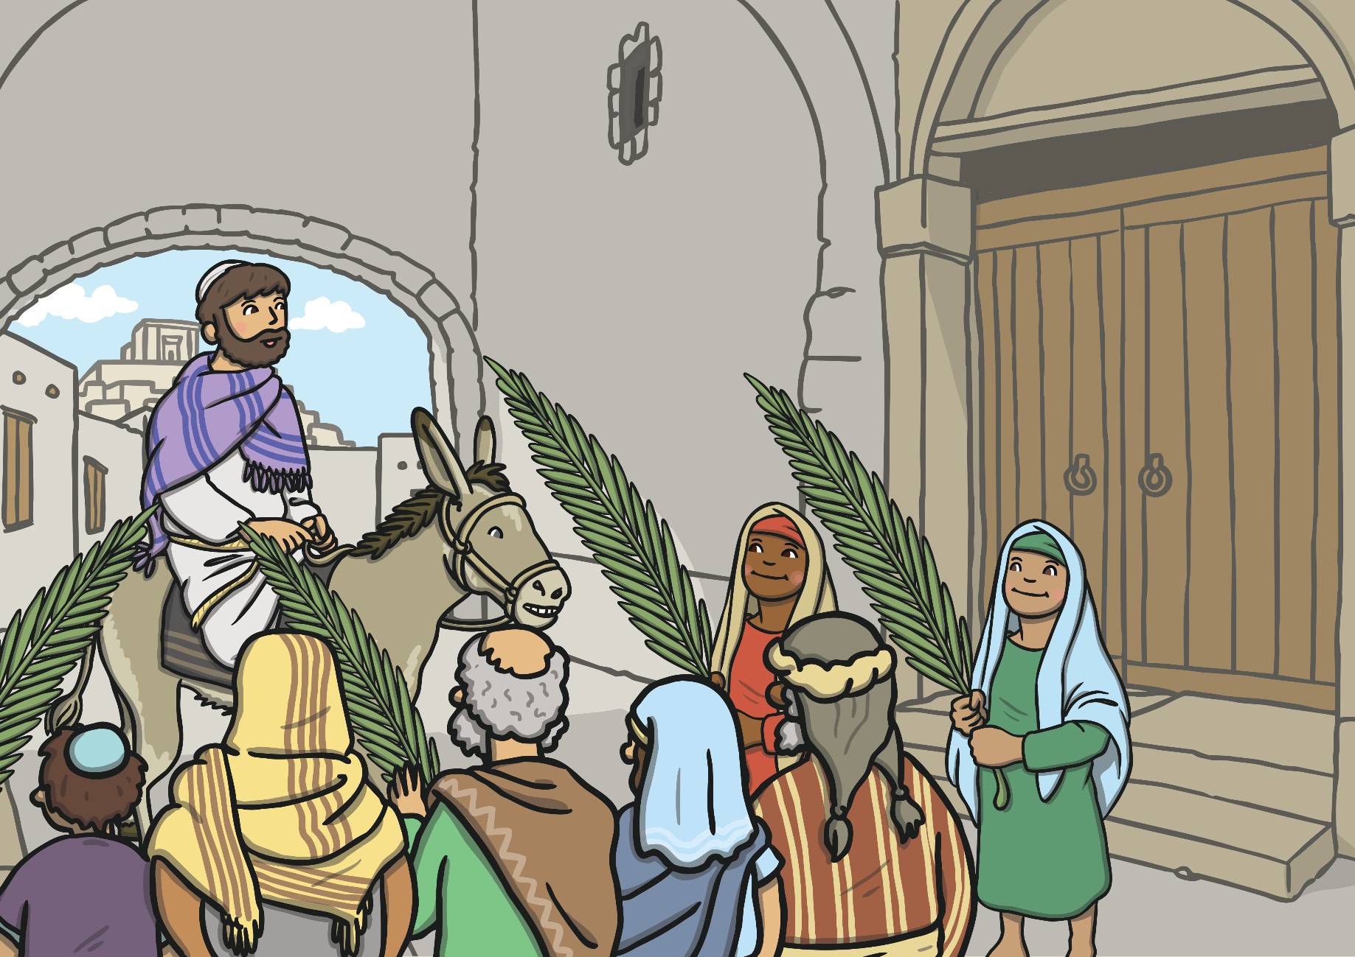
Jesus arrived in Jerusalem on Palm Sunday. The people were happy to see Jesus and waved palm branches.

Slide 35
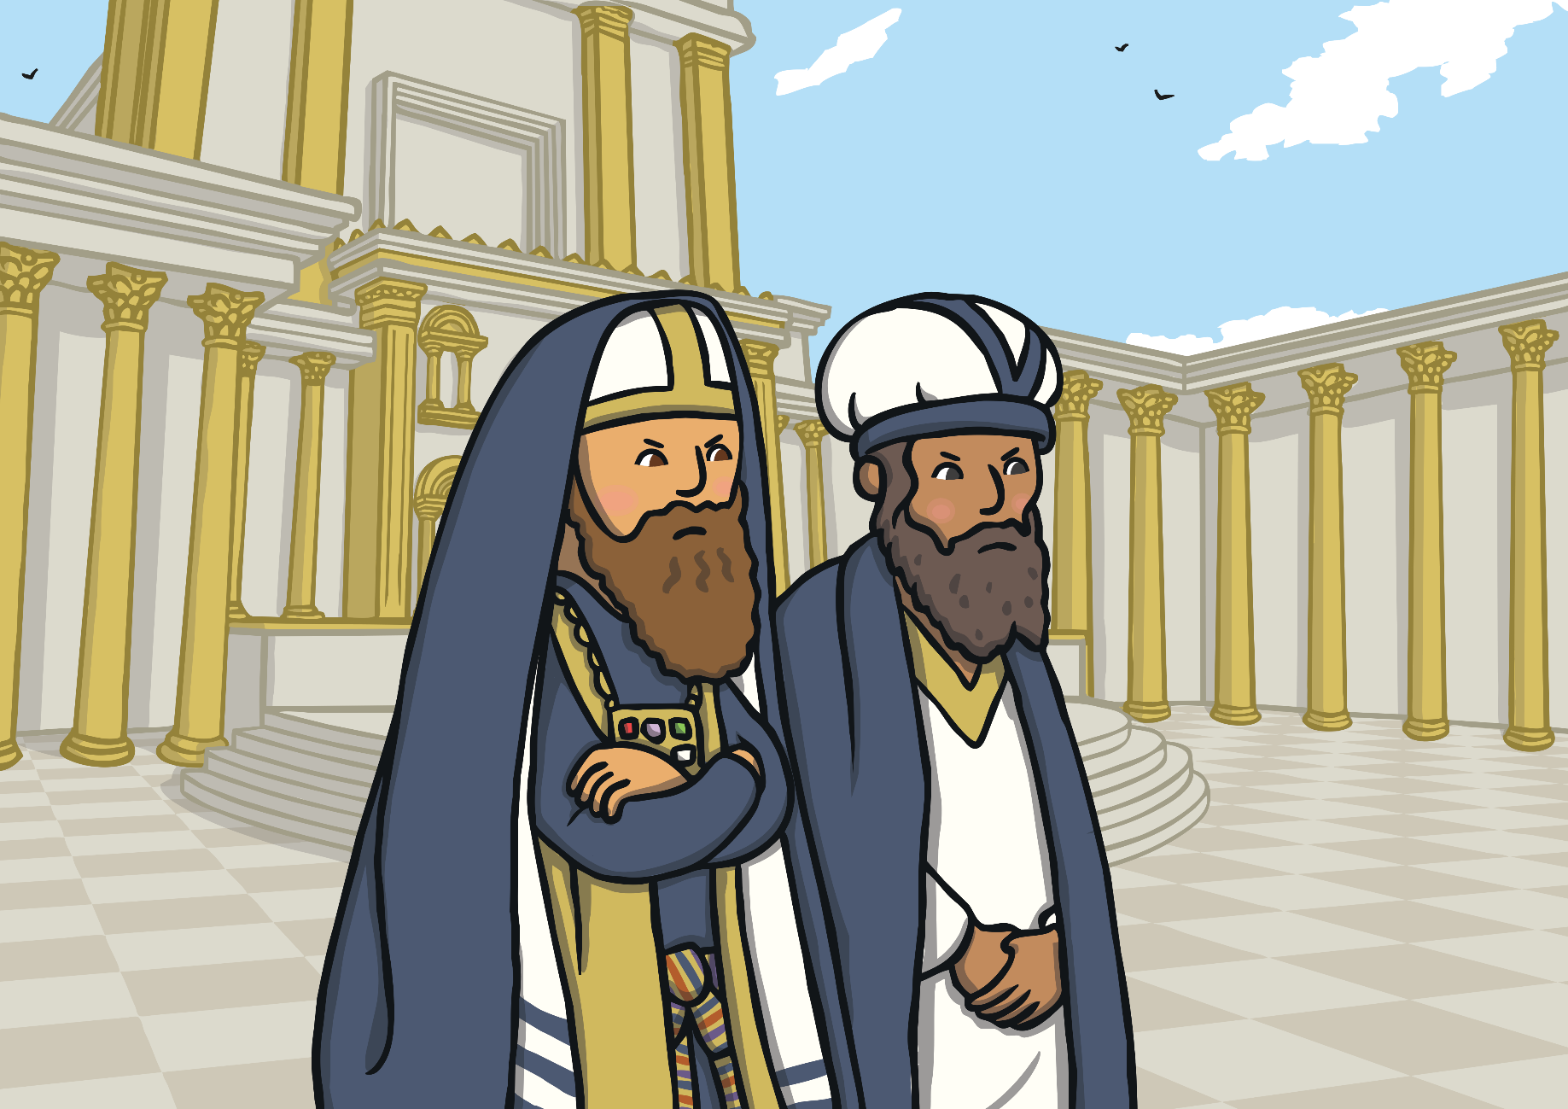
Some important people were jealous of how much the people loved Jesus.

Slide 36
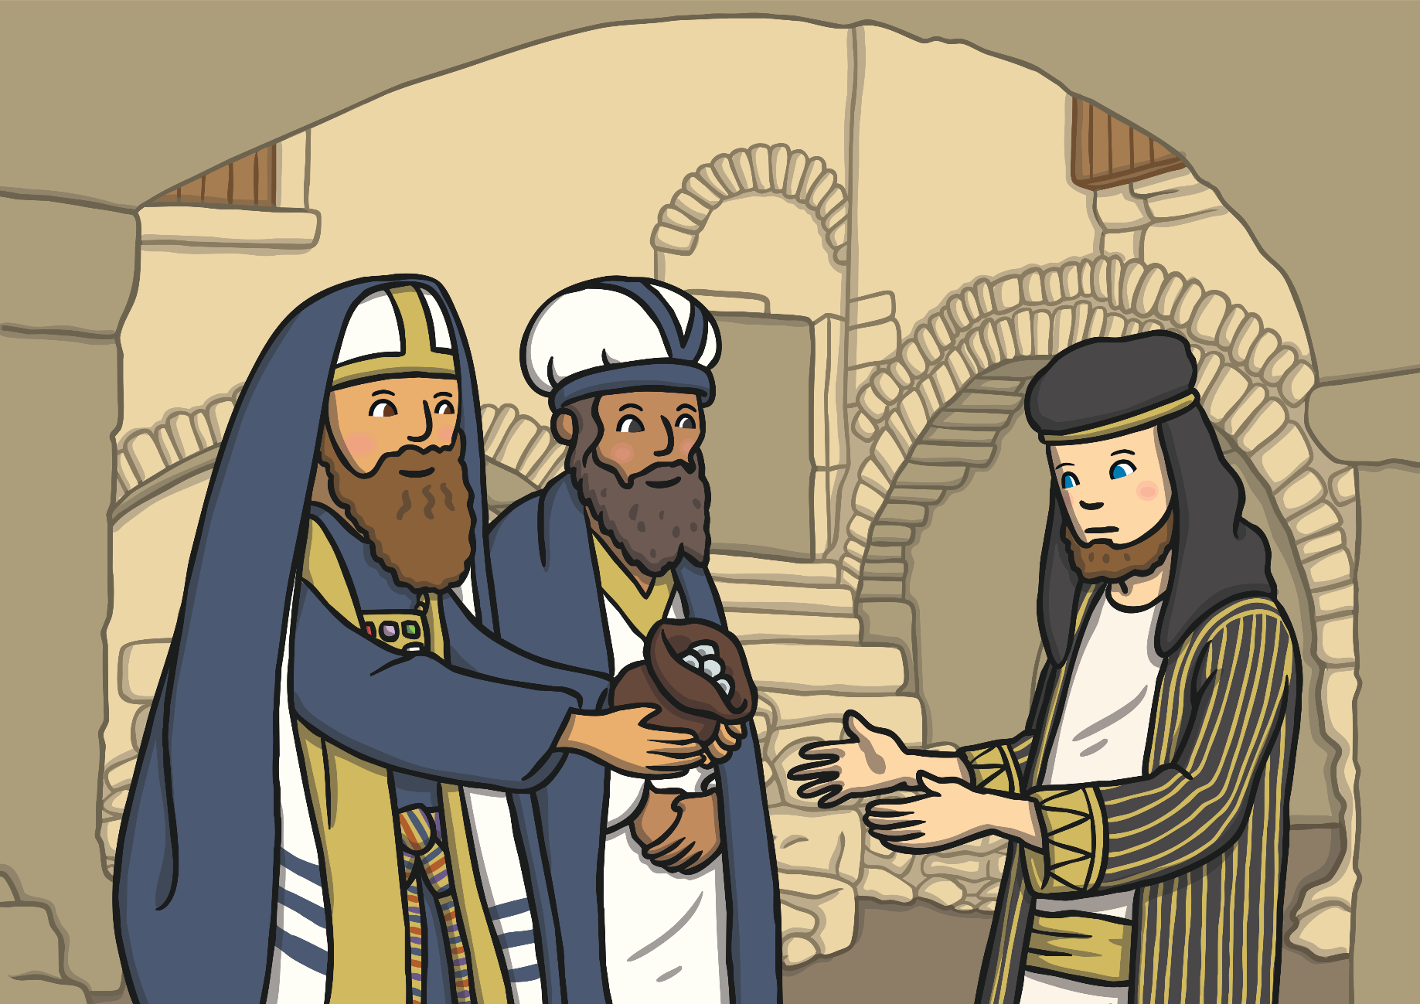
Judas was one of Jesus’ special friends. The important people gave Judas money to tell them where Jesus was so they could arrest him.

Slide 37
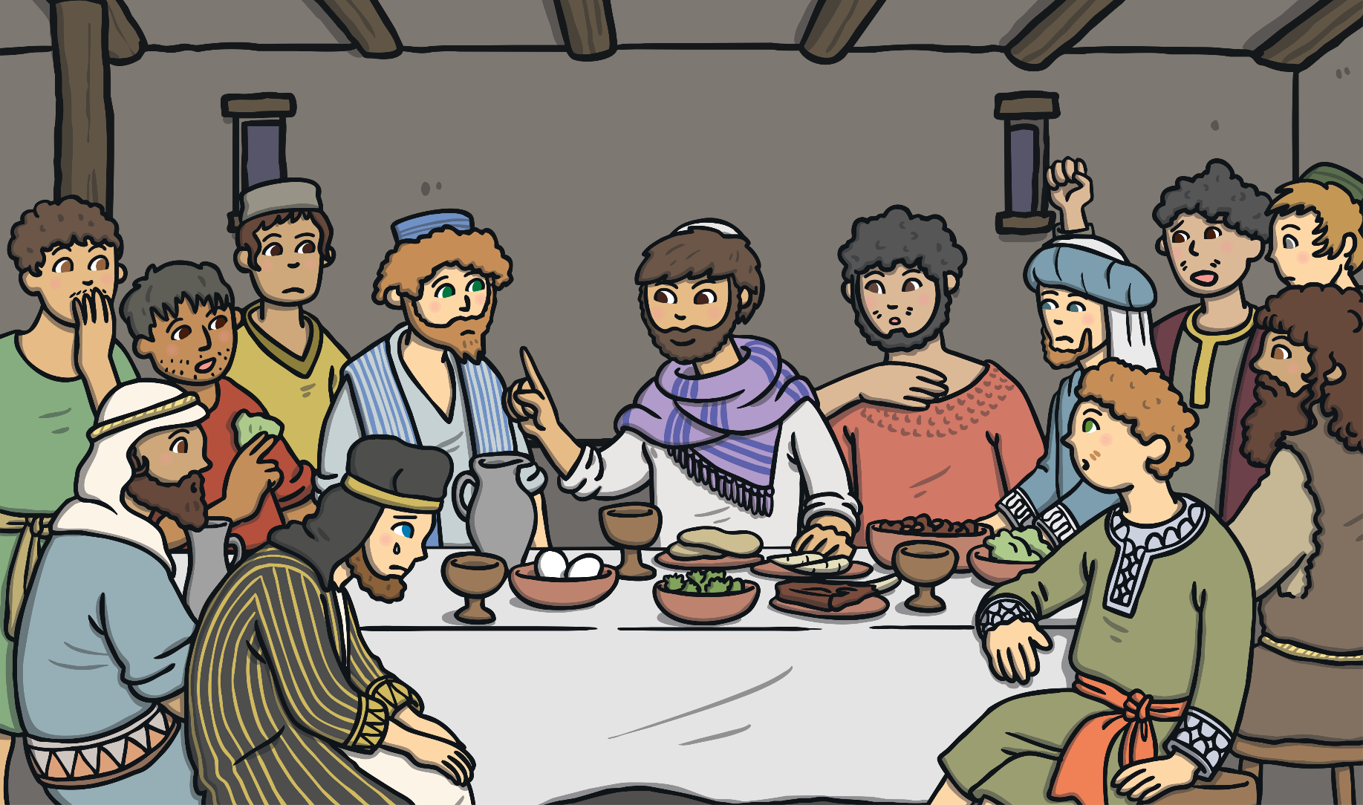
Jesus had a special dinner called a Passover meal with his friends. This meal is now known as the Last Supper.

Slide 38
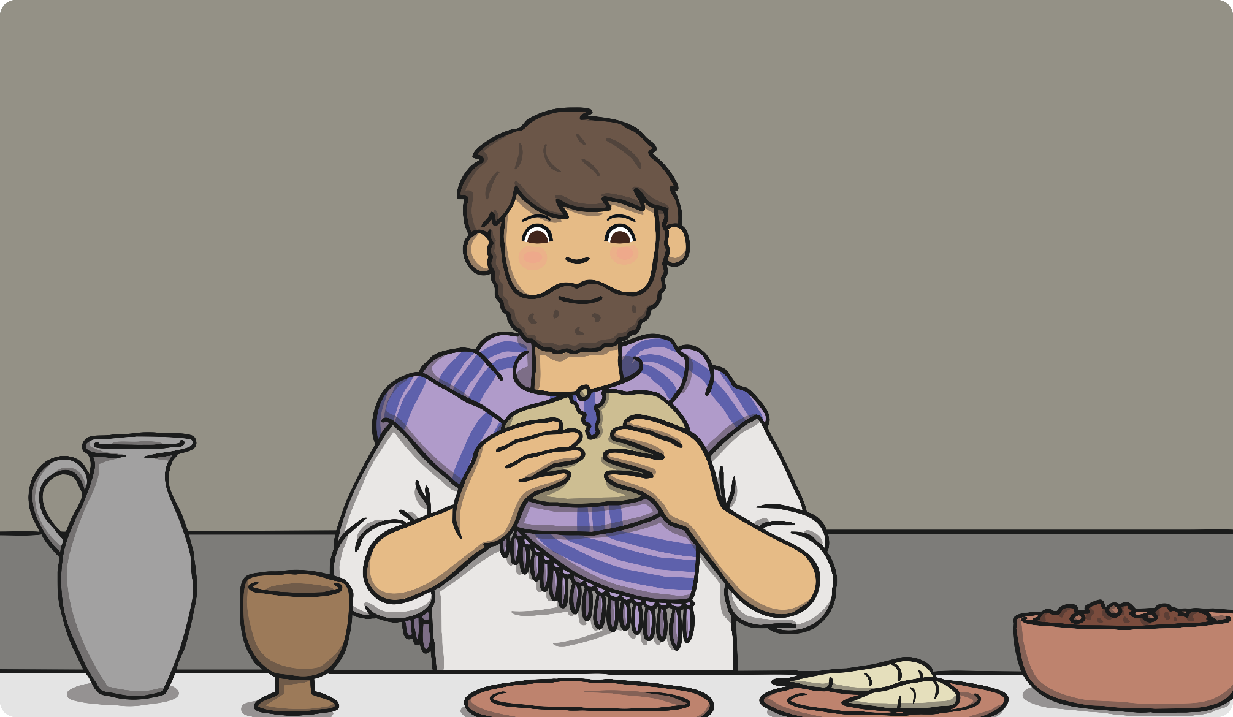
Jesus gave his friends bread and wine. He then told them that one of them had turned against him.

Slide 39
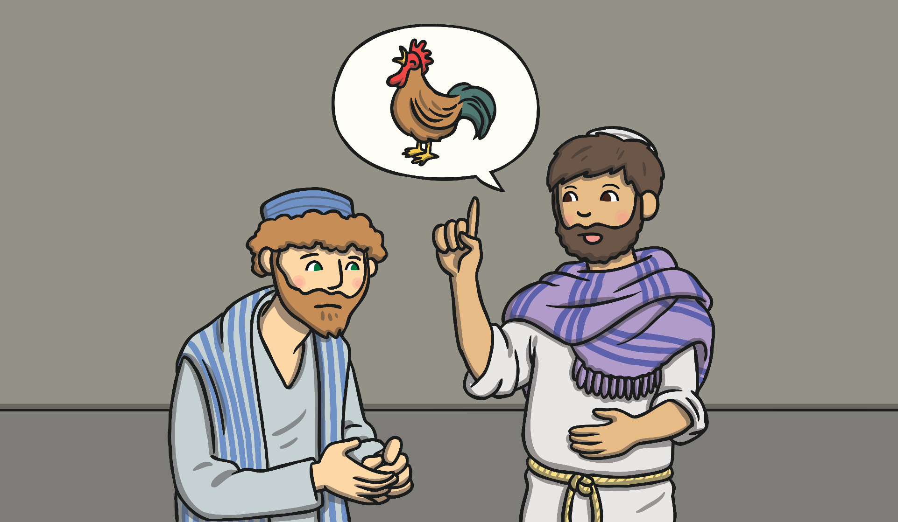
Jesus said that Peter would pretend he didn’t know Jesus before the morning arrived and the cock crowed.

Slide 40
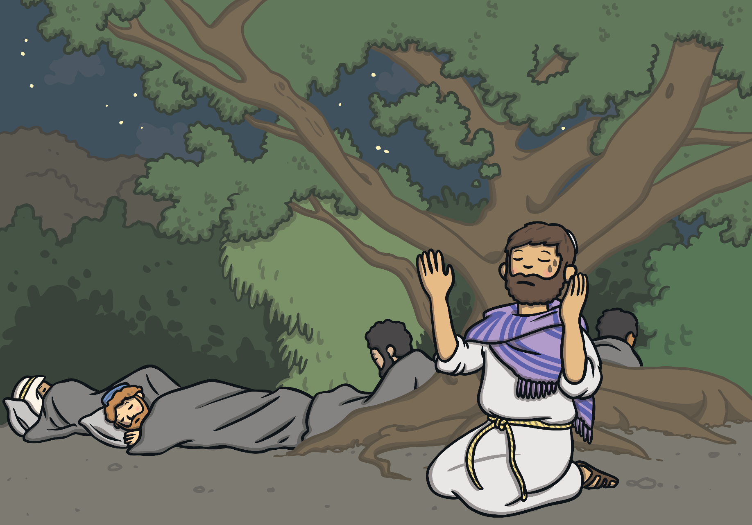
Then Jesus went to pray in the garden of Gethsemane.

Slide 41
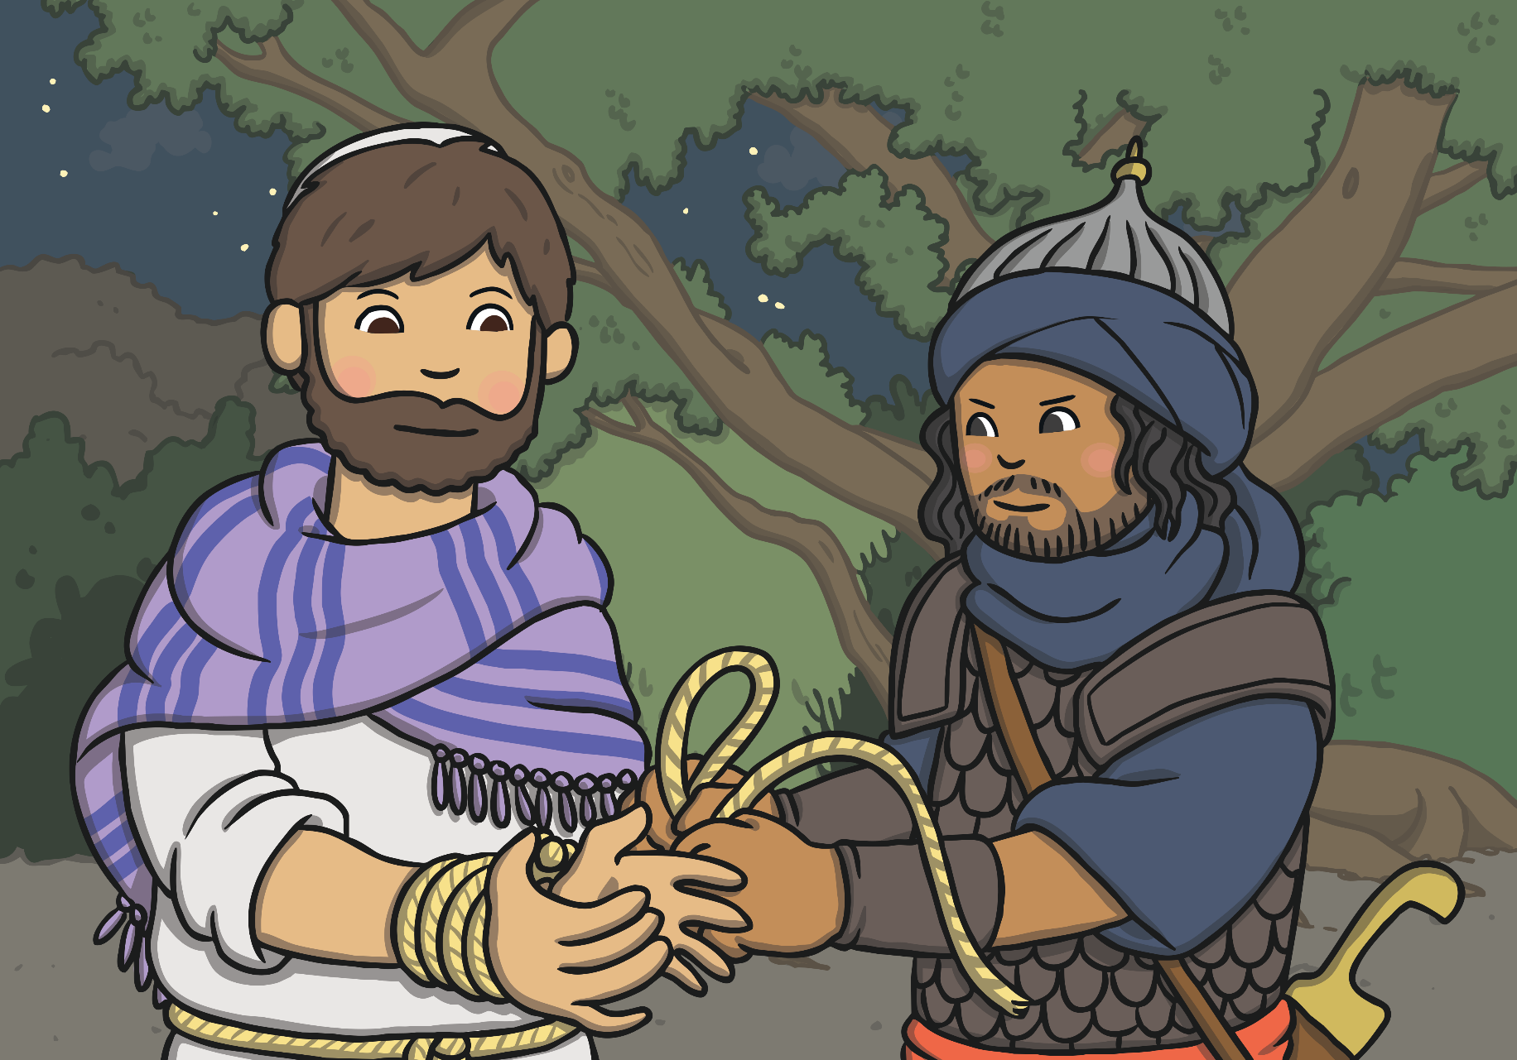
Judas told the important people where Jesus was. Jesus was arrested.

Slide 42
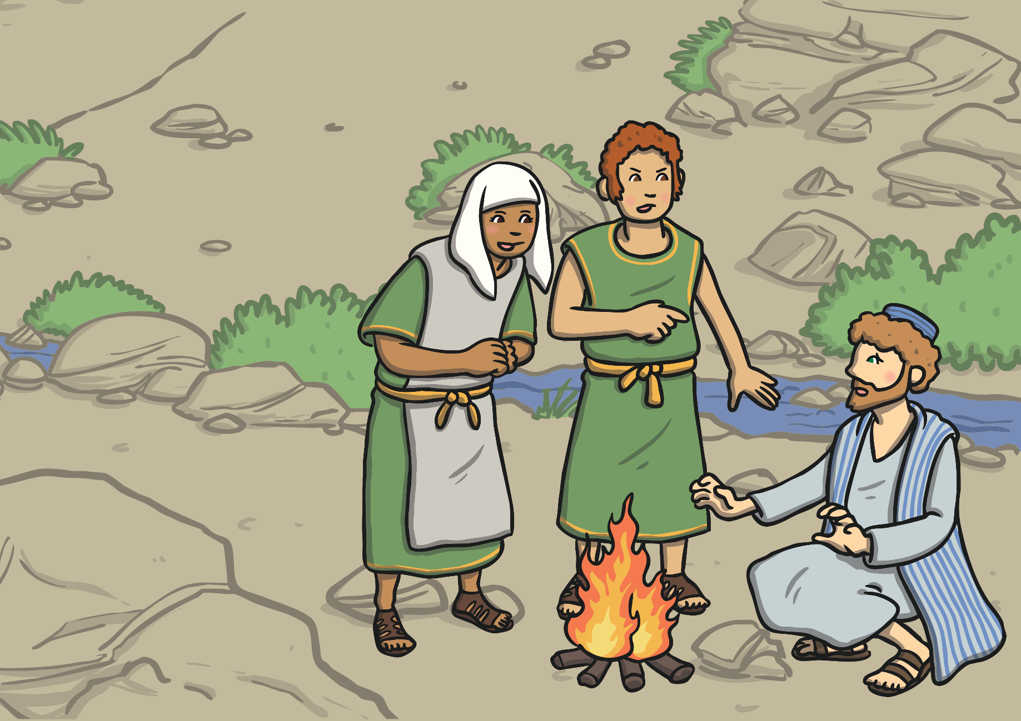
Peter followed Jesus and waited outside where he was being held. Someone asked if he was Jesus’ friend. Peter said he didn’t know Jesus.

Slide 43
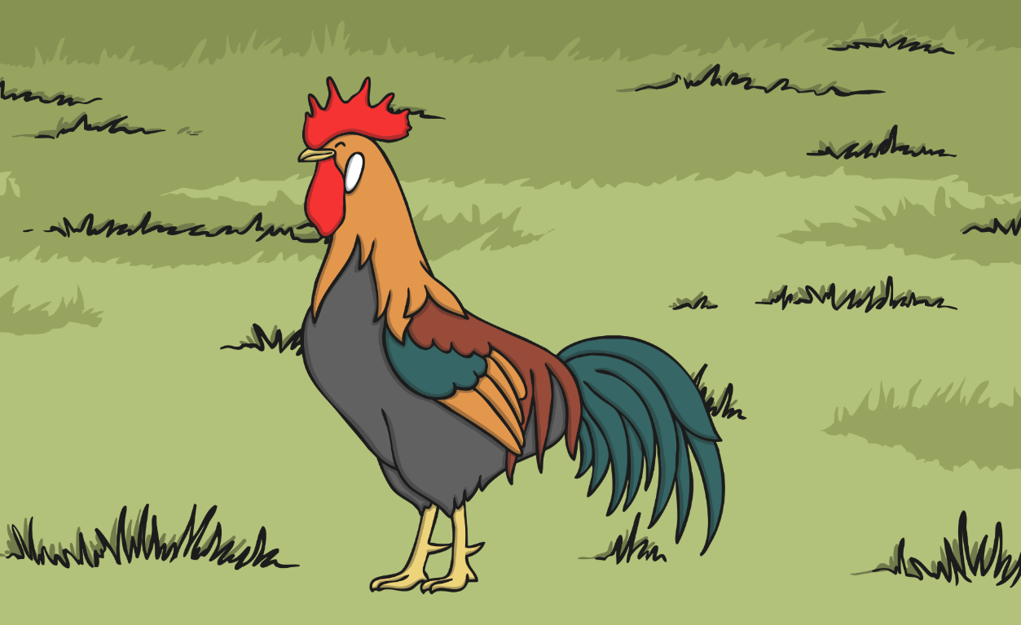
Then the cock crowed. Peter remembered what Jesus had said and felt very sad.

Slide 44
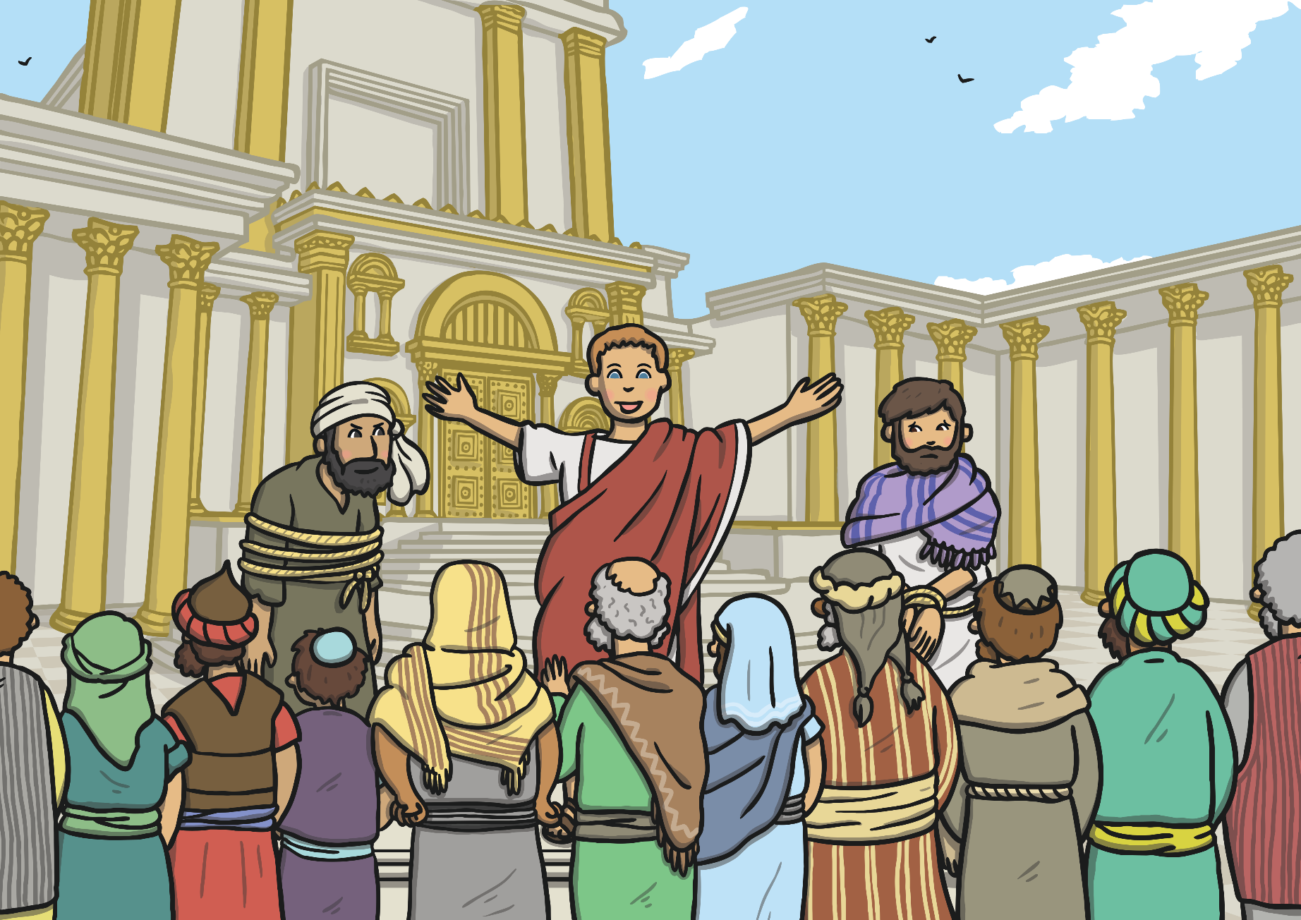
Pontius Pilate set Barabbas free instead of Jesus. The crowd wanted Jesus punished.

Slide 45
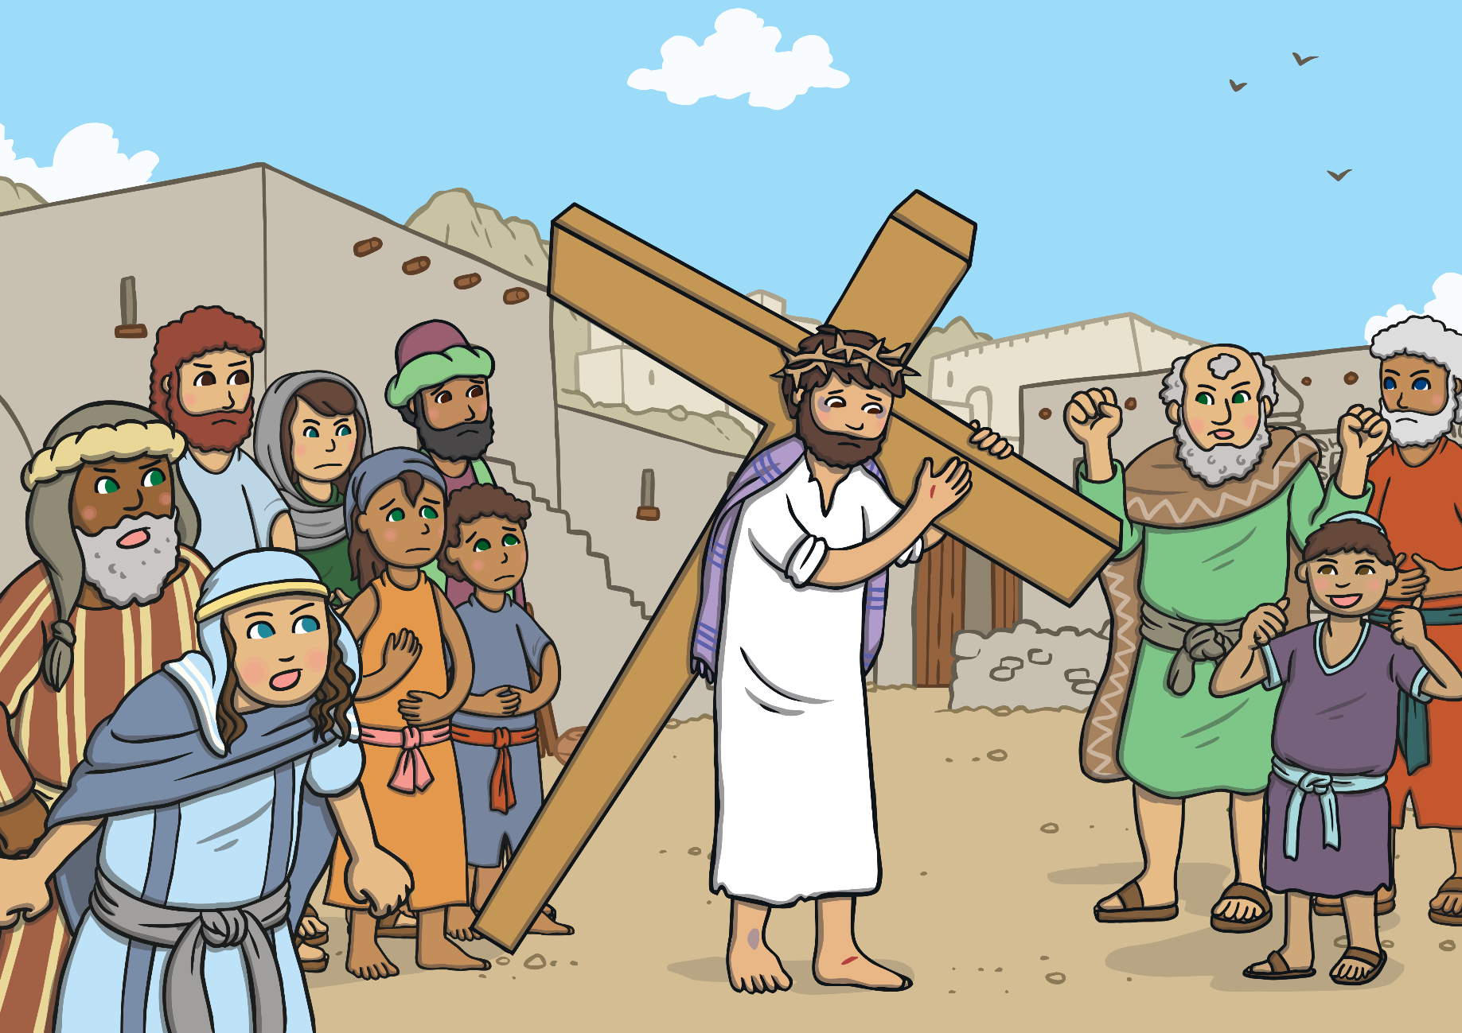
Jesus had to carry a heavy cross through the streets of Jerusalem.

Slide 46
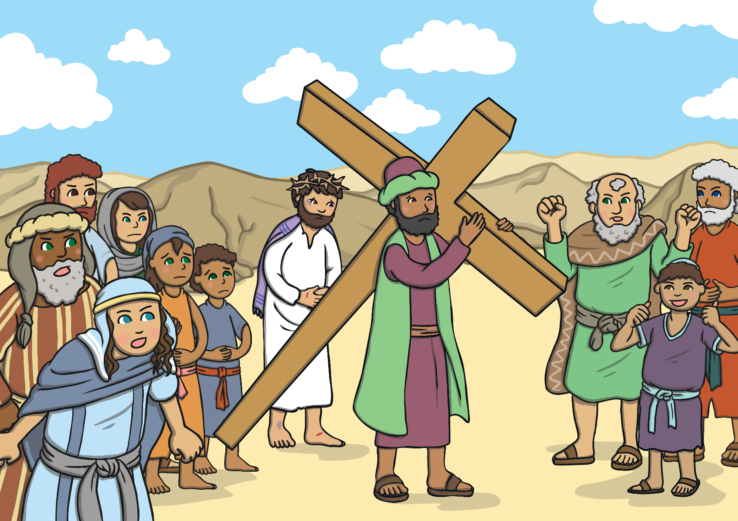
Simon carried Jesus’ cross to the hill.

Slide 47
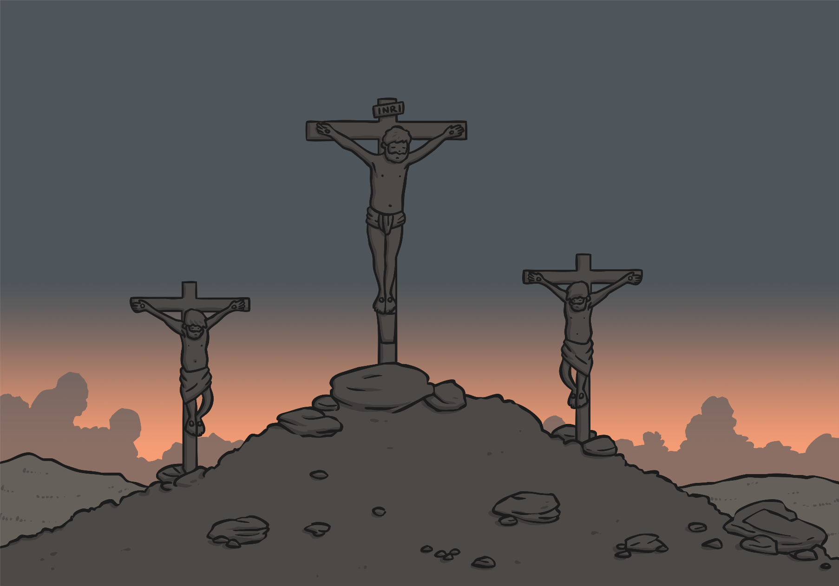
Jesus died on the cross. His friends and family were very sad.

Slide 48
When Jesus died, the earth shook. The curtain in a special place called the Temple was torn in two.

Slide 49
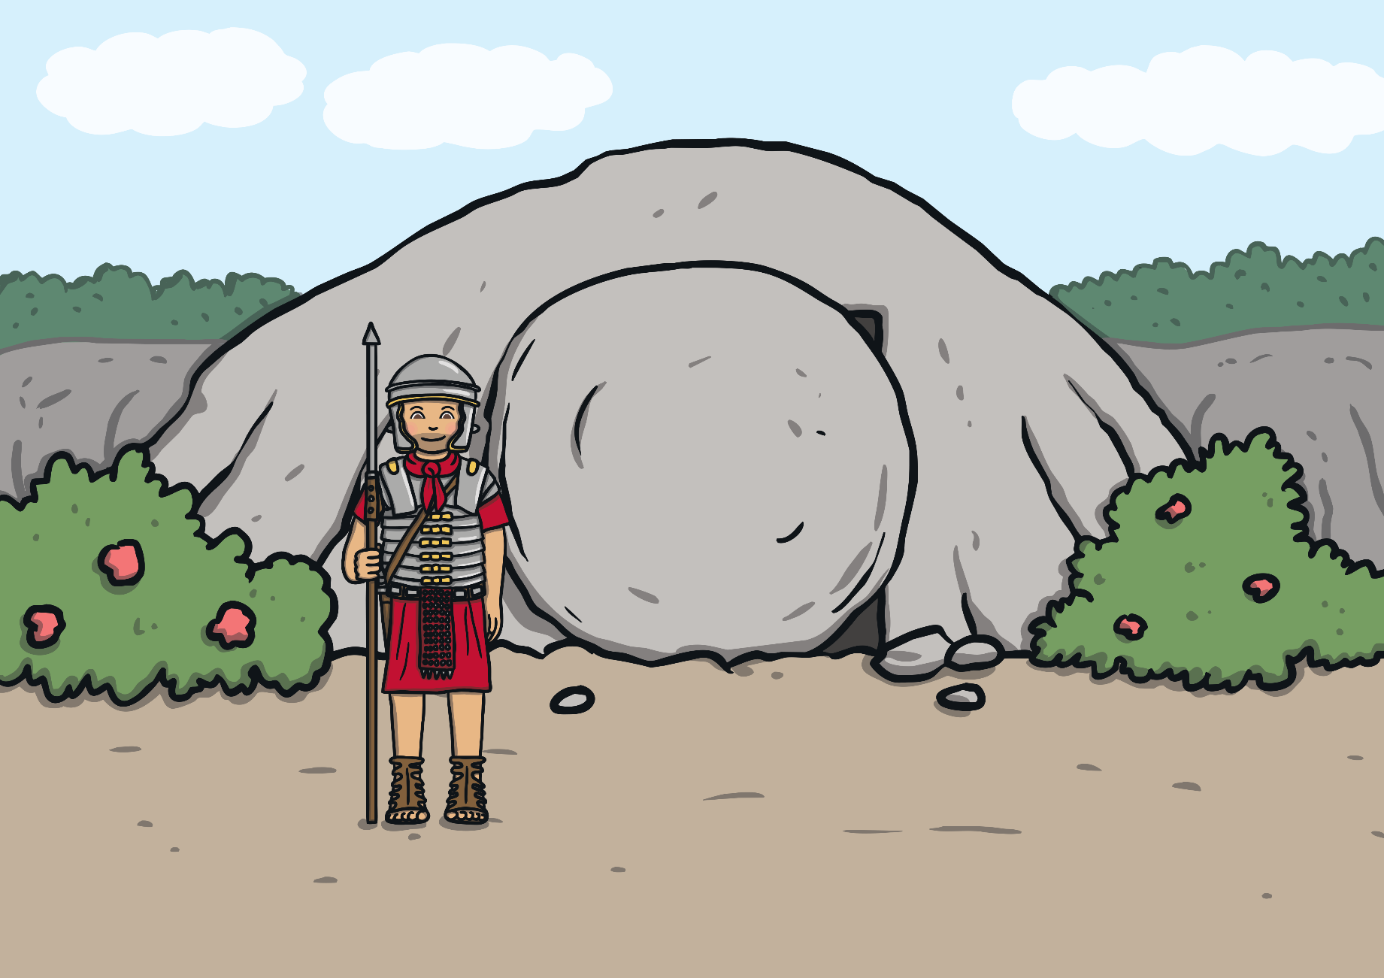
Jesus’ body was put into a tomb. A large, heavy stone was put in front of the entrance.

Slide 50
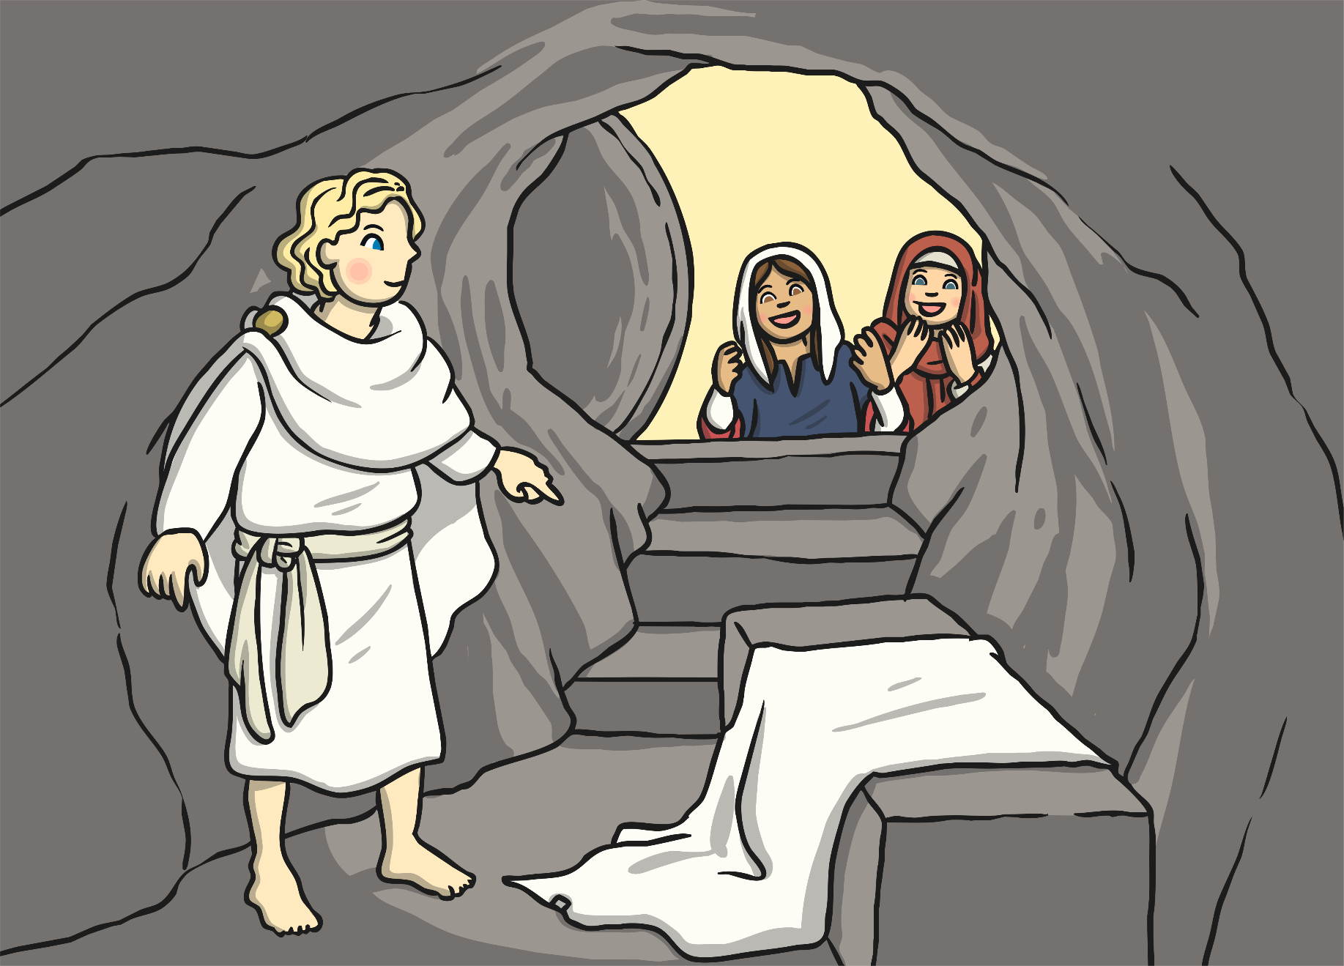
On the third day, Mary and some of Jesus’ other friends went to the tomb. Jesus’ body wasn’t there and the stone had been rolled away. An angel told them that Jesus had risen from the dead.

Slide 51
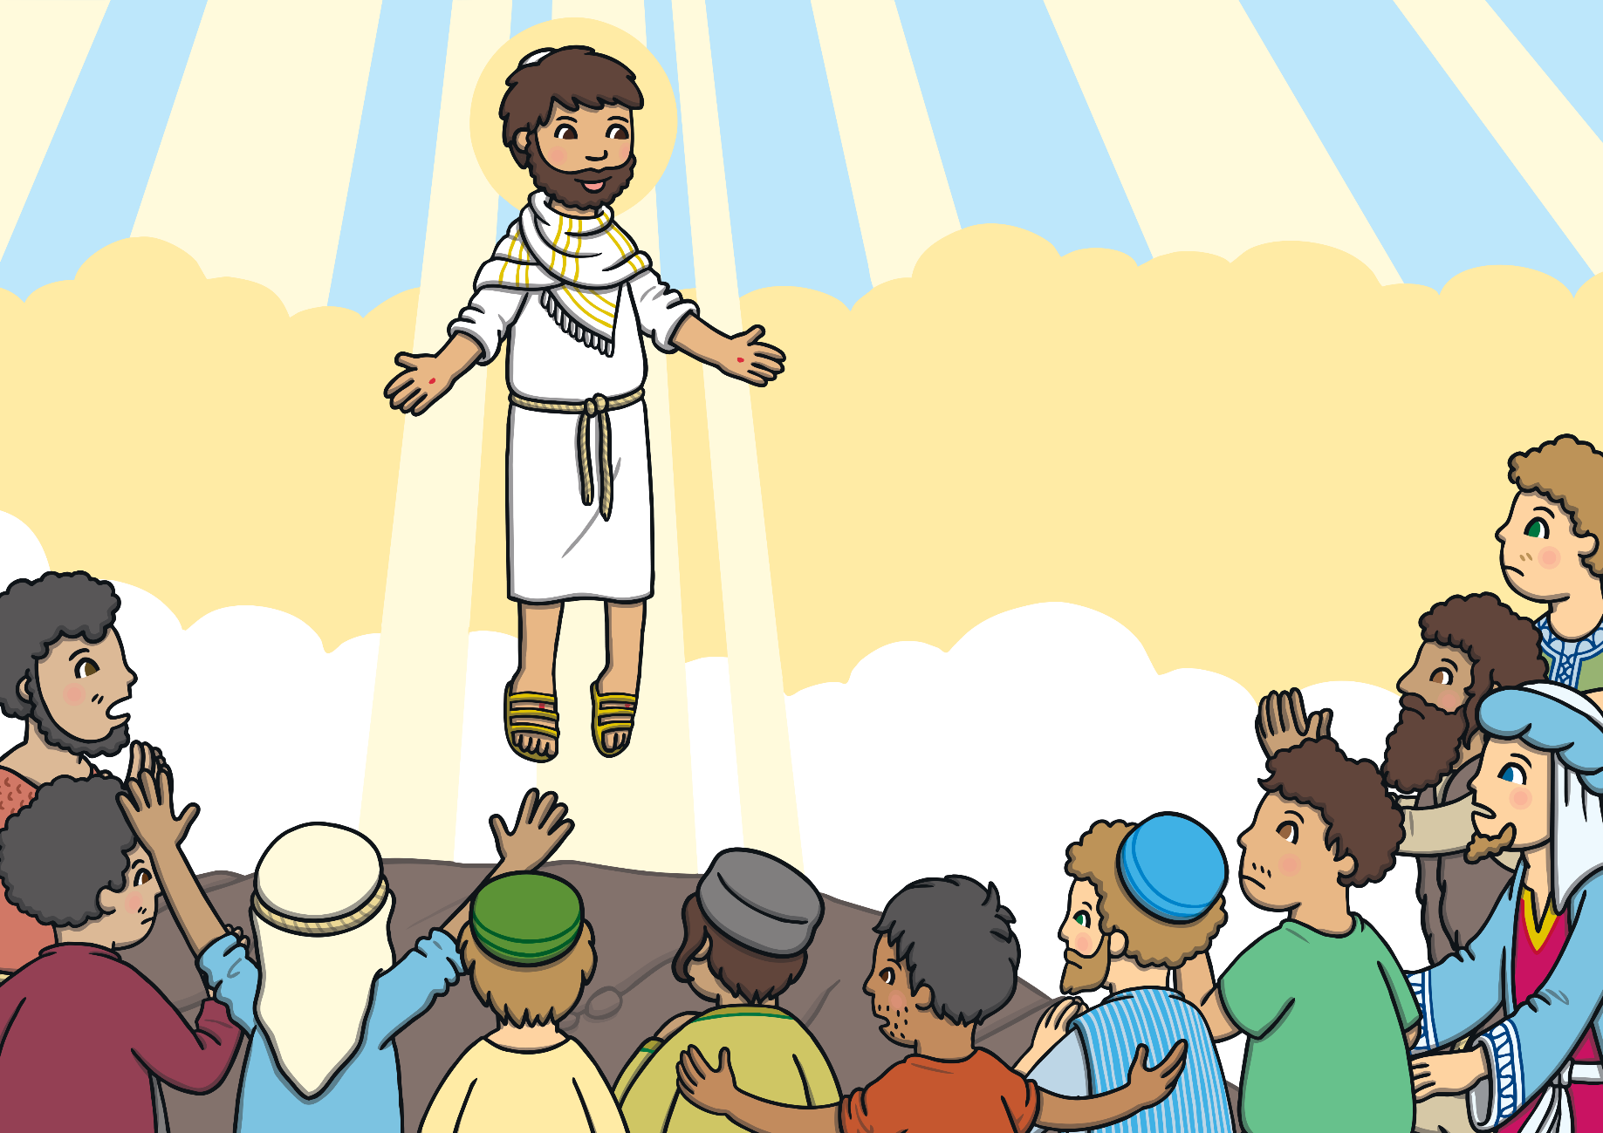
Jesus visited his friends before going to heaven.

Slide 52
Comic Strips!
Create a comic strip retelling the story of Easter:
Challenge – choose template 1 and add pictures.
Super challenge – choose template 2 and add pictures and sentences.
Supersonic Challenge – Create your own comic strip from scratch! Use paper and pencils or the computer.

Slide 53
Template 1

Slide 54
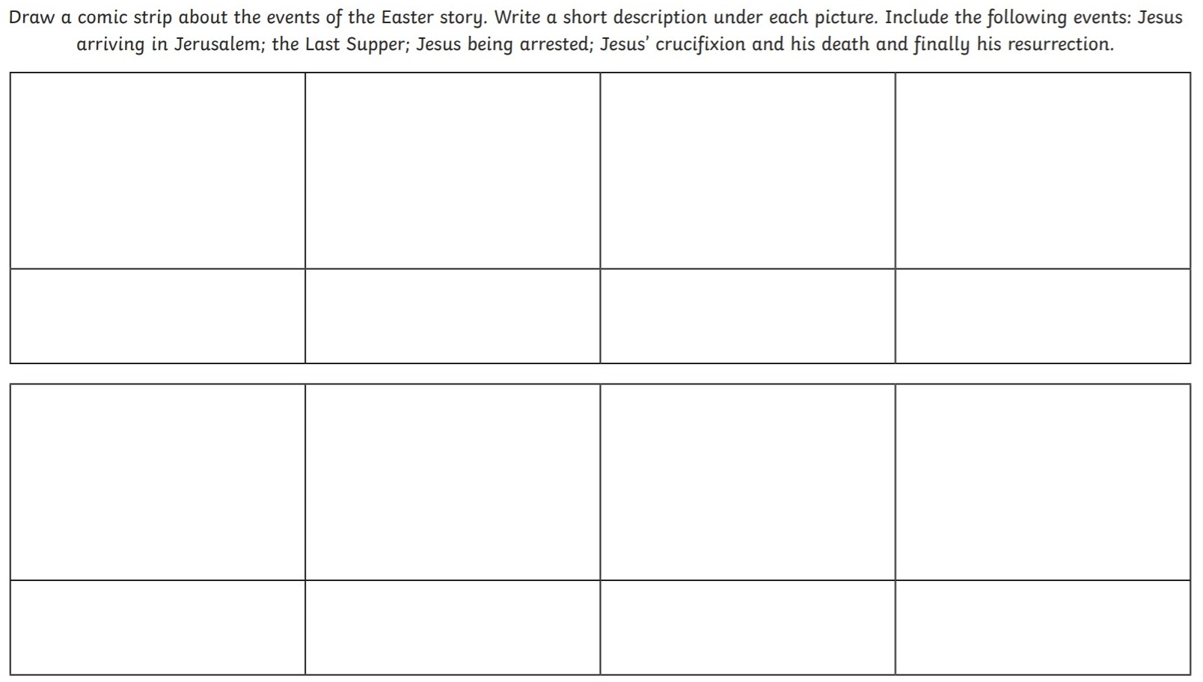
Template 2

Slide 55
Optional extra task
Print and complete the Easter colouring activities!

Slide 56
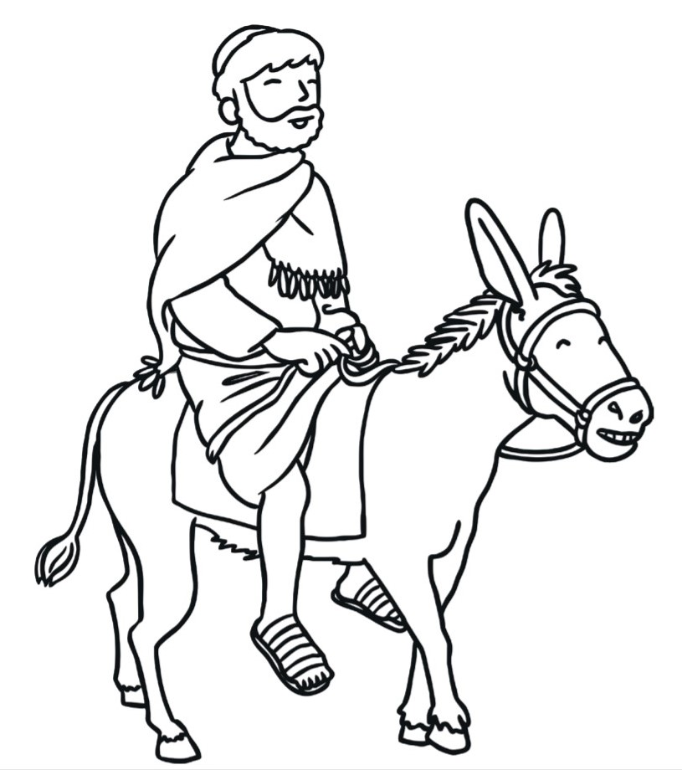

Slide 57
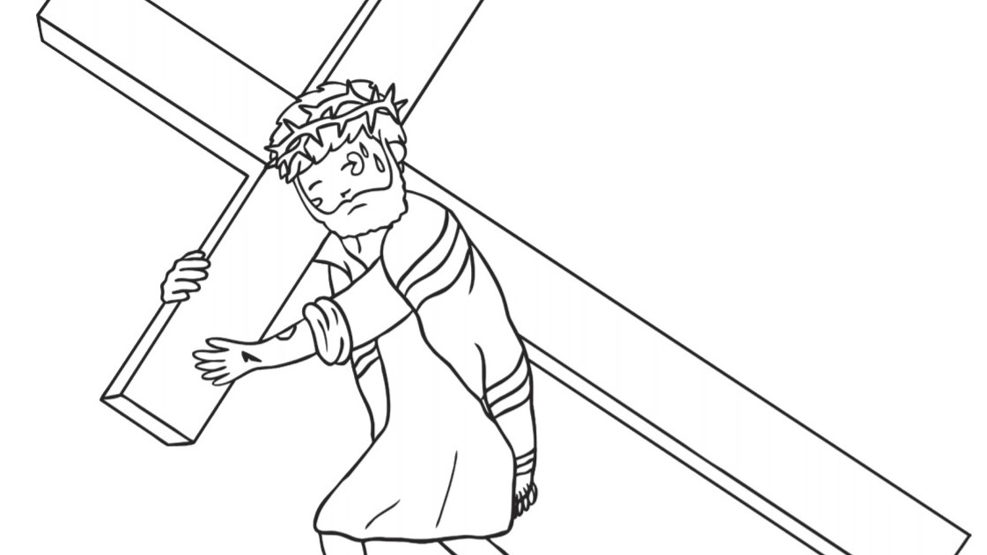

Slide 58
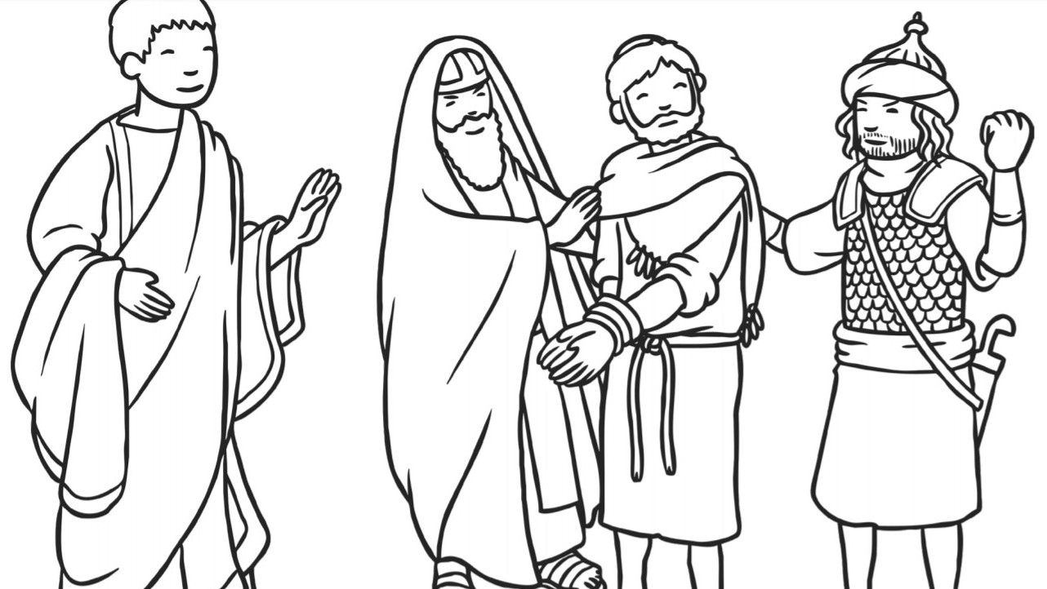

Slide 59
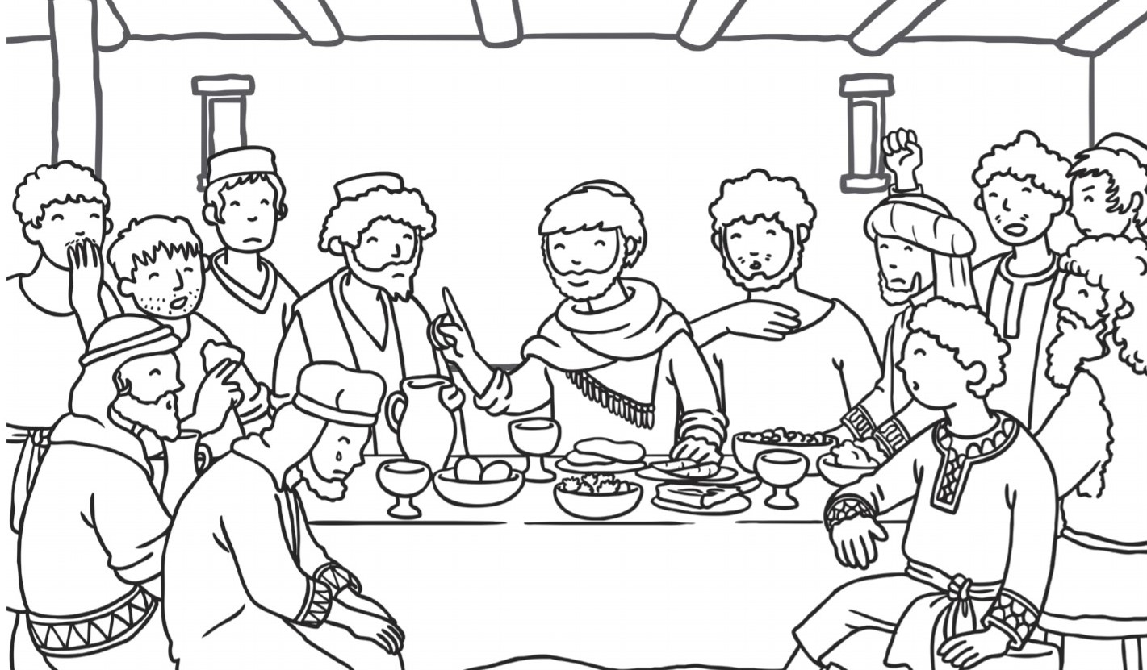

Slide 60
Form II Home Learning 03/04/2020
Well done! You finished today’s lessons!
I’m looking forward to seeing you all back at school soon!
Miss Ardley

